Slide 1
Global Alliance for Buildings and Construction (GlobalABC)
Towards a zero-emissions, efficient and resilient buildings and construction sector: EEAP webinar
Gennai Kamata,
Associate Programme Officer, GlobalABC, UNEP
<gennai.kamata@un.org>
April 2025

Slide 2
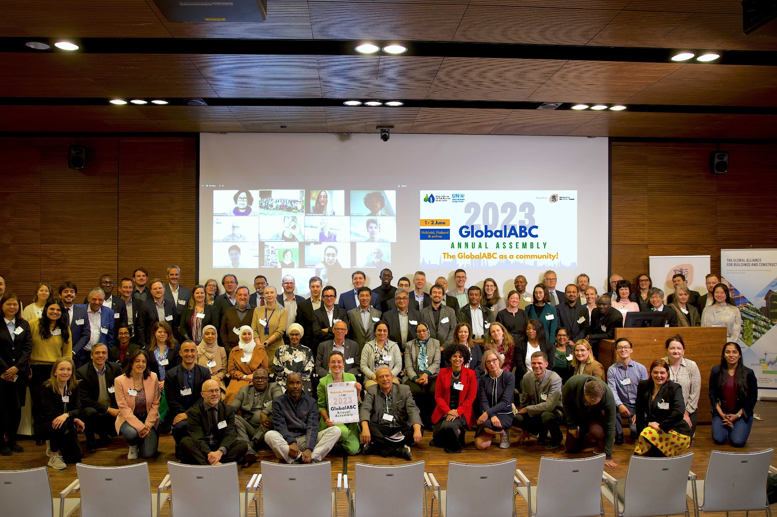
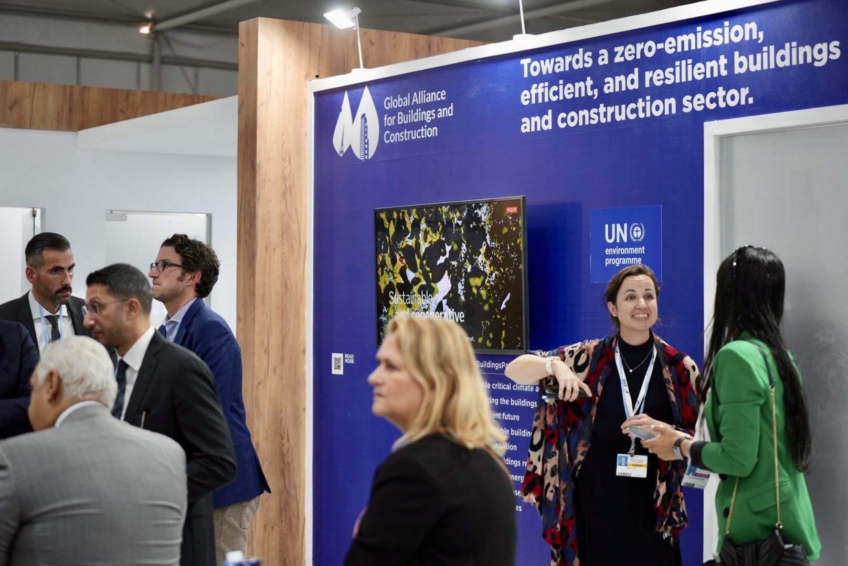
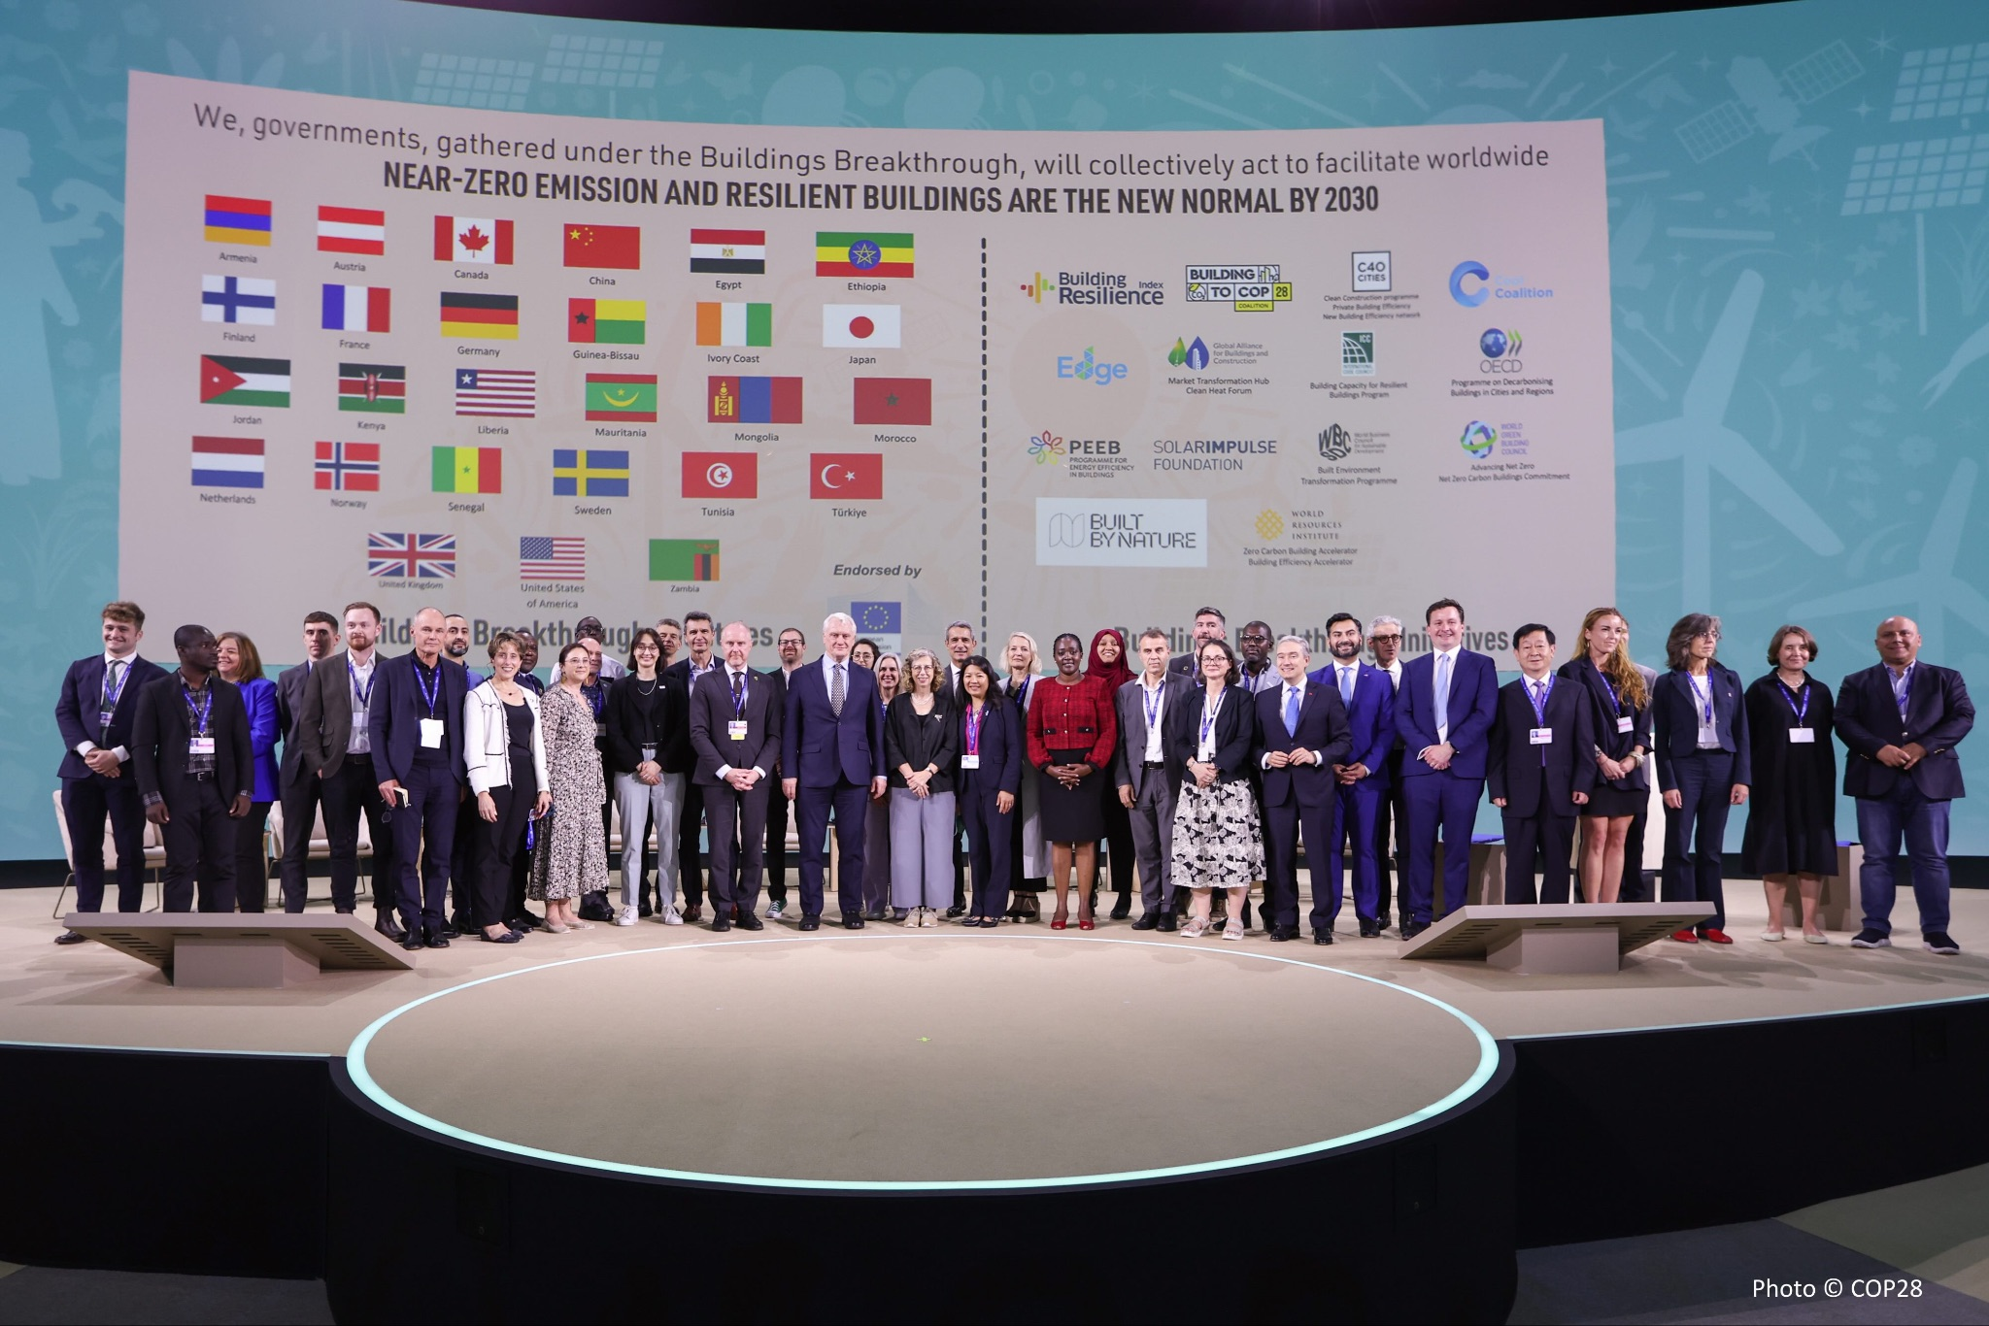
The GlobalABC
Founded at COP21, hosted by UNEP with 339 members, including 68 countries, the Global Alliance for Buildings and Construction (GlobalABC) is the leading global platform for all buildings stakeholders committed to a common vision: A zero-emission, efficient and resilient buildings and construction sector.

Slide 3
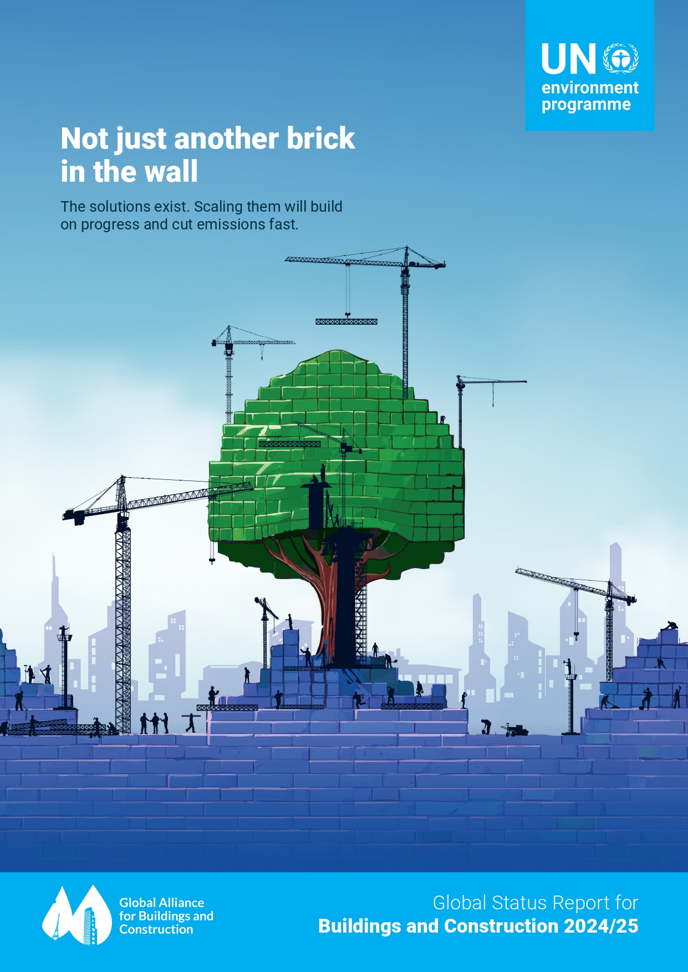
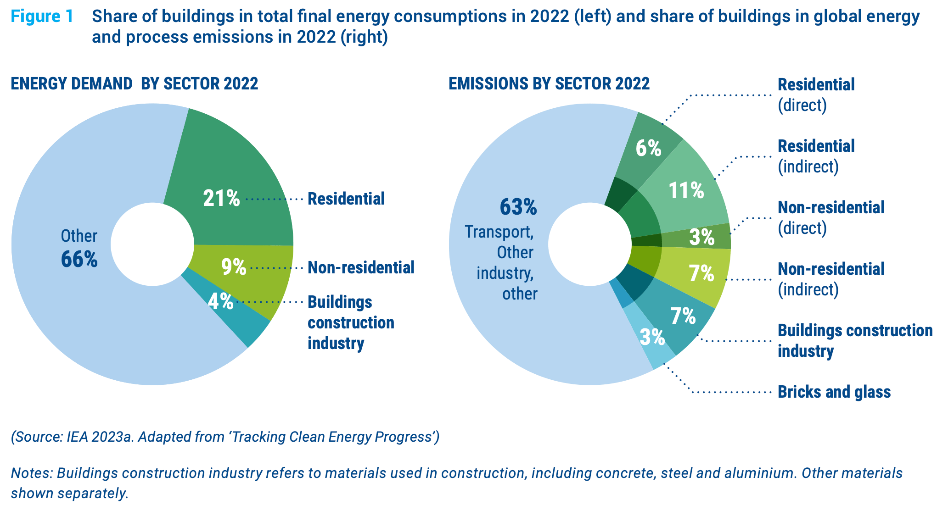
Flagship Publication
Buildings Global Status Report:
Ninth edition of this annual snapshot on the progress of the buildings and construction sector globally towards achieving the Paris Agreement goals:
An update on the drivers of CO₂ emissions and energy demand globally,
Status of policies, finance, and key actions that support a zero-emission, efficient, and resilient buildings and construction sector,
An updated method and findings of the global Building Climate Tracker

Slide 4
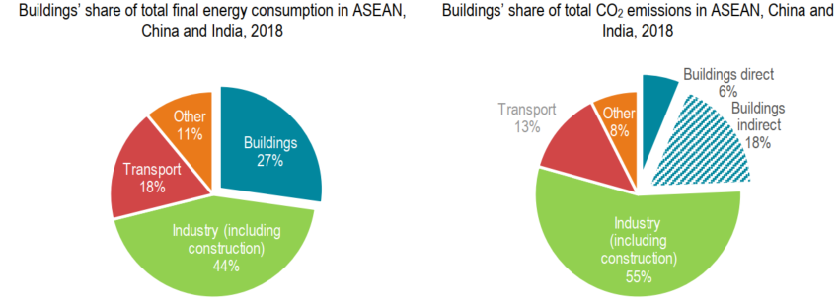
Energy Consumption & CO2 Emissions in ASEAN, China and India, 2018.
IEA 2020.

Slide 5
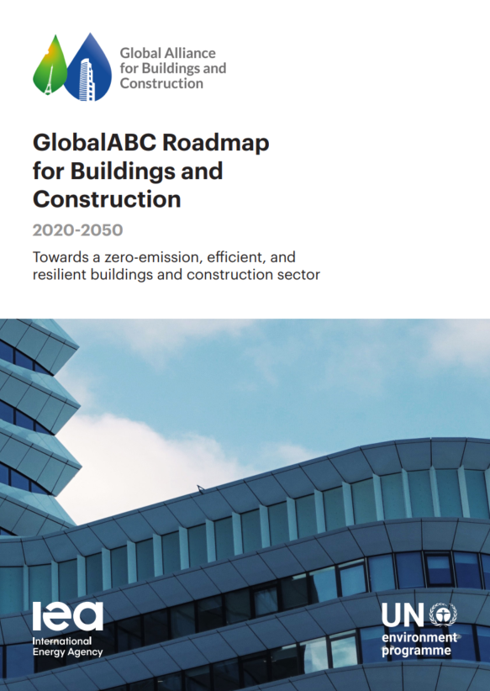
GlobalABC Building Roadmap
GlobalABC Building Roadmap was developed through consultations with 700+ experts, bringing a common vision and language for the buildings and construction sector’s highly fragmented value-chain, and identifying key measures to achieve the transition towards a zero-emission, efficient and resilient buildings and construction sector.
https://globalabc.org/climate-action-roadmaps-buildings-and-construction

Slide 6
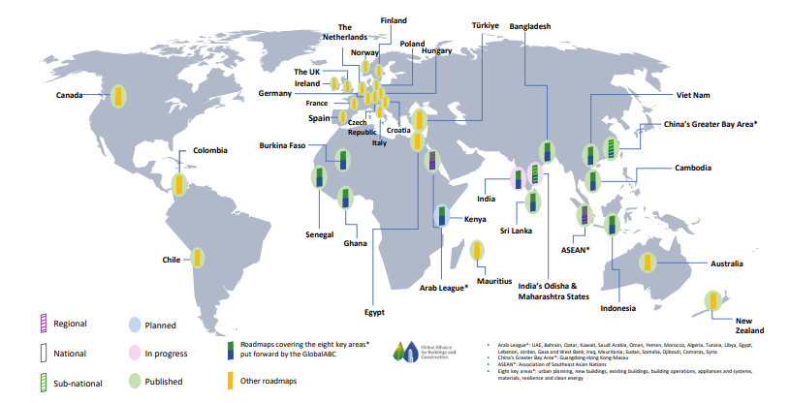
Which countries have developed roadmaps?
The GlobalABC roadmaps model is being cascaded to sub-regional, national and sub-national levels in over 30 countries.

Slide 7
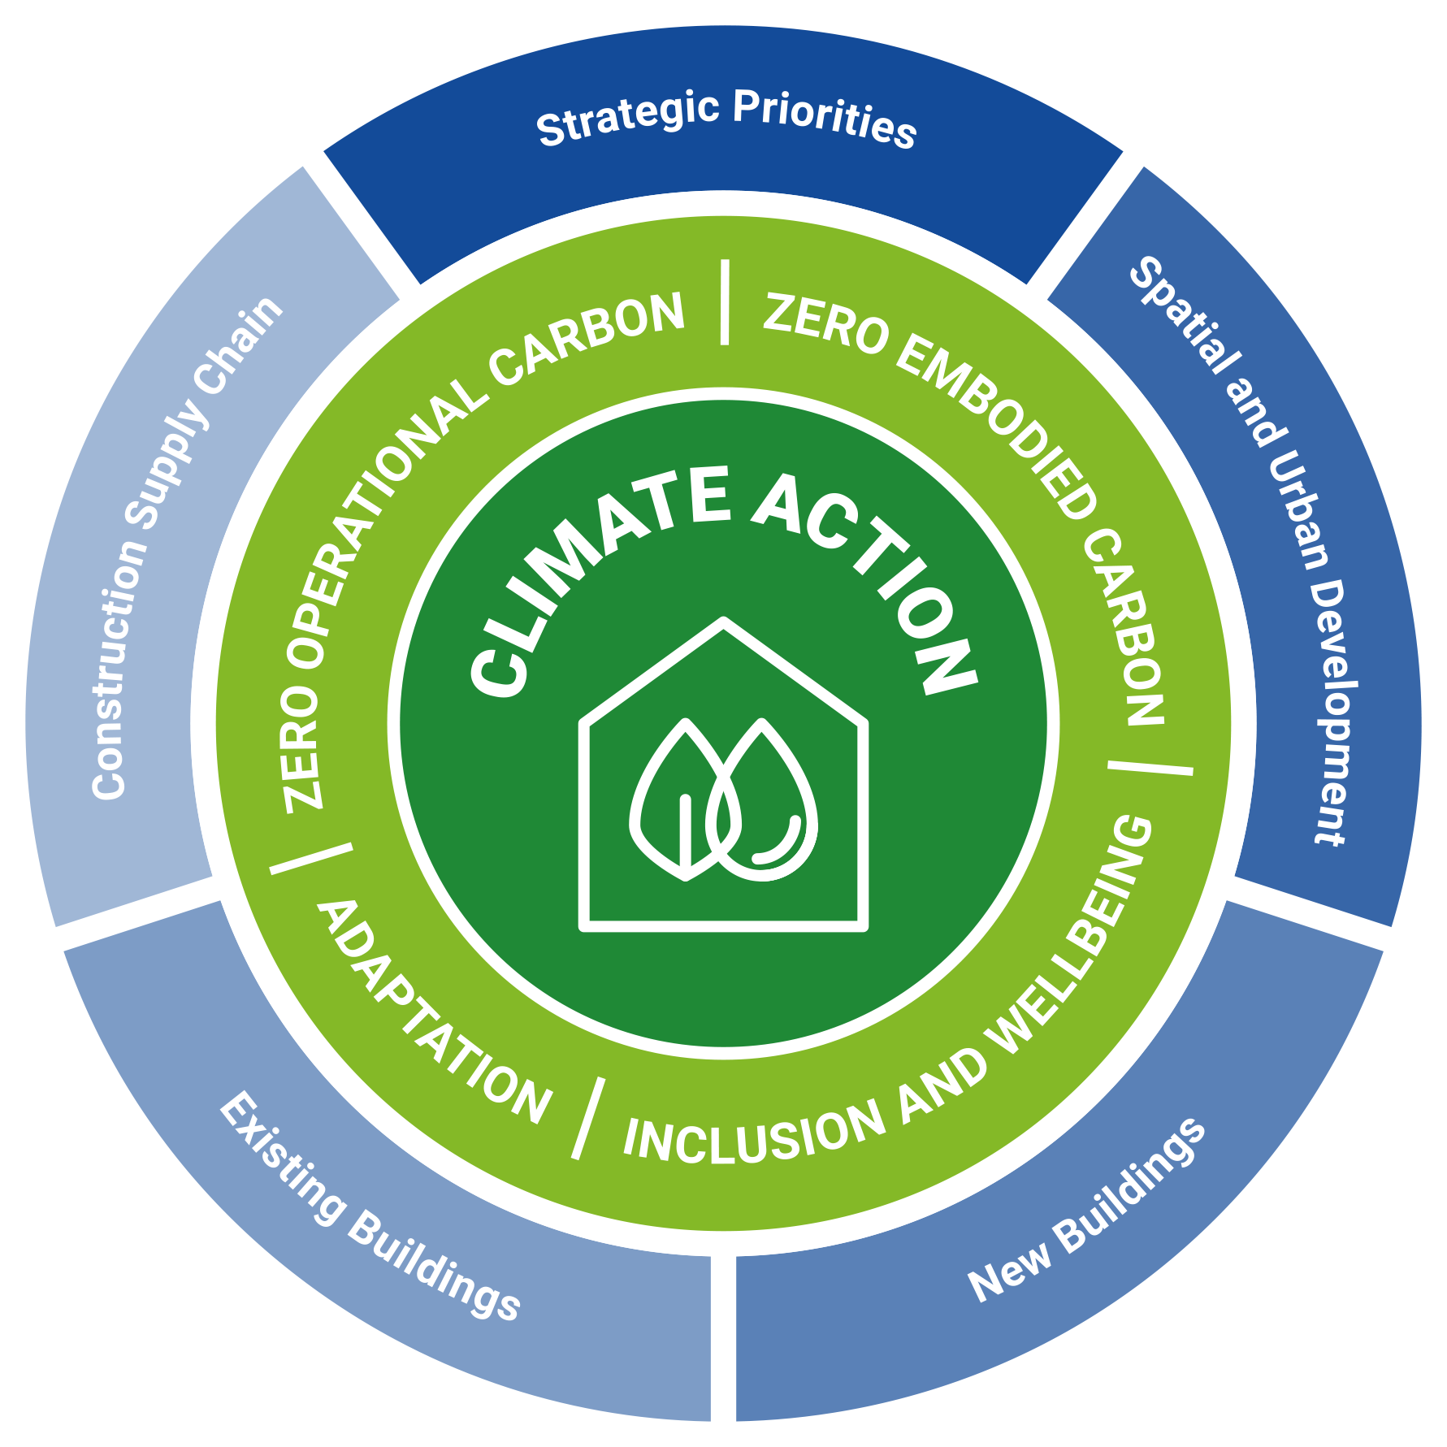
GlobalABC new roadmaps methodology
Developed as a framework and a process, the roadmaps present a comprehensive approach to emission reductions from the built environment along the whole life cycle. They define a timeline and pathway to achieve zero-emission, efficient and resilient buildings and construction between 2020 and 2050.
Objectives:
Zero embodied carbon
Zero operational carbon
Adaptation
Inclusion & Wellbeing
5 Action Areas:
Strategic Priorities
Spatial and Urban Development
Existing Buildings
New Buildings
Construction Supply Chain

Slide 8
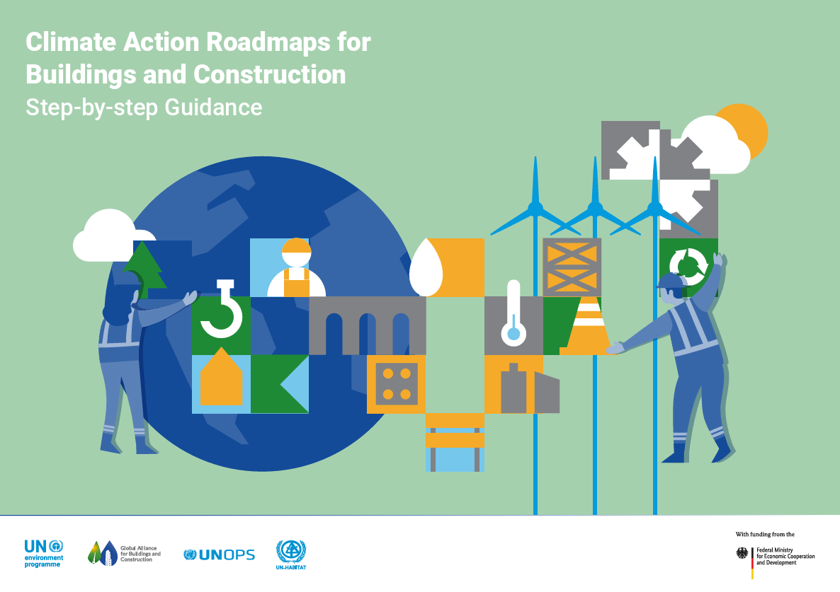
Step-by-step Guides
The newly launched step-by-step guide (2024) provides detailed guidance for setting goals, identifying key actions, and creating a pathway towards a more efficient, low-carbon, resilient and inclusive buildings and construction sector.
https://globalabc.org/resources/publications/new-step-step-guide-climate-action-roadmaps-buildings-and-construction

Slide 9
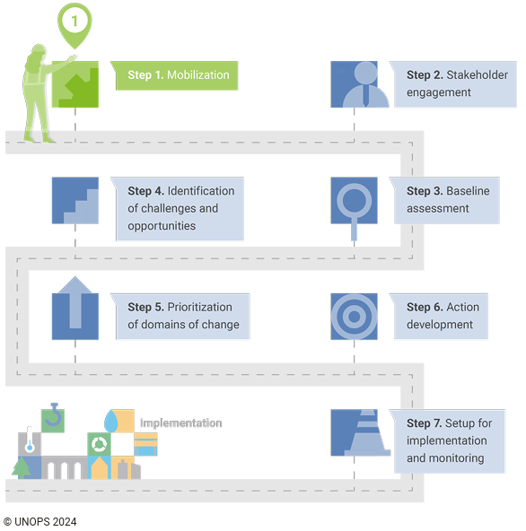
Step-by-step Guides
Seven-step process:
Mobilisation
Stakeholder Engagement
Baseline Assessment
Identification of Challenges and Opportunities
Priorization of Domains of Change
Action Development
Setup for Implementing, Monitoring and Evaluation
https://globalabc.org/resources/publications/new-step-step-guide-climate-action-roadmaps-buildings-and-construction

Slide 10
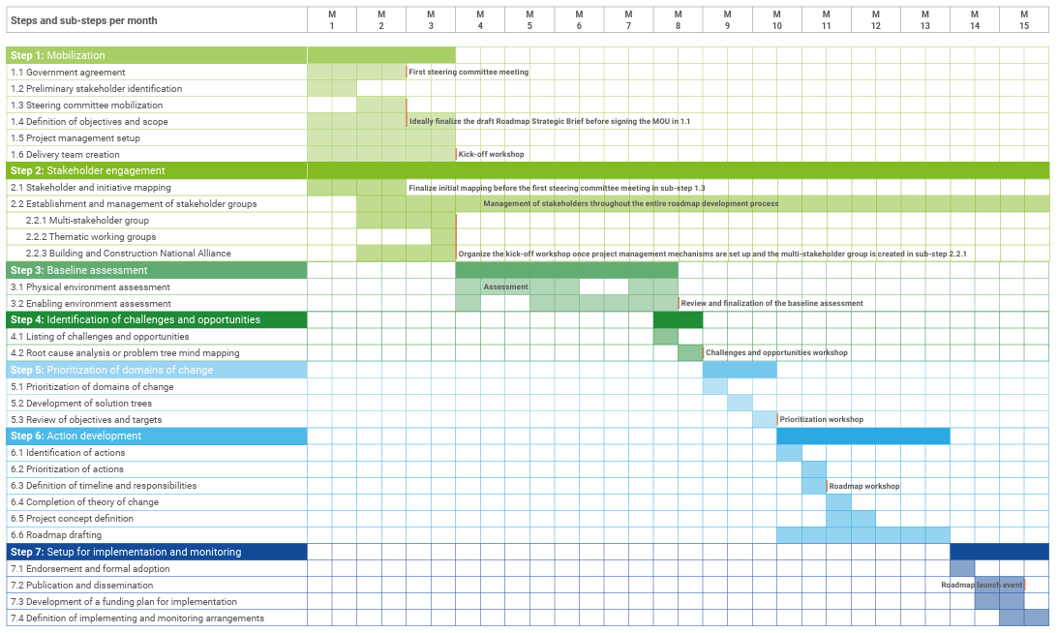
Step-by-step Guides
Gantt-chart:
Breakdowns of each step and indicative timeline facilitate smooth project coordination.

Slide 11
Evaluations
Multi-dimensional Progress Assessment
Important to evaluate progress across several interconnected dimensions:
Technical progress: Changes in building energy performance, material efficiency, and embodied carbon
Policy advancement: Evolution/update of building codes, standards, and regulatory frameworks
Market transformation: Shifts in investment patterns and commercial practices
Capacity development: Enhancement of skills across the building value chain
Climate impacts: On top of the CO2 reduction, evaluate climate resilience
Notes:
Energy Consumption, Energy Use Intensity (EUI), per square metre. CO2 emissions from building - embodied & operational.
NDC/National Adaptation Plans

Slide 12
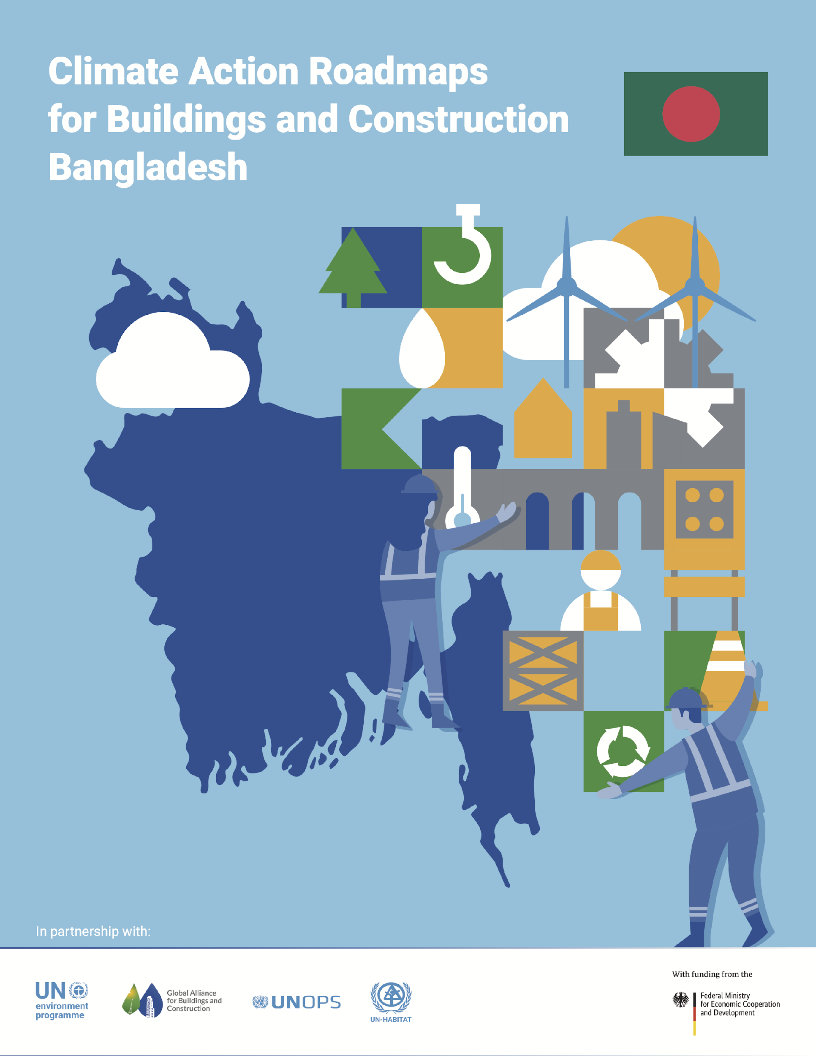
Building Roadmap _ Bangladesh
High Carbon Emissions: Bangladesh's carbon emissions have increased by 400% in the last 20 years and are projected to double by 2041.
Materials and Construction: Increasing use of high-carbon materials like concrete and bricks instead of sustainable alternatives.
Housing Deficits: Bangladesh faces a housing deficit of 4.6 million units in urban areas, with limited access to housing finance.
Coordination Issues: Lack of coordination among government agencies, weak enforcement of regulations, and widespread informality in the construction sector.
Urban Development Challenges: Rapid and uncontrolled urbanization not keeping pace with demand for adequate shelter and infrastructure.
Data Management: Poor data transparency and lack of comprehensive systems for monitoring carbon emissions.

Slide 13
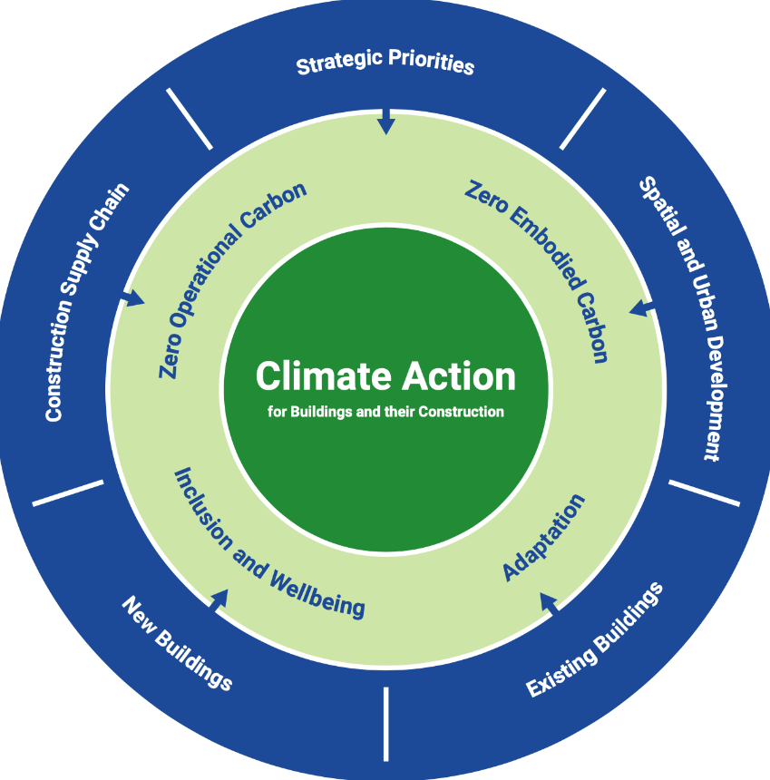
Building Roadmap _ Bangladesh
Zero Embodied Carbon:
Priority:
Material decarbonisation needs in
bricks (48%) and Concrete(35%)
CO2 reduction target:
30% reduction by 2030 and 60%
by 2040 from 2020 levels
Adaptation:
Priority:
Extreme vulnerability to cyclones,
floods and other climate hazards.
Target:
Reduction of persons affected by
disasters to less than 2,000 per
100,000 by 2025 and less than
1,000 by 2050.
Zero Operational Carbon:
Priority:
Household EE needs
Ozone-depleting HCFCs in RAC
reduction Needs
CO2 reduction target:
25% reduction by 2030 and 50%
by 2040 from 2020 levels
Well-being and Inclusion:
Priority:
Housing quality and QOL
Accessibility for handicapped
persons and inclusion of
marginalized community

Slide 14
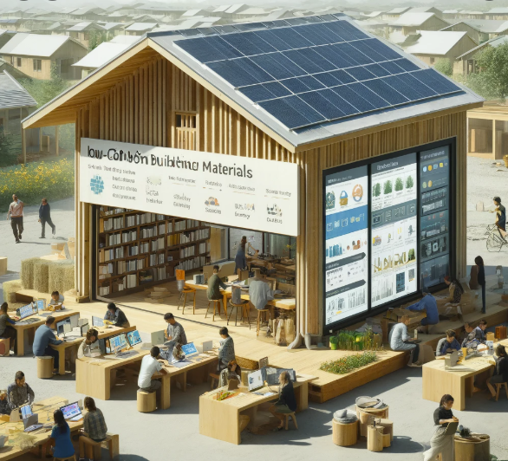
Building Roadmap _ Bangladesh
Strategic Priorities:
Establishing a central data repository to monitor carbon emissions
Forming a Council for Decarbonization with relevant experts and stakeholders
Revising the Bangladesh National Building Code to incorporate actionable regulations on carbon reduction
Chat GPT

Slide 15
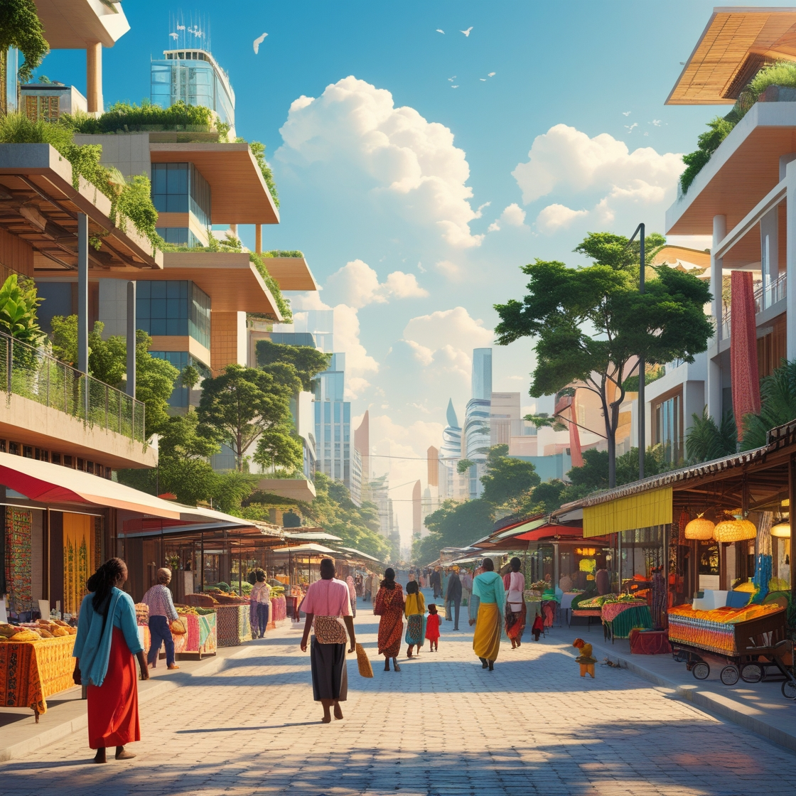
Building Roadmap _ Bangladesh
2. Spatial and Urban Development:
Developing a National Urban Policy to streamline planning processes
Creating sustainable urban infrastructure guidelines
Addressing the urban heat island effect through urban greening programs
Improving stakeholder engagement, especially for marginalized communities
Leonardo AI

Slide 16
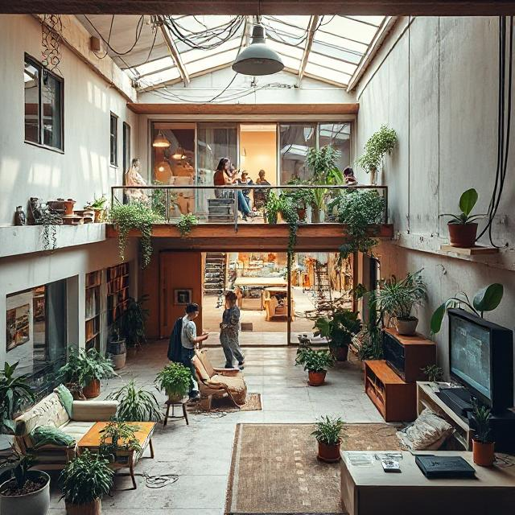
Building Roadmap _ Bangladesh
3. Existing Buildings:
Regulating the informal recycling market
Implementing routine surveys and audits of waste management practices
Supporting retrofitting of buildings for energy efficiency and climate resilience
Improving accessibility for persons with disabilities
Deep AI
Notes:
unregulated market/ unofficial individuals and organisations collect building materials to resell it on the market without the quality guarantees.
renovating window system to more highly insulated glasses and frames, cool paint to reflect solar radationation to reduce the cooling demands
Improving accessibility of handicapped people by incorporating universal design such as installing lifts, signage with braille, guide stud, slope, etc.

Slide 17
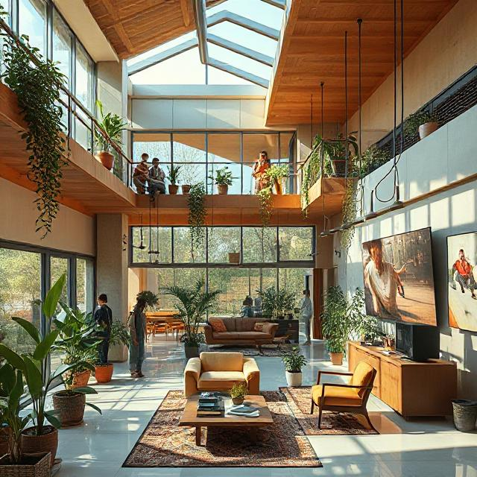
Building Roadmap _ Bangladesh
4. New Buildings:
Increasing the use of low-carbon, local, and recycled materials
Launching demonstration projects for zero-emission buildings
Establishing energy labeling systems
Retrieving and reviving traditional knowledge and materials for climate-resilient design
Deep AI

Slide 18
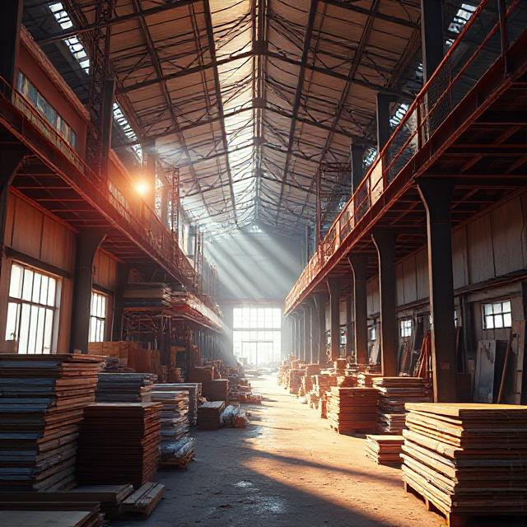
Building Roadmap _ Bangladesh
5. Construction Supply Chain:
Dedicating funds for research on low-carbon, local, and vernacular building materials
Providing subsidies and soft loans for private sector investors in sustainable materials
Implementing systematic data collection on adaptation and resilience practices
Improving occupational health and safety standards for construction workers
Deep AI
Notes:
materials that can address natural hazards, for example, the concrete that can resist to the earthquake, bricks that can ensure thermal comfort with high insulation.

Slide 19
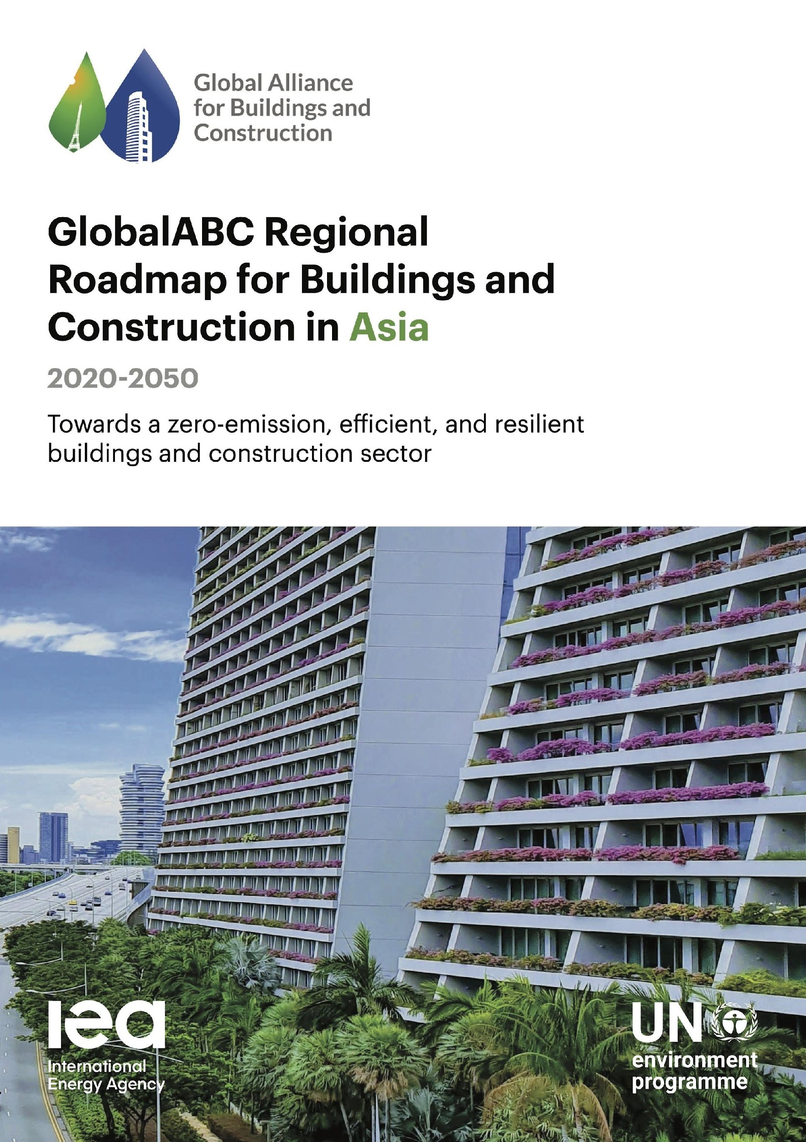
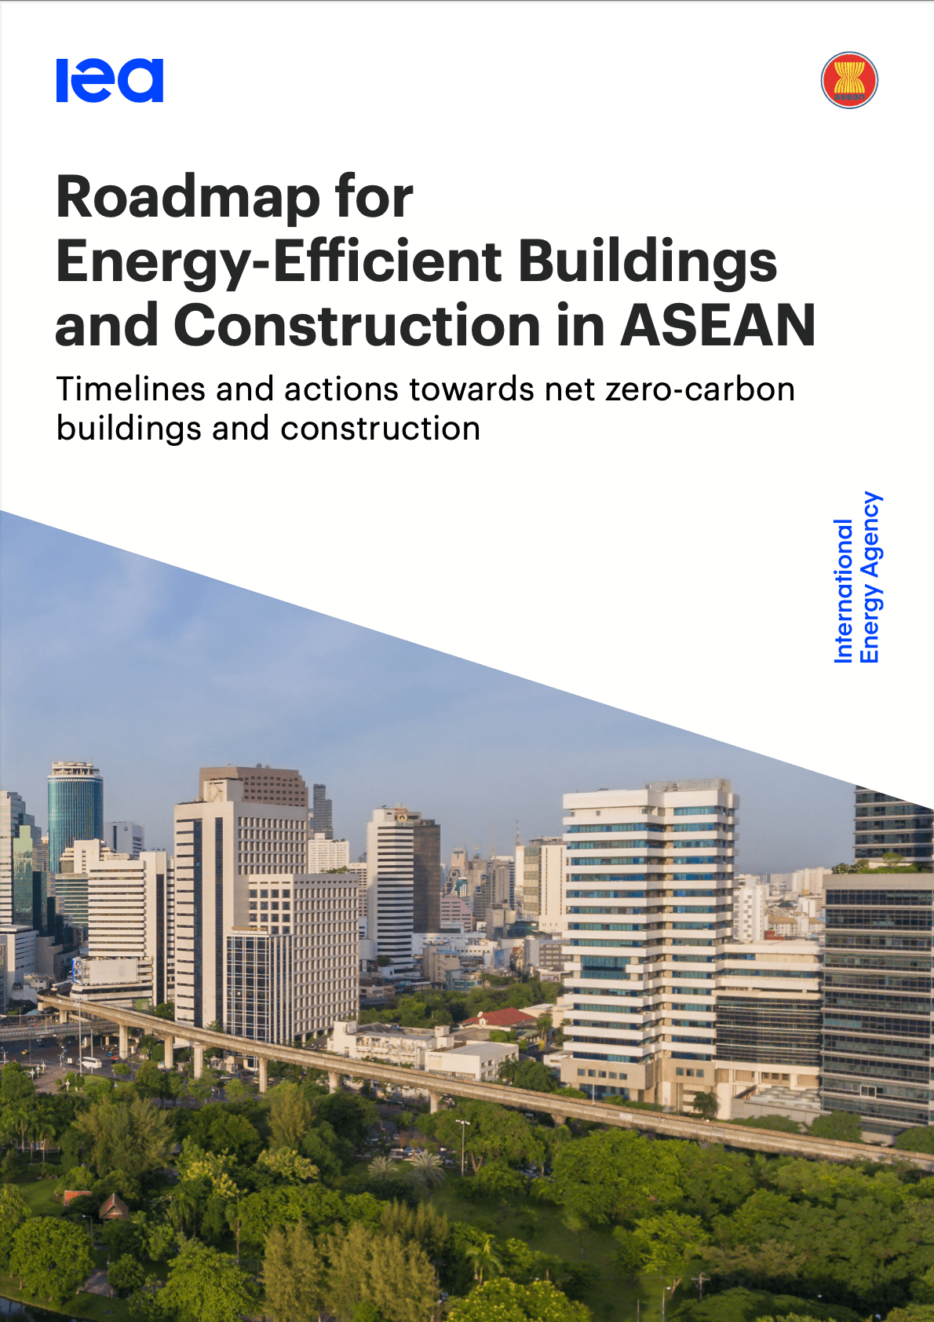
References
GlobalABC Regional Roadmap for Buildings and Construction in Asia
Roadmap for Energy-efficient Buildings and Construction in ASEAN

Slide 20
Find out more:
www.globalabc.org
global.abc@un.org
Notes:
Those interested in joining the GlobalABC and/or these groups can contact global.abc@un.org

