Slide 1
Green Manufacturing for Energy Efficiency: Insights from Chongqing, China
Sharing Policy Implementation & Industrial Innovations
Mr. Ma Ding Ping, Secretary General, Chongqing Renewable Energy Society

Slide 2
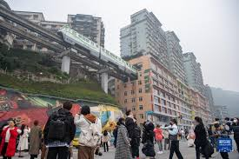
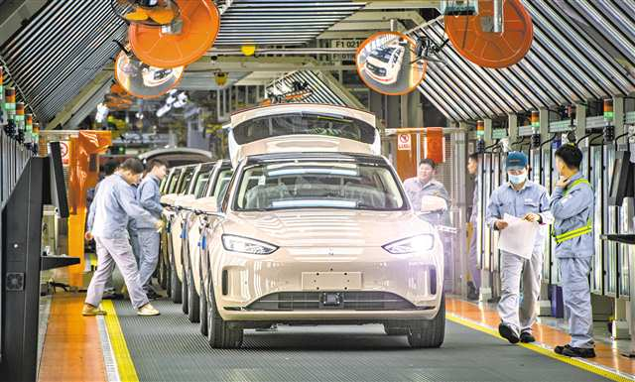
Introduction
Chongqing, located in southwest China, is a key industrial city with a strong emphasis on green development. The city plays a pivotal role in China's industrial transformation, contributing significantly to the nation's energy efficiency goals.

Slide 3
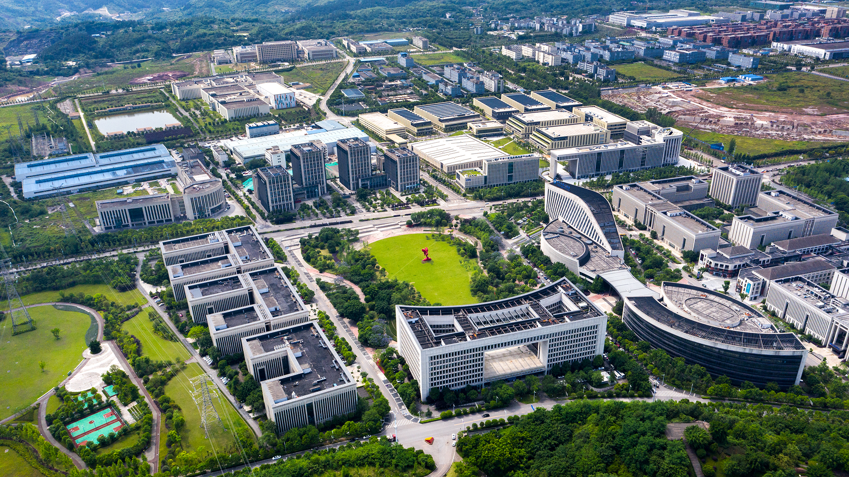
1. Introduction: Chongqing as a Green Industrial Hub
Key Statistics:
Industrial GDP accounts for over 40% of Chongqing’s total GDP.
Energy efficiency and emission reduction targets are central to Chongqing's industrial policies.
Core Message:
From Policy to Practice: Chongqing serves as a model for other developing economies, demonstrating how green manufacturing policies can be successfully implemented at the local level.

Slide 4
2.China's Energy Efficiency Management Framework
• China's energy efficiency management involves a structured process from central policy formulation to local execution and industry adoption. Key areas include:
Industrial Sector:
Technological improvements like waste heat recovery and optimized motor systems.
Green manufacturing systems (green factories, parks, and supply chains).
Public Institutions:
Creation of energy-saving demonstration units (e.g., government buildings).
Promotion of energy-saving awareness and training.
Buildings:
Green building standards (e.g., LEED China).
Retrofitting of existing buildings for energy efficiency (public buildings).
Transport:
New energy vehicles (electric buses, charging infrastructure).
Smart transportation systems (e.g., Chongqing’s intelligent transport pilot).
Green logistics (optimization of multimodal transport)

Slide 5
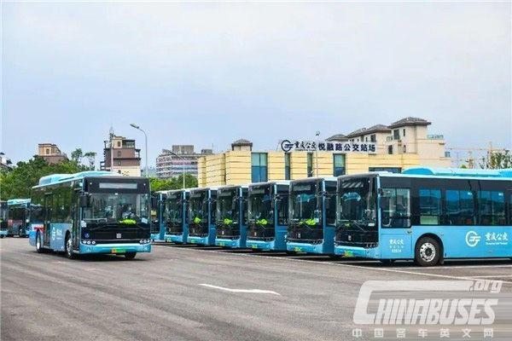
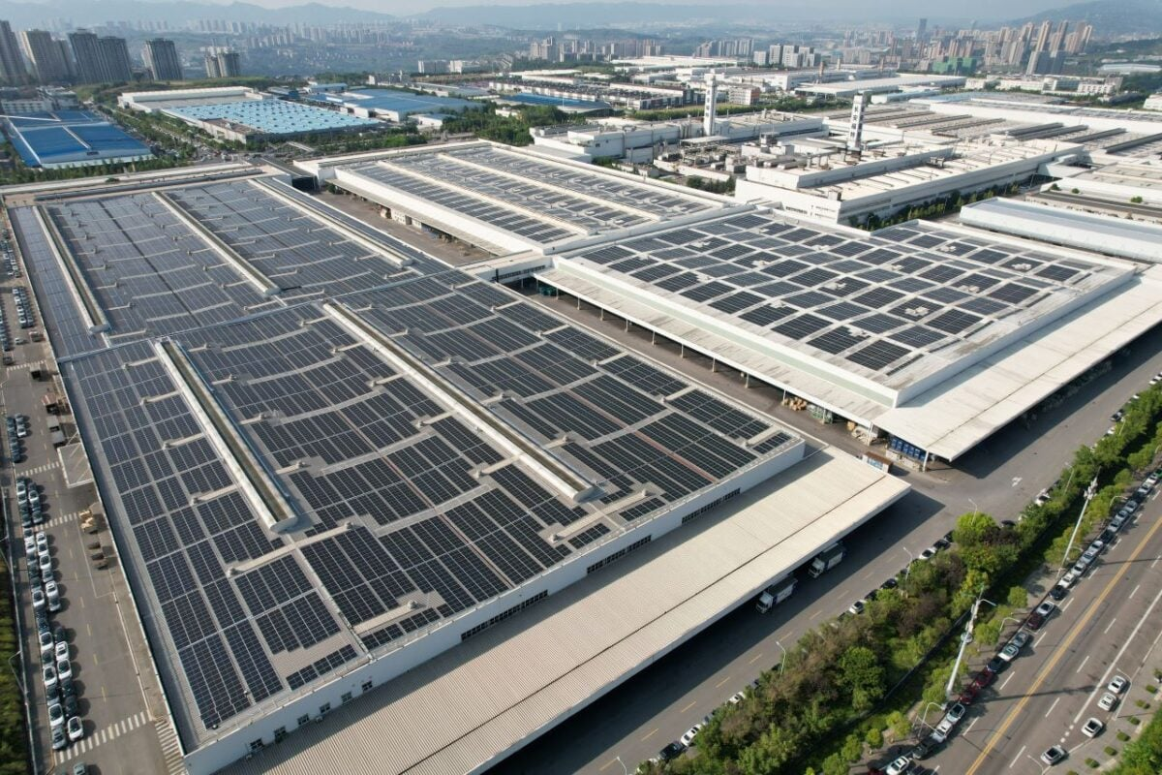

Slide 6
3.Green Manufacturing 2.0: Chongqing's Industrial Innovations
Green Industrial Parks: Example: Liangjiang New Area’s circular economy transformation.
Green Factories: Implementation of ISO 50001 standards and local evaluation metrics.
Green Supply Chains: Changan Automobile’s carbon management programs with suppliers.
Green Products: Collaboration with Beijing on developing eco-friendly products.
Data Highlight:
Chongqing has established over 50 national-level green factories, with energy efficiency improvements of up to 15% in key industrial sectors.
Version 1.0: Focus on energy savings.
Version 2.0: Emphasizes green manufacturing, combining energy efficiency with environmental sustainability and low-carbon practices.

Slide 7
4. International Collaboration: Knowledge Transfer & Capacity Building
Chongqing is a hub for international collaboration in green manufacturing and energy efficiency.
Key Achievements:
Technical Manuals: Case studies on technologies like waste heat recovery.

Slide 8
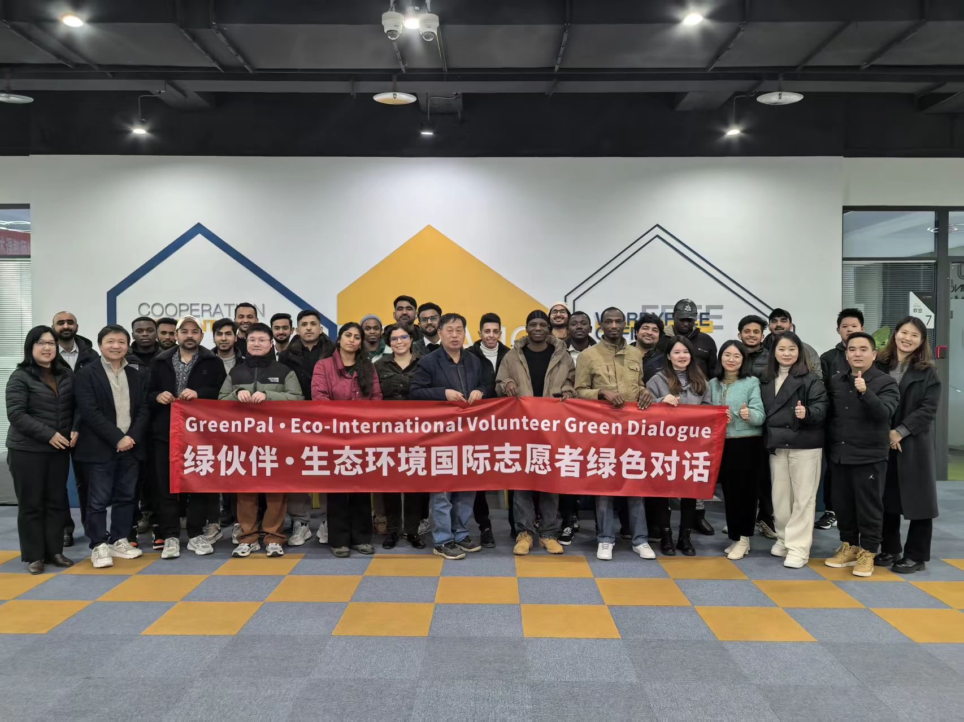
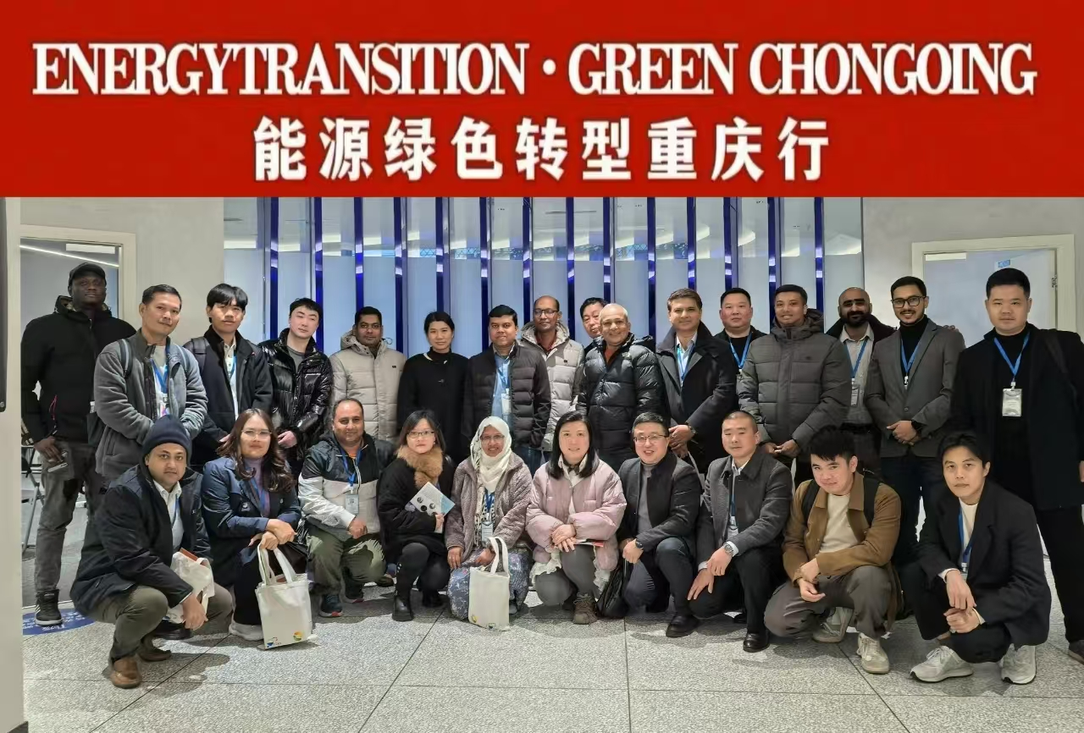
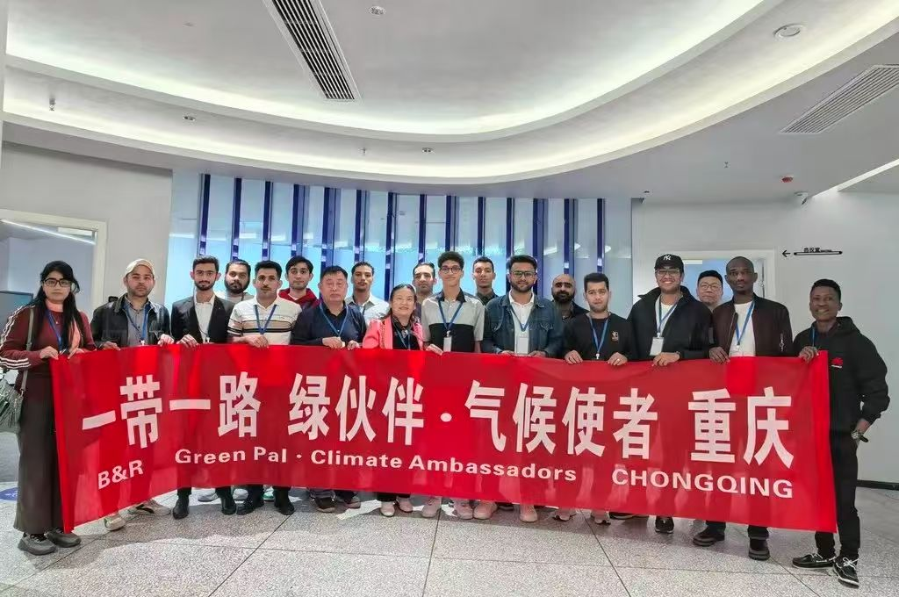
Exchange Programs:
Plan Host 8 delegations in Chongqing for exchange visits in 2025.
The 2024 activities promoted technology transfer and sustainability, but stronger mentorship, funding, and implementation are needed for greater impact in 2025.

Slide 9
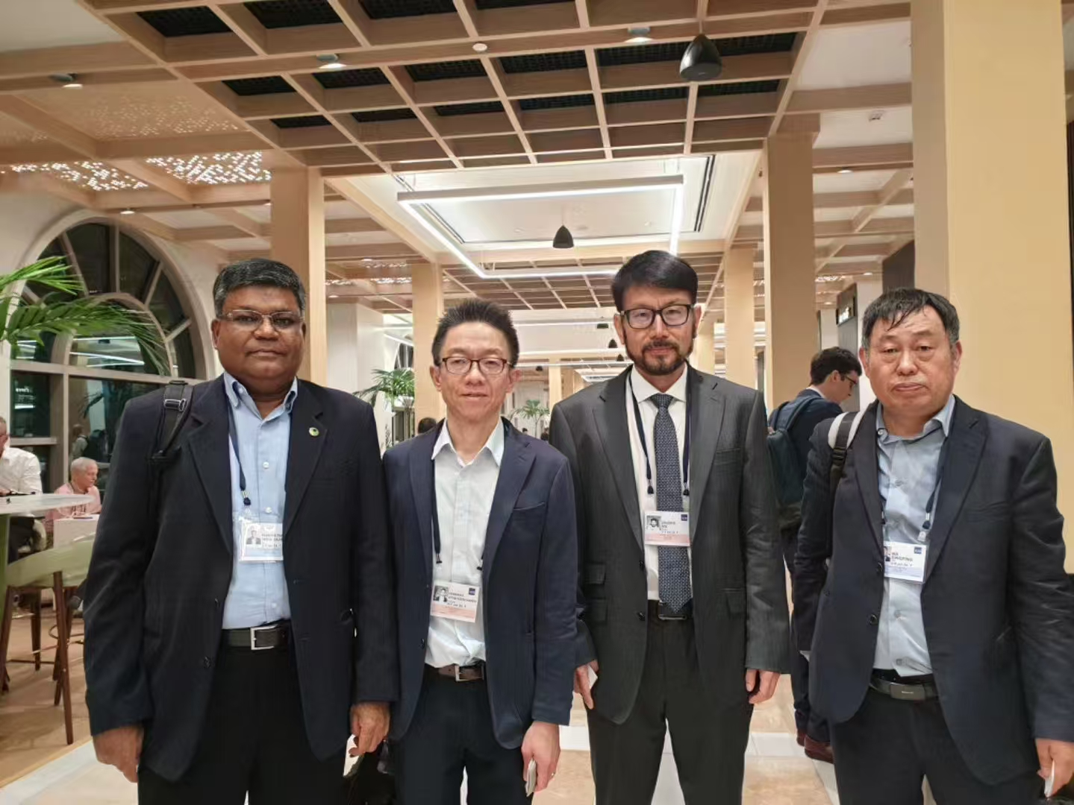
AIT Technology Transfer Center
Green Partners: Collaborative activities with international students and partners.
Future Plans:
Technology Transfer Roadmap (2024-2026): Expanding green technology outreach.
Training Modules for Southeast Asia: Focus on green manufacturing and energy efficiency.
Adjust AIT Technology Center:
Shift focus away from its current role.
Transform it into a demonstration and service center.

Slide 10
5. Conclusion & Call for Collaboration
Chongqing’s green manufacturing journey offers scalable solutions for other industrializing nations looking to transition to sustainable manufacturing practices.
Core Message:
Chongqing's experience serves as a replicable model for other developing economies seeking to enhance their industrial green transformation.
Call for Collaboration:
Joint research on energy efficiency standards.
Talent exchange programs.
Collaborative development of international green manufacturing projects.

Slide 11
Evaluating Chongqing’s Green Development Efforts
Current Evaluation Efforts
Industrial Sector:
Energy Audits: Chongqing has conducted energy audits focusing on waste heat recovery and motor efficiency. By 2025, the city aims for over 70% of new motors to be energy-efficient, and over 80% for new transformers.
Green Energy Adoption: While specific data for Chongqing is limited, China's broader commitment to renewable energy is evident. As of 2023, China leads globally in wind and solar capacity, with wind and solar accounting for 16% of its electricity generation.
Buildings:
Green Building Certifications: Chongqing has adopted green building standards, such as LEED China, to promote energy efficiency. As of 2020, China had nearly 2,600 projects certified under LEED, encompassing approximately 95.8 million square meters. However, detailed data on the long-term energy savings from these retrofitting efforts in Chongqing is currently limited.
Public Institutions:
Energy-Saving Demonstrations: The city has established energy-saving demonstration projects in government buildings. Comprehensive performance data on these initiatives is not readily available, indicating a need for consistent monitoring and reporting.
Transport:
Chongqing's intelligent transport pilot and the deployment of electric buses are steps toward sustainable urban mobility. While usage statistics are monitored, comprehensive impact assessments, including environmental benefits and user adoption rates, are necessary to evaluate effectiveness.

Slide 12
Challenges & Gaps
Limited long-term data on sustainability impact.
Need for standardized evaluation frameworks across sectors.
Lack of collaboration between policymakers, researchers, and industries.
Next Steps: Strengthening Evaluation in Chongqing
Develop standardized monitoring & assessment frameworks.
Expand data collection & transparency for better policy decisions.
Strengthen partnerships between government, universities, and sustainability experts.
Conduct regular audits of industrial parks, public buildings, and transport systems.

Slide 13
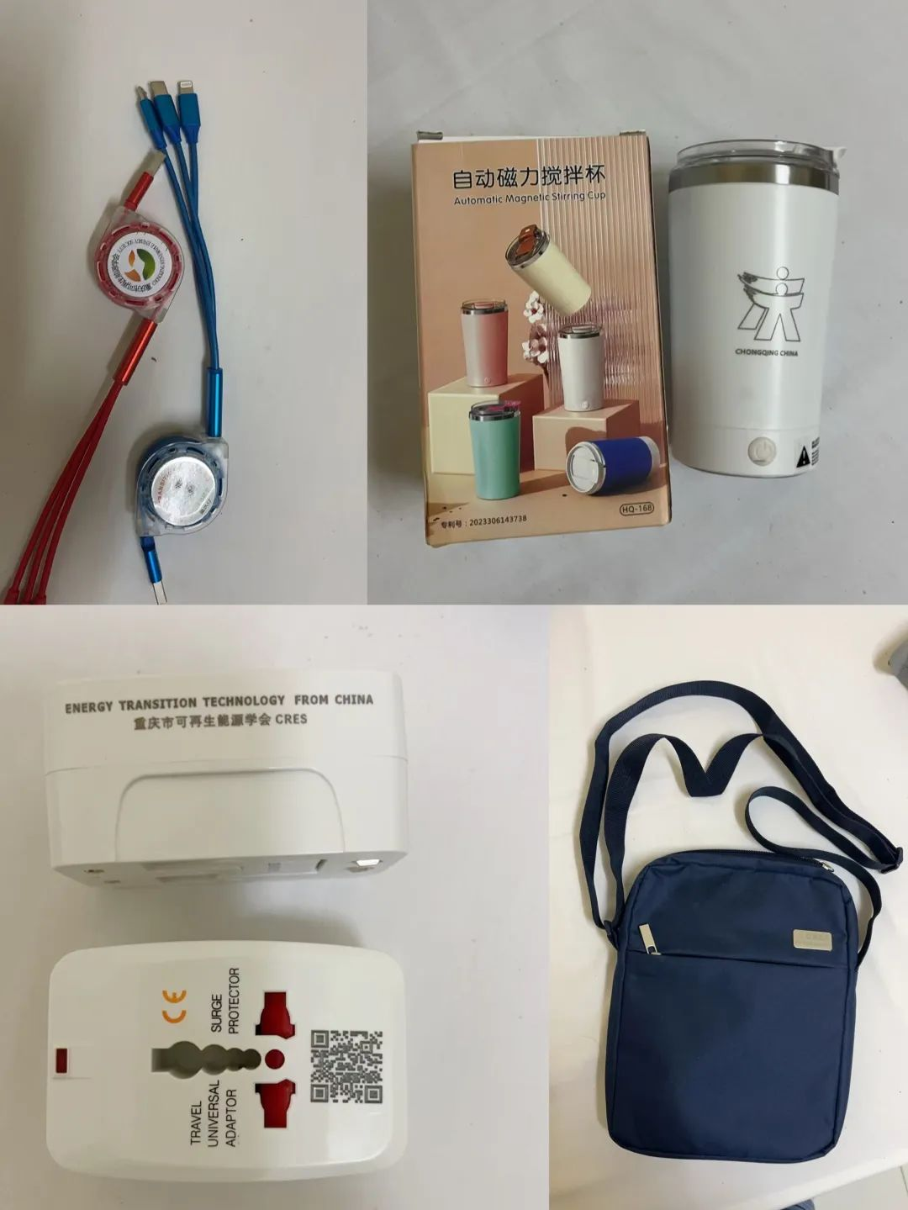
Together for a Greener Industrial Future
Thank You
Contact:
Name: Mr. Ma Ding Ping
Organization: Chongqing Energy Research Society
Email: madingping@cqres.org.cn

