Slide 1


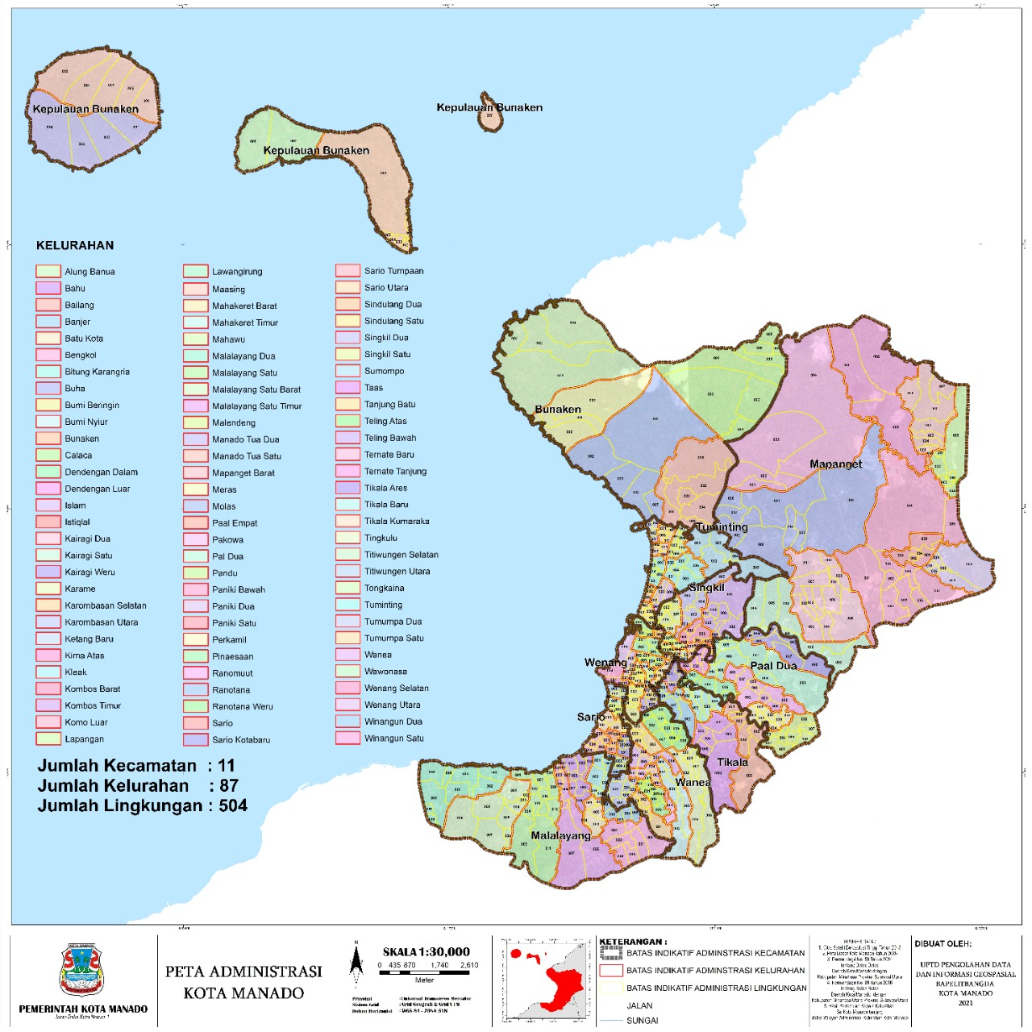
REGIONAL RESEARCH AND DEVELOPMENT PLANNING AGENCY (BAPELITBANGDA)
MANADO CITY - INDONESIA
Energy Project Evaluation for underprivileged community in Bunaken Island, Manado.
by: Brury Bangun, ST, MUrbanEnvPlan

Slide 2
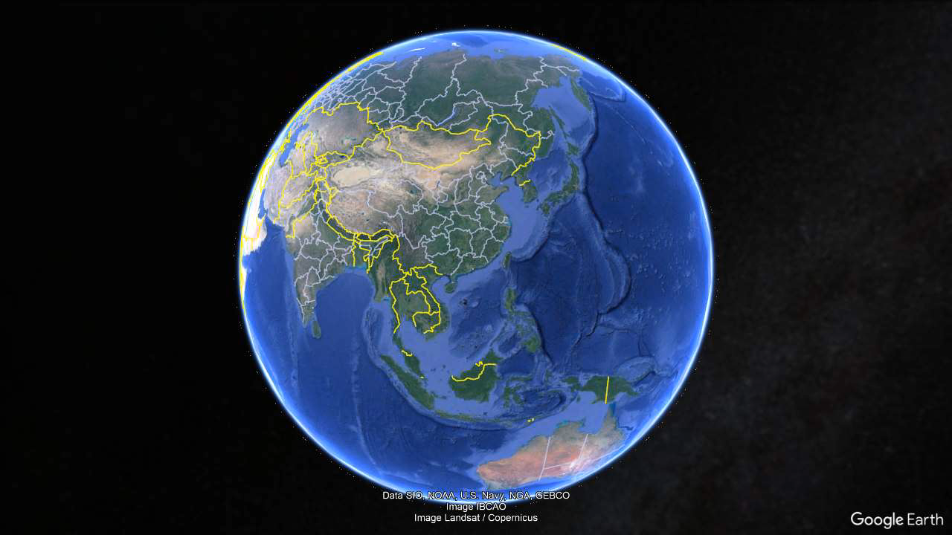
MANADO CITY GE0LOCATION

Slide 3
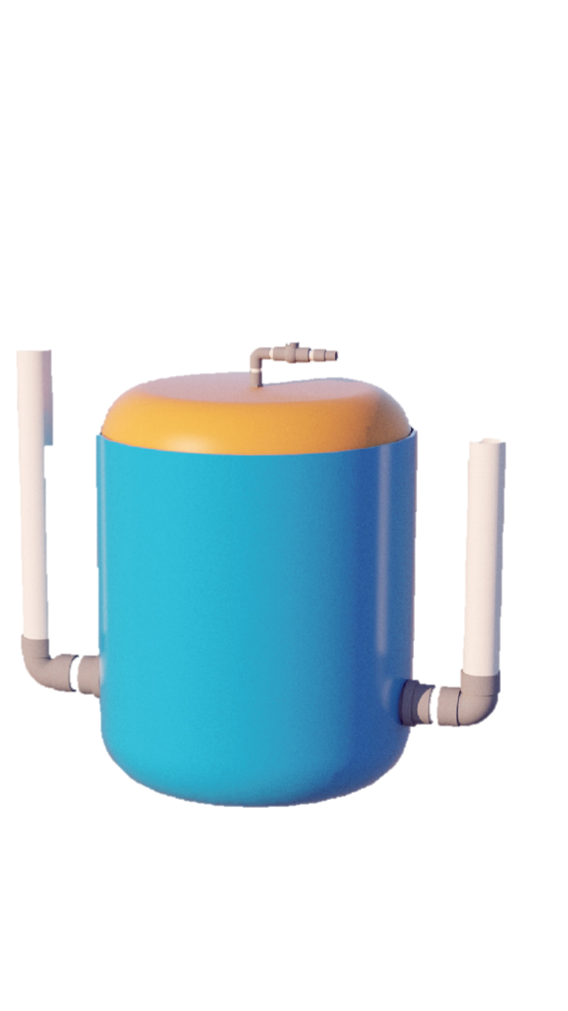
the key goal is SDG7: “ensure access to affordable, reliable, sustainable, and modern energy for all.”
evaluators will need to focus more on process evaluation rather than on impact evaluation
First, how can interventions be planned to address inequities? Second, are those who are intended to benefit from the intervention the ones who actually benefit? Hence, the evaluation of a specific program will move beyond the focus on outputs (e.g., how many households were served? How many kilowatt hours were saved or produced?) toward a better understanding of who was served and where the program recipients belonged in the continuum of need? As a result, the evaluation focuses on equity (not effectiveness) and moves from average impacts to the distribution of impacts.

Slide 4

SDG 7, which focuses on "Affordable and Clean Energy", has several targets that must be achieved by countries, including Indonesia. For Indonesia, these targets include:
Target 7.1: Ensure universal access to affordable, reliable and modern energy for all
Including in remote areas
Target 7.2: Increasing the proportion of renewable energy in the global energy mix.
Target 7.3: Significantly increase energy efficiency by 2030.
This involves efforts to improve energy efficiency in the industrial, transport and household sectors.
Target 7.a: Enhance international cooperation to facilitate access to clean and renewable energy technologies.
Target 7.b: Supporting investment in clean energy infrastructure and technologies.

Slide 5
Indonesia's Challenges in Achieving SDG 7
High dependence on fossil fuels (coal, oil, and gas).
The still high dependence on fossil fuels (coal, oil, and gas).
The need for large investments in renewable energy such as solar, wind, and hydro.
Changes in energy consumption patterns to increase efficiency and reduce carbon emissions.

Slide 6

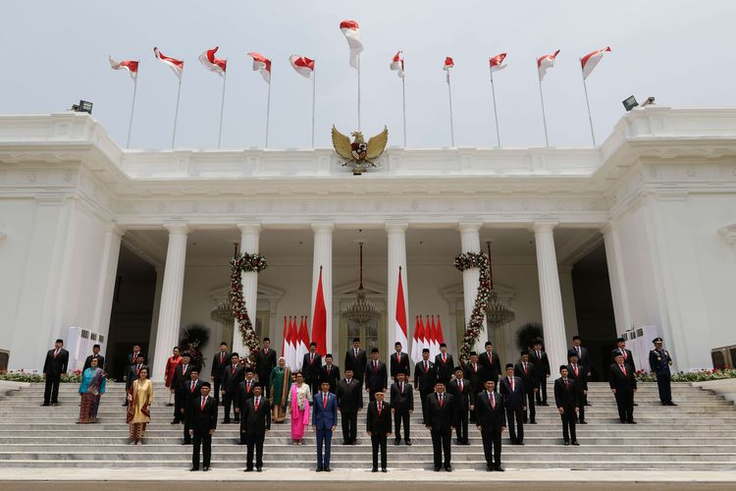
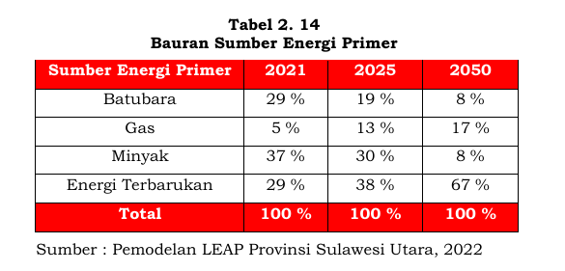


The Indonesian Government Targets:
The Indonesian Government through RUEN (National Energy General Plan) dan targets an increase in renewable energy to 23% by 2025 as part of its SDGs7 commitment
North Sulawesi Province targets:
Coal
Gas
Oil
Renewable Energy
Manado City targets:

Slide 7
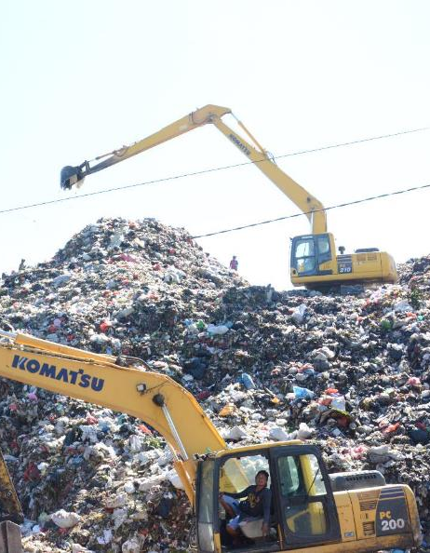
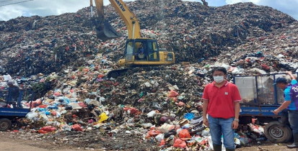
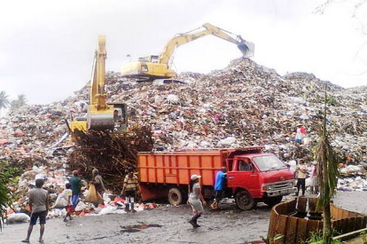
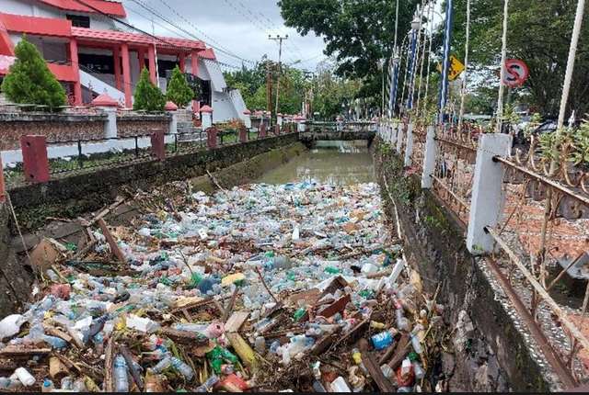
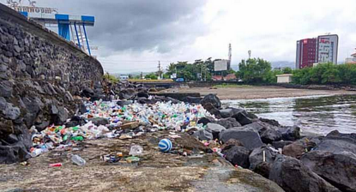
Waste Problem
H2S
CH4
CO
CO2
106.000 ton of waste yearly

Slide 8

Why Biodigester?

Slide 9

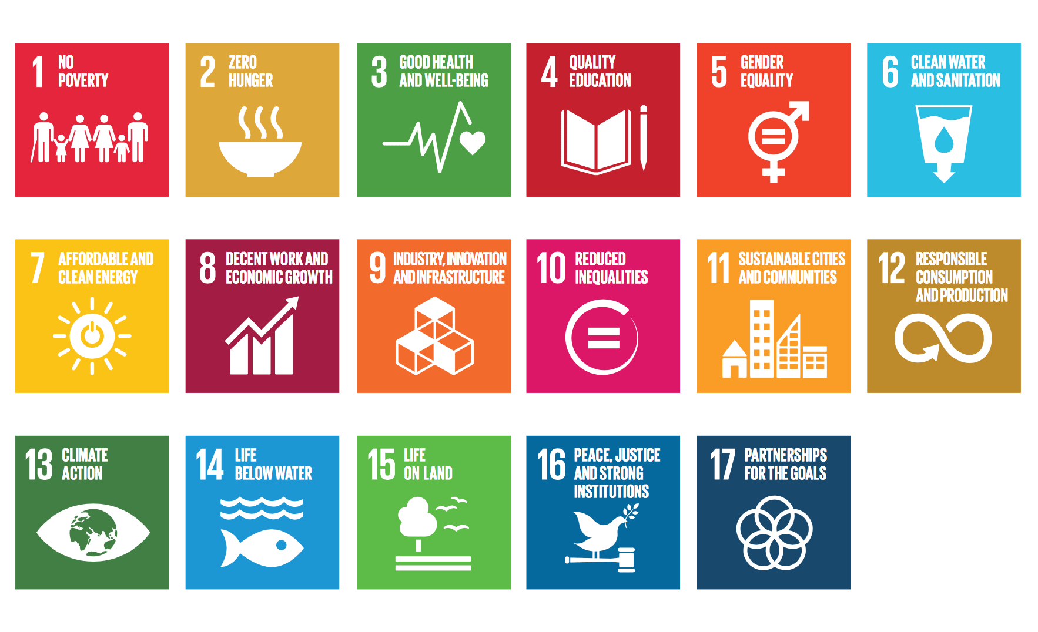
Why Biodigester?

Slide 10
Waste Problem
H2S
CH4
CO
CO2
106.000 ton of waste yearly

Slide 11
Komposisi Sampah Kota Manado Tahun 2021
Food organic waste
48%
Paper based waste
19%
Plastic baserd
Source: Ministry of Forestry

Slide 12


BIOMAN
BIODIGESTER MANADO
The Manado Biodigester is a technology for processing organic matter with the addition of microorganism bacteria as a starter to speed up the process of decomposition of organic matter in an airless [anaerobic] state.
This Device can produce gas around 400-500 ltr/day = 1-1.5 hours of cooking every day with a processing capacity of 30-35 ltr of organic waste + water with a ratio of 1:1.
The gas produced can be used for cooking purposes and the fermented liquid that comes out every day can be used as liquid fertilizer
In addition to reducing the generation of household organic waste, this Device can cut costs for LPG and can also produce fertilizer to fertilize plants.

Slide 13
BIOMAN INSTALATION
BIOMAN ASEMBLY STEPS
3. Attach the inlet and outlet pipe
Inlet pipe for organic waste
1. Cut off the top of the tank
Outlet pipe for excessive sludge
4. The installation of 550 L tank into the 650 L tank
2. Drill a 3 inch hole at the lower of the tank and install a 3 inch elbow pipe
Notes:
Manado is not an agropolitan, however FAO has warned of a potential global food crisis. The world's food supply chain is also under threat amid the imposition of regional quarantines, social restrictions and travel bans. The policies of each country in preventing the spread of Covid-19 also have implications for their food policies and production capabilities. This reality shows that food security is as important as public health. If doctors and medical personnel are soldiers in an effort to fight the spread of Covid-19, so are farmers, extension workers, and other agricultural people. Manado City Strategy: Utilizing idle land, Opening new jobs in the urban agricultural sector, with a choice of vegetable crops that can already see results within 3 months (moving the community's economy, shortening the food supply chain). We do urban farming by utilizing organic waste from the kitchen to make Liquid Organic Fertilizer (fermented mixed vegetables and fish cleaning residues as raw materials), as well as leftover biogas equipment which produces renewable energy in the form of gas which can be used for cooking. An important defense against COVID-19 is food security. In terms of health protocols, the government has prepared a special strategy to prevent the spread of the virus through large-scale social restrictions. This strategy will only be effective as long as staple food is available to the people. Thus, the main steps that need to be taken are to increase national production based on smallholder agriculture and in favor of small farmers. To be able to make this happen, the government has reallocated a larger budget to be allocated in the form of seed assistance, work-intensive programs. The local government must be committed to encouraging the use of sub-optimal land, such as dry land and swamps, as well as preventing the conversion of agricultural land. Utilization of yards is carried out through efforts to empower families or larger community groups for the cultivation of yards and the processing of their produce. Efforts to use land are carried out not only by cultivating various types of food and horticultural crops, but also by cultivating livestock and fish so that they can provide sufficient food availability, both carbohydrates, protein, vitamins and minerals. Yard land use activities can be carried out by the family as the smallest unit of community group. The use of yard land can also be done by community groups, such as residents of settlements, flats, dormitories, or school students, and Islamic boarding schools. marketing chain efficiency also facilitates cooperation between farmers and producers with a number of online-based inter-services, such as Go-Jek, Grab, Blibli, and Tokopedia. Other efforts made are facilitating and collaborating with startups engaged in the marketing chain. https://mediaindonesia.com/read/detail/308928-strategi-pertanian-menghadapi-pandemi-covid-19?utm_source=dable

Slide 14





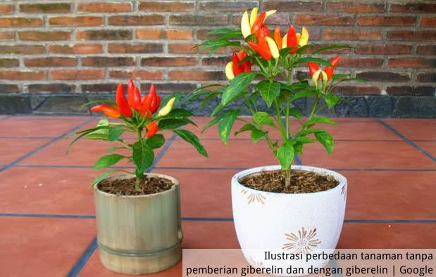

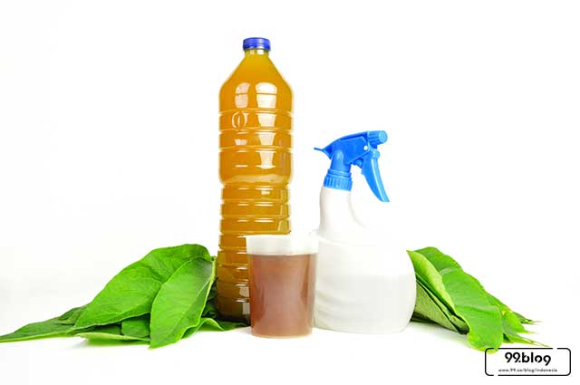

BIOGAS PROCESS
BAPELITBANG
Methane gas flows into the kitchen
Organic waste 30-35 L/day
(1 Organic Waste: 1 Water)
Filter
Methane gas is used for cooking through Gas Stoves
Methan, Co2, H2S
Producing Liquid Organic Fertilizer
1-1,5 hour/day
500 L
30-35 L/day
Fermentation Process by Bacteria
Sludge
STARTER 150 L COW MANURE + 100 RUMEN+250 L WATER (Fermentation 14 -20 Hari)
Packaged Organic Liquid Fertilizer (Rp 10.000/ltr NPK)
Plants become fertile
METHAN
CO2,H2S
Masak
ORGANIC
WASTE
BIO GAS
COMPOST
PUPUK ORGANIC CAIR
Menyuburkan tanaman
Notes:
This device is equivalent to a 3 kg gas cylinder which is used 10 gas cylinders/month at a cost of Rp 200.000.
Utilizing household waste 33 L/day (organic waste production of 3f households) if 1 household produces 10 L/day (2.5 L x 4 persons)
The use of biogas can reduce the generation of municipal organic waste and become one of poverty alleviation tools.
The amount of Manado City waste is 1,147.5 m3, equivalent to 1,147,500 liters. 60% organic waste = 688,500 Liters (20,864 Biogas equipment raw materials).
If this tool is given to 22,090 under privileged households, 57.4 billion funds are needed.
The benefits of this tool for under priviliged families are as follows: Reducing waste generation, saving gas costs 200 thousand / month, cooking using biogas
and earn Rp. 20,000,000 per month in the form of selling liquid fertilizer (sold in packs) or purchased by the government to replace the use of inorganic fertilizers by the Agriculture Agency and to water environmental parks

Slide 15
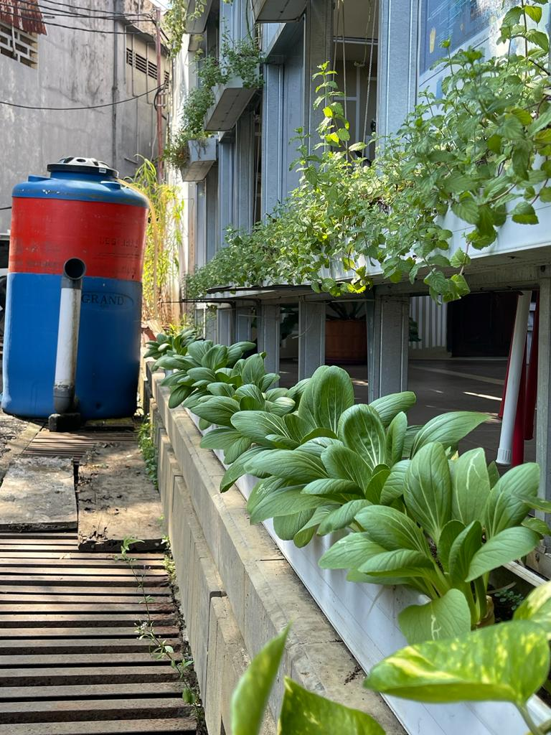
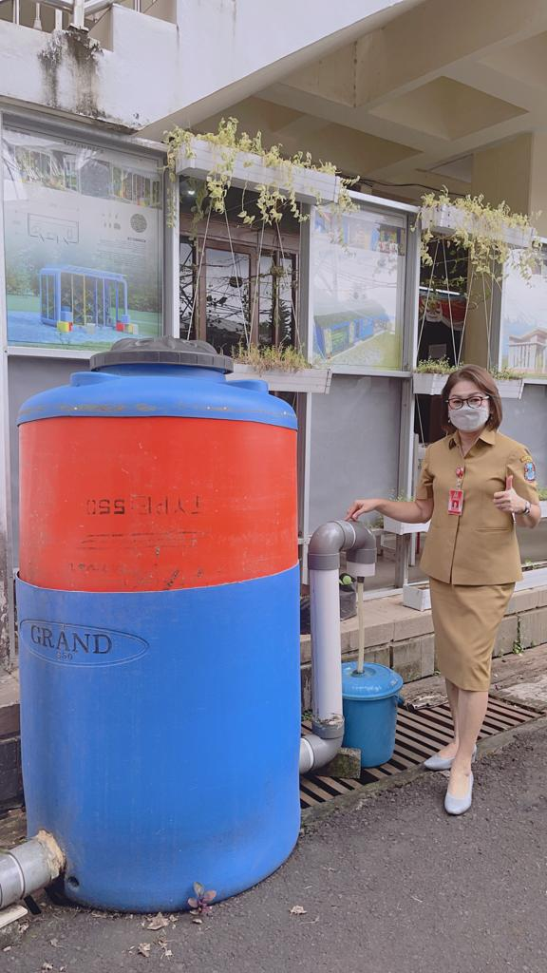
BIOMAN demonstration tool at Bapelitbangda Office

Slide 16

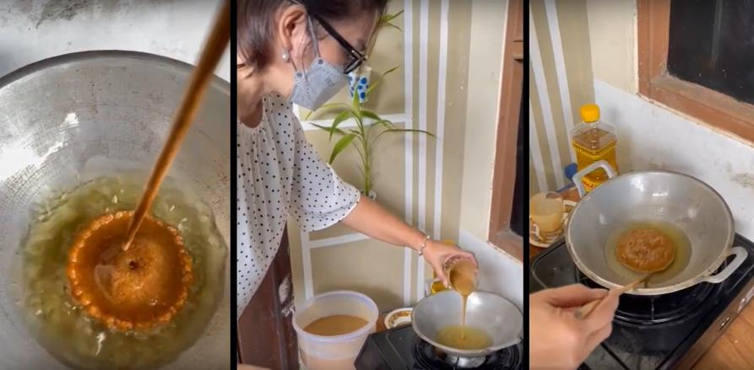
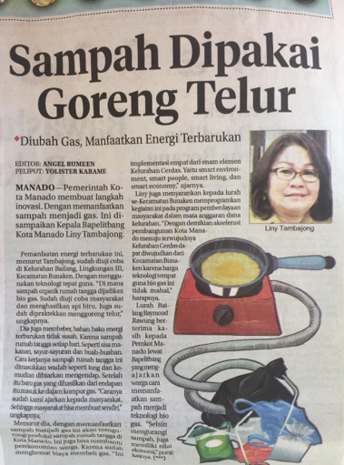
Some Documentation
Dokumentasi Penggunaan Biodigester

Slide 17
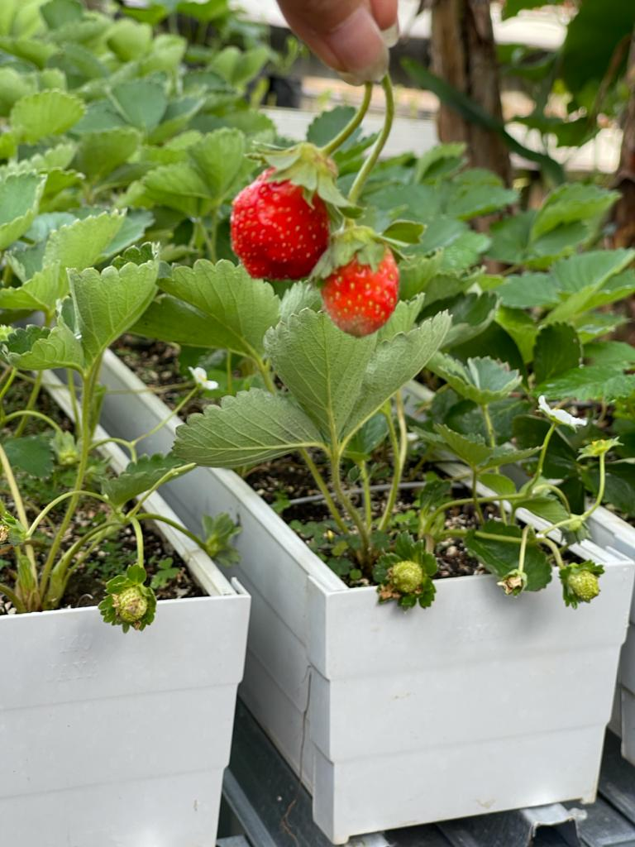
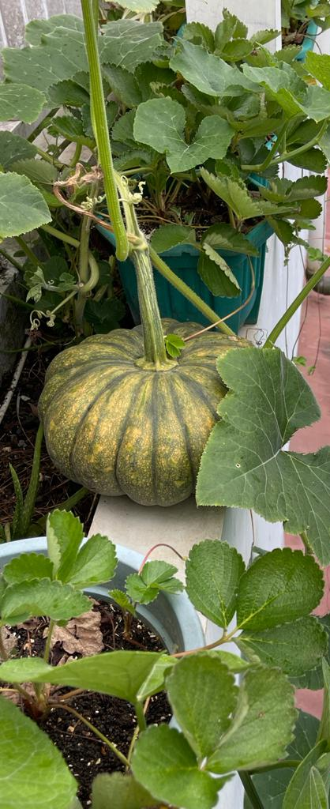
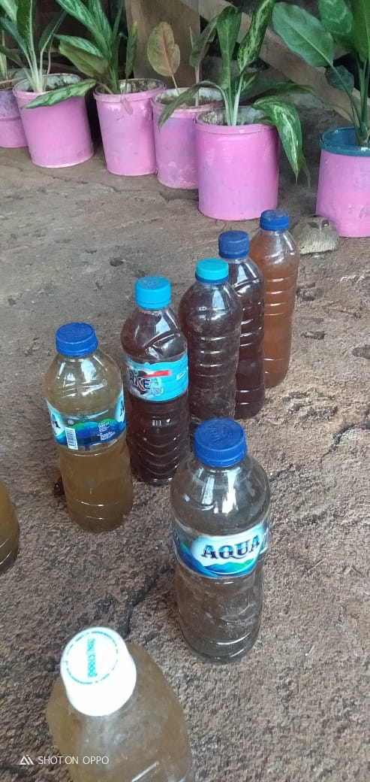
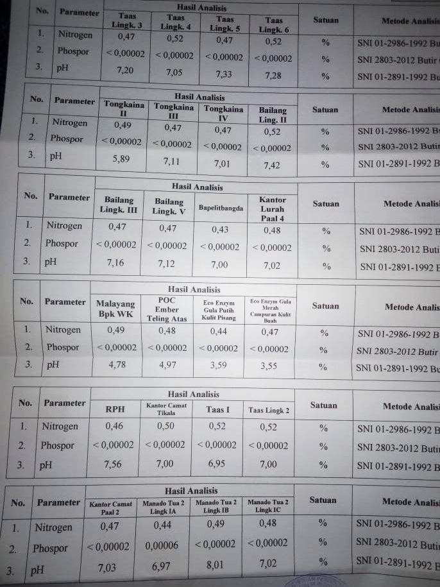
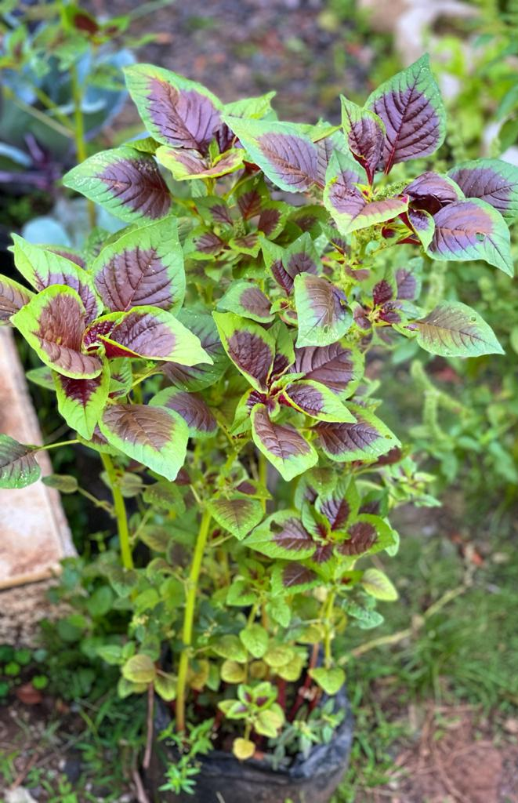
BIOMAN Liquid organic fertilizer Usage
The fermented liquid from the biodigester is used as liquid organic fertilizer for fruits and vegetables
Table of Liquid Organic Fertilizer inspection results

Slide 18
Biodigester for Household Organic Waste

Slide 19
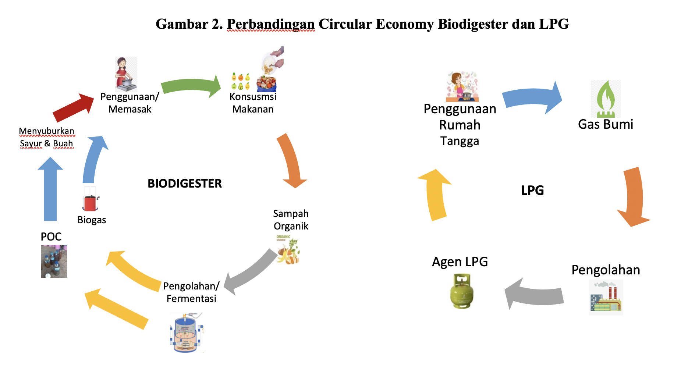
CIRCULAR ECONOMY
Renewable Energy & Circular Economy utilizes organic waste
Biogas will never run out as long as organic waste is present
Non-Renewable Energy & Circular Economy does not occur
Occasionally there is a shortage of gas supplies at the gas station/ base

Slide 20
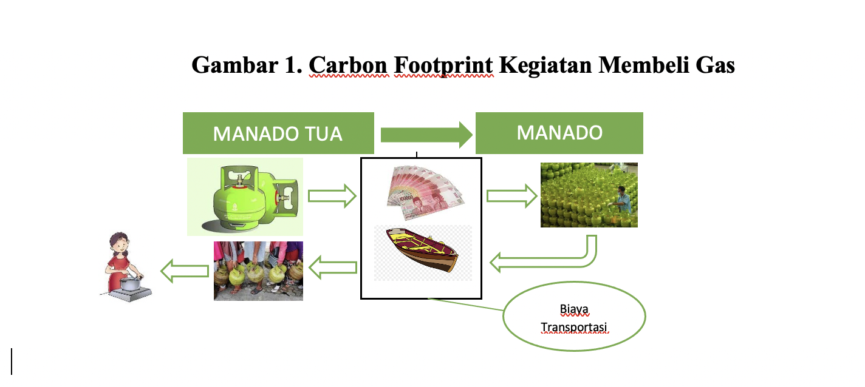
MAKASAR
CARBON FOOTPRINT LPG
BITUNG
Gas Refill in Manado
Goes back to Manado Tua island
Transport Cost
LPG has a long carbon footprint from Makassar, while BIOMAN is processed on site.
It is very useful for use in the Archipelago and remote areas

Slide 21
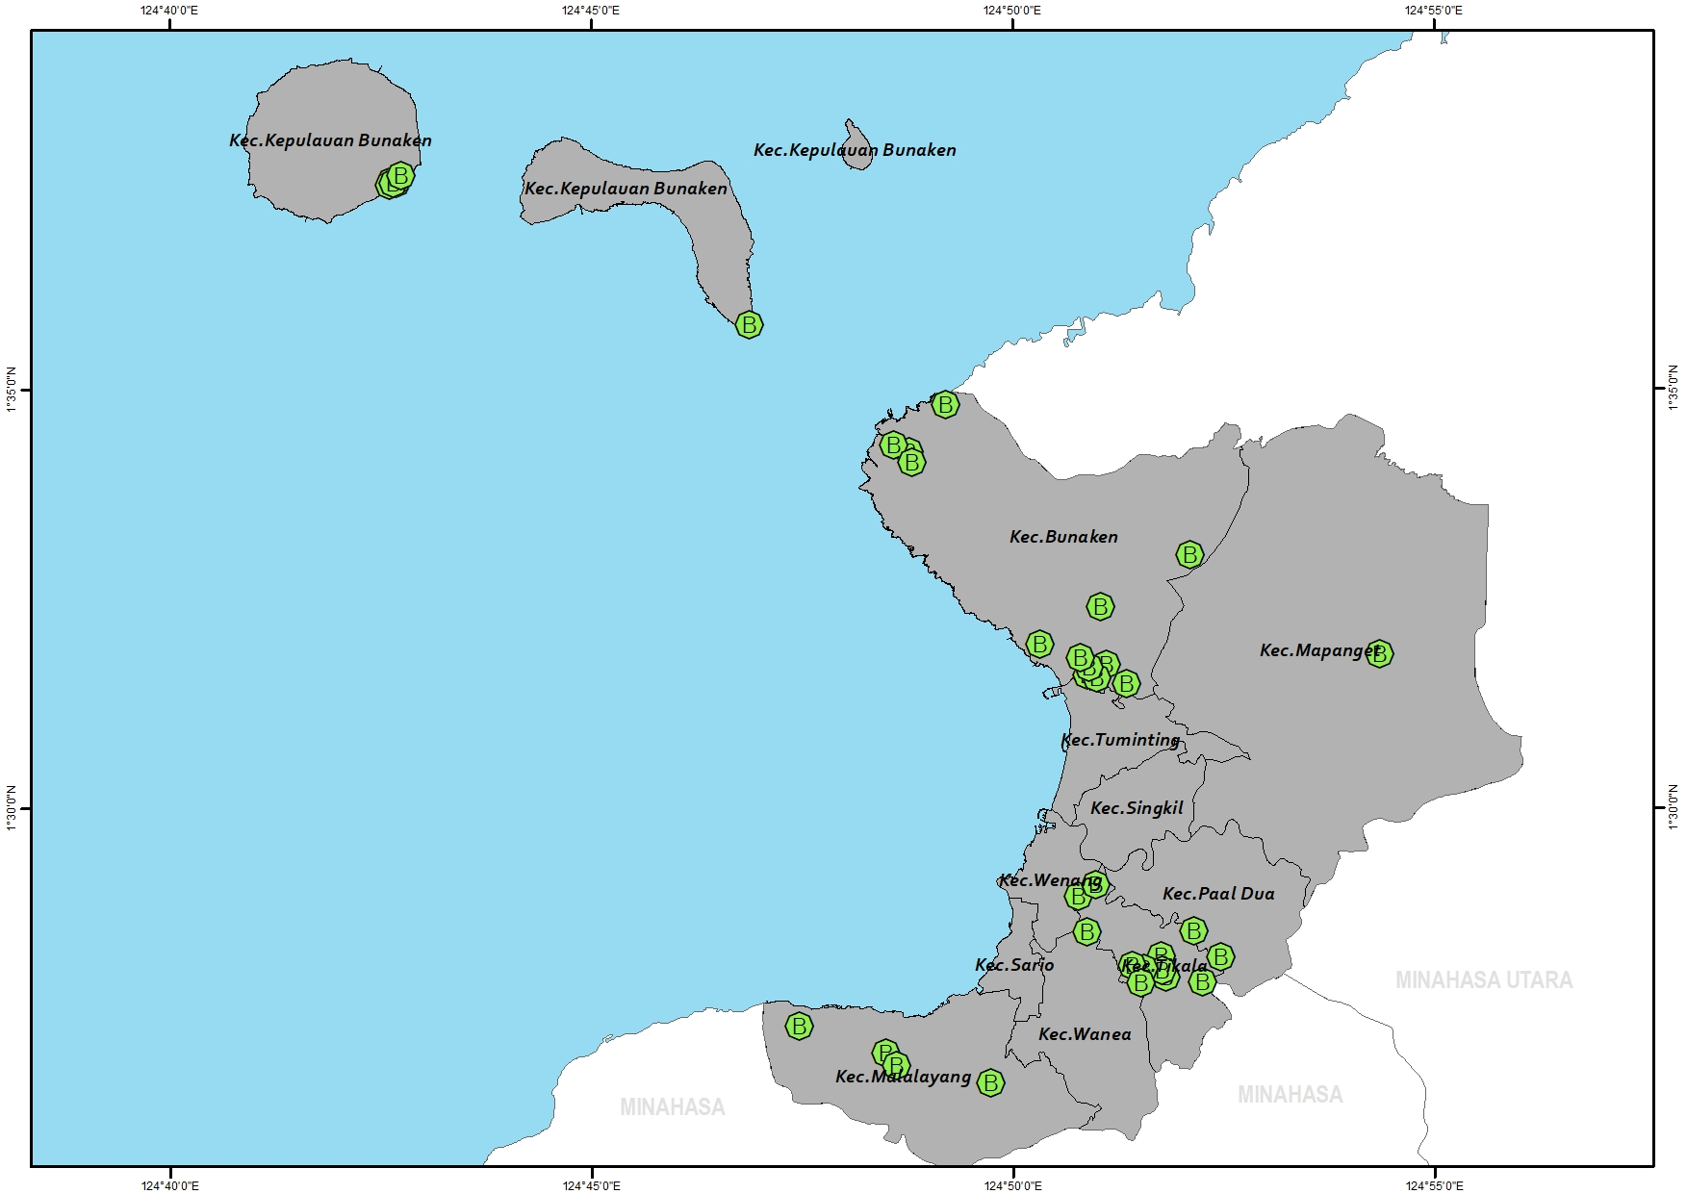
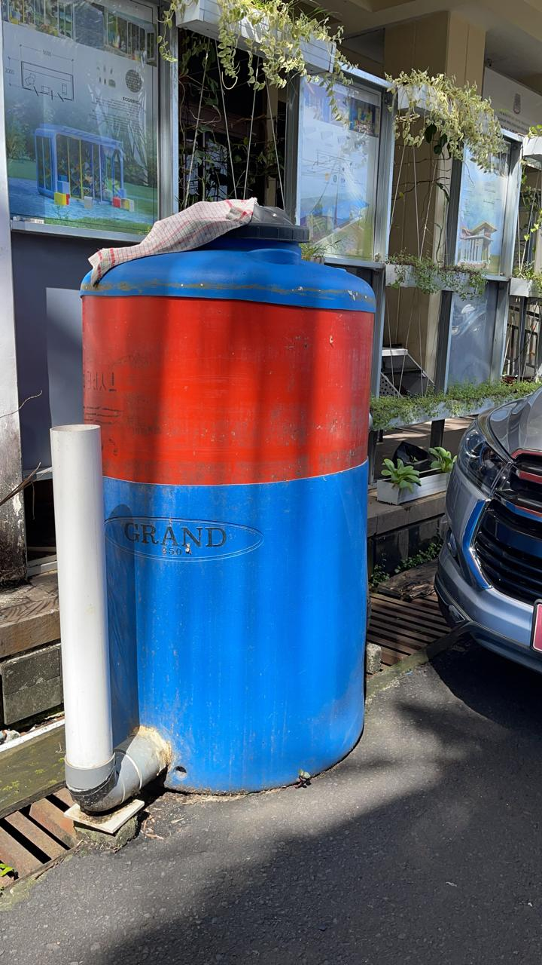
Biodigester Distribution Map in Manado City
BIOMAN
https://panada.manadokota.go.id/

Slide 22
BIOMAN
Biodigester Distribution Map in Manado City
YEAR 2019 8 UNIT
YEAR 2020 20 UNIT
YEAR 2021 11 UNIT
YEAR 2022 12 UNIT
YEAR 2023 3 UNIT
YEAR 2024 2 UNIT
https://panada.manadokota.go.id/

Slide 23
Evaluation Survey

Slide 34

“Lesson Learned”
Lesson learnt:
Distribute the biodigesters to people who really need them.
Provide the biodigester beneficiaries with practical knowledge on how to operate and maintain the devices given.
Provide incentives and award to those who successfully operate the biodigester for a dedicated time frame.

Slide 35
BIOMAN
Planned Biodigester Distribution Map in Manado City
YEAR 2019 8 UNIT
YEAR 2020 20 UNIT
YEAR 2021 11 UNIT
YEAR 2022 12 UNIT
YEAR 2023 3 UNIT
YEAR 2024 2 UNIT
YEAR 2025 x UNIT
https://panada.manadokota.go.id/

Slide 36
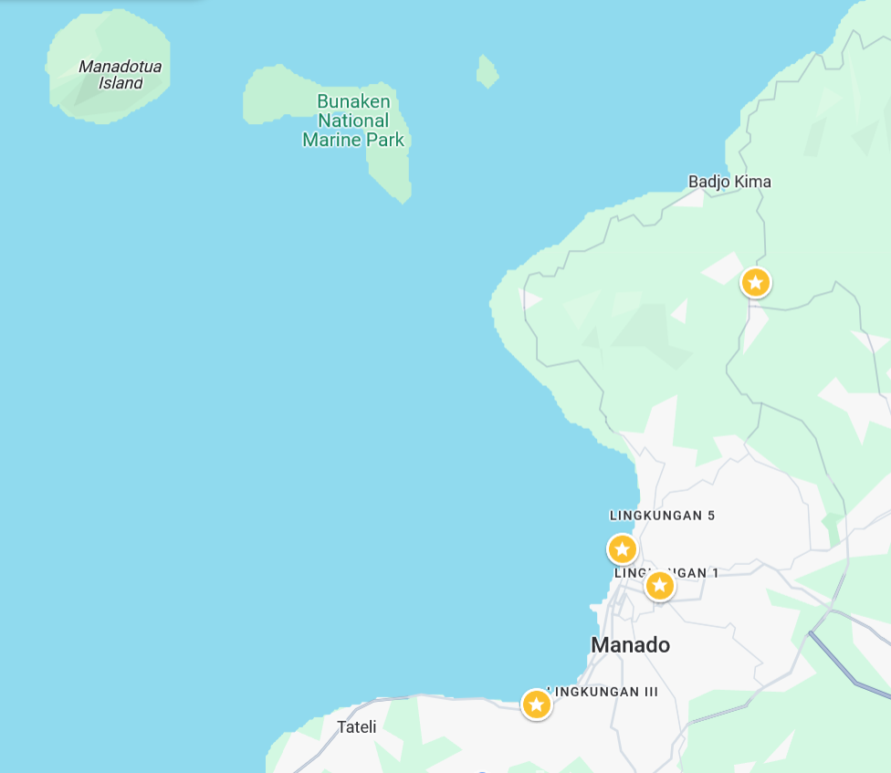
Population : 4.000 Inhabitants
Area : 8 km2
Density : 500 inhabitants/km2
Major occupation : Fisherman and small traders
Distance to City : 18 km

Slide 37
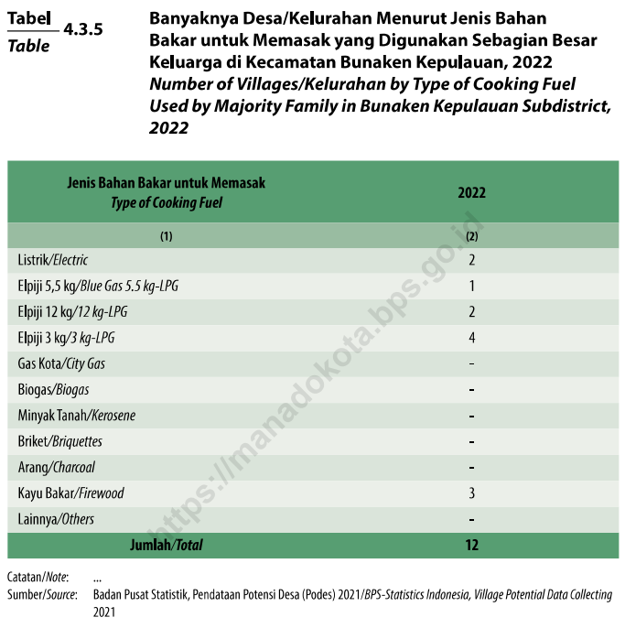
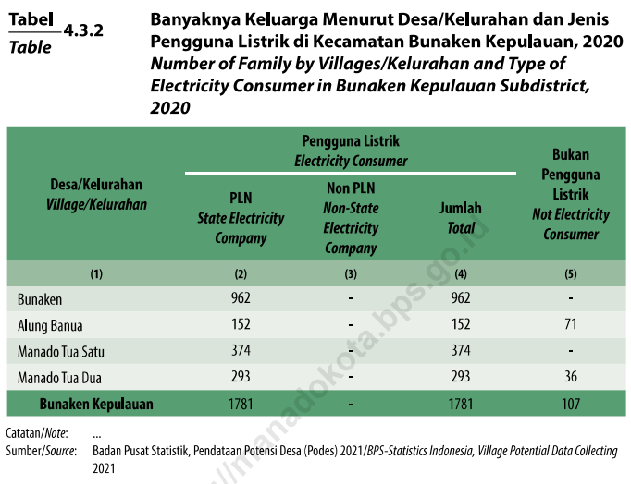

Slide 38

Thank You

