Slide 1
AI for Energy Programs and Policies Unveiled: Current Trends, Innovations, and Future Horizons
The Role of AI in Energy Programs and Policies
Haider Khan
VP Energy Analytics and Advisory
November 12, 2024
Notes:
In this presentation, we will explore the role of artificial intelligence (AI) in energy programs and policies. We will start with an introduction to AI and its benefits for the energy sector. Then, we will delve into the current trends and innovations in AI for energy. Finally, we will discuss the future horizons of AI for energy and its potential to transform the industry.

Slide 2
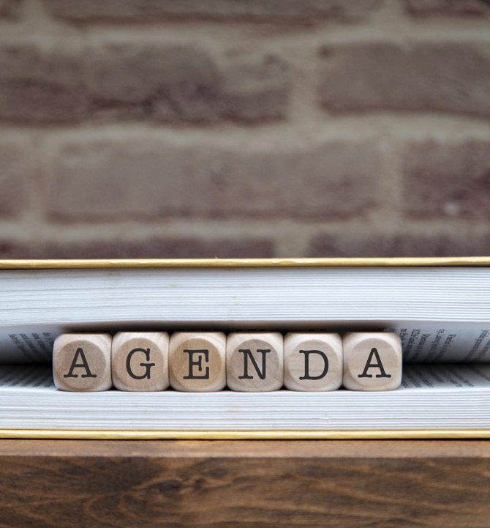
Agenda
Current Trends
Innovations
Future Horizons

Slide 3
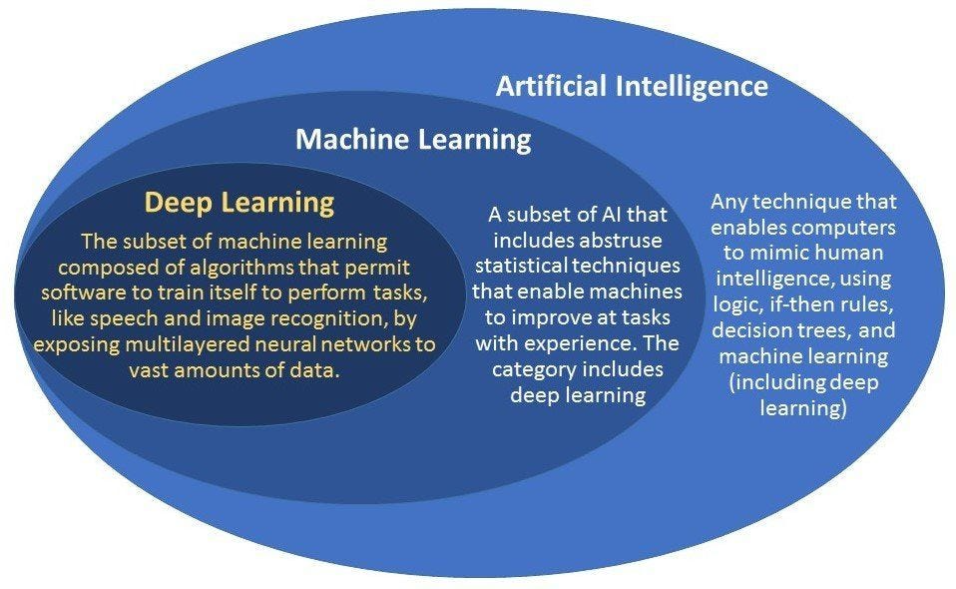
Current Trends
Notes:
Lets start with some definitions. Ed covered most of this so I wont spend a lot of time here. Overall, AI is a broad term that includes machine learning, deep learning large language models in it. to make sure we are all on the same page, AI is any technique that enables computers to mimic humans. E.g. if-then rules, regression trees, and deep learinng
Machine learning is a subset of AI that refers to statistical techniques that are used to enable machines to learn from past issues and improve over time.
Deep learning where all the AI hype is coming from is where you try to mimic organic brain function through creating an artificial neural network and exposing it a large amounts of data in hopes that it forms models that are generative in function.
I will now talk about how each of these are being applied to solve complex energy and evaluation problems.

Slide 4
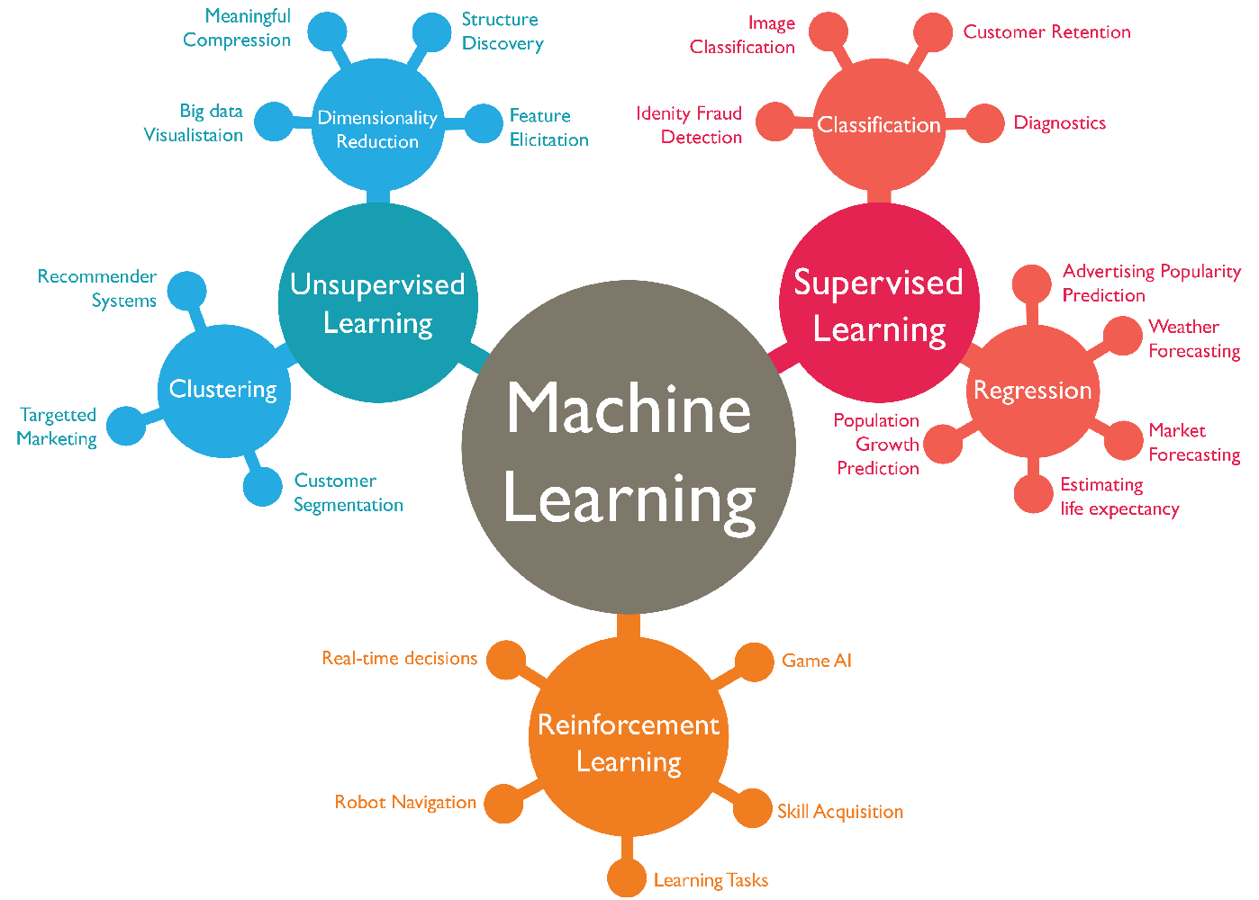
Current Trends – Machine Learning
Forecasting
On-going operation optimization
Evaluation
Notes:
Leverage large amounts of data and make inference
Forecasting: how much load on the grid is expected, who is likely to participate in a utility-sponsored customer program, how much solar generation is expected, energy trading,
On going operations:
energy management systems controls, renewable energy technologies, grid management, reliability, predictive maintenance
Evaluation
connecting forecasting to evaluation, and on-going operations to get better throughput.

Slide 5
Current Trends – Deep Learning
Large Language Models
Generative AI
  Create images, videos, documents
Use of Generative AI in Energy is becoming quite prevalent,
  specifically in marketing for customer programs – avatars
  Incentive processing
  Anomaly detection
  Energy reporting and evaluation filings
Notes:
Started from making pictures and videos of people that ended up with 6 fingers or 3 nostrils to a point where specialized tools are needed to determine if they were generated by AI
Image processing
Large Language Models
Generative AI
Digital Twins

Slide 6
Innovation
Digital Twin
Digital twin
Cloud Storage
Cloud computing / Artificial Intelligence
IOT
Notes:
Let me talk about an innovation that we have done leveraging AI that is helping us solve complex energy and evaluation problems, and its referred to as digital twins. Digital twins utilize a combination of machine learning and large language models to digitally represent the physical world in the best possible manner. Digital twins can be contructed in many different ways, but we are finding that using on data to create them leads to significant errors. We understand the physical world enough to represent it mathematically while ensuring the physical phenomenon such as heat transfer are taken into account. In our case, we leverage data, AI, and the physics of the system in our case the buildings for the demand side and the distribution, transmission, and generation for the supply side of the energy equation.

Slide 7
Innovation – Digital Twin
Forecast dispatch response
  Day ahead
  Hour ahead
Orchestrate dispatch
  Cohort similar buildings
  Dispatch to buildings that will minimally impact occupant comfort
Evaluate impact
  Read telemetry data to evaluate response of building
Improve forecast
  Apply learnings to improve digital twin
Notes:
An example of how we then use these digital twins for evaluation is represented in this slide. First we use the digital twins to simulate the how the building and the grid would react to the weather conditions in the next day or hour. Then we use the results of the simulations to orchestrate dispatch of signals that either lower or increase thermostat settings, or discharge or charge batteries, or inject or curtail power generation. We then evaluate using actual energy data right after the event how the system performed. We learn from the evaluation and apply the learnings to the digital twins and orchestration algorithms to improve the performance of the system.

Slide 8
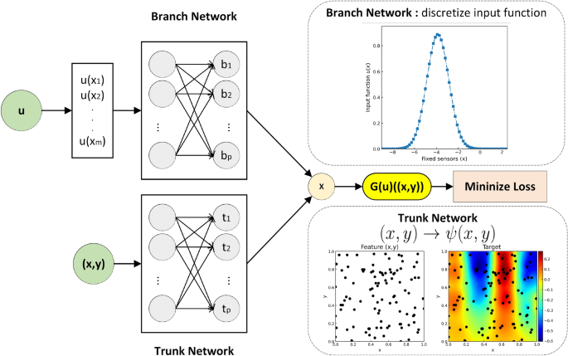
Future Horizons
Neural Operators
  Solving complex mathematical equations without the need for applying advanced computationally expensive numerical techniques
Notes:
Just a quick sneak peak on what is coming up in our industry in terms of AI. The digital twins that I talked about in the last two slides are created by leveraging AI and solving engineering equations that define laws of physics such as heat transfer, thermodynamics, and fluid dynamics. However these are complex equations that are computationally expensive to solve. A deep learning method is on the horizon that would enable us to solve these complex mathematical equations using AI called Neural networks. This would allow us to run the types of analysis that I talked about much more efficiently.

