Slide 1


QUICK TIPS TO ASSESS THE RISKS OF AI APPLICATIONS IN
MONITORING AND EVALUATION
Presented by Laura Gagliardone, UN Women Headquarters, Programme Coordinator Consultant
November 12th, 2024
Guidance Group

Slide 2
Artificial Intelligence (AI)…
May be defined as intelligence - perceiving, synthesizing, and processing information - demonstrated by machines, as opposed to human intelligence.
Adapts to meet users’ needs by analyzing usage patterns across diverse data sources or general guidelines within a vast information landscape.
Undertakes tasks requiring human intelligence, including visual perception, speech recognition, and language translation.
Is not a new phenomenon, having been utilized by organizations for over 30 years. Recently, however, there has been a surge of interest from multilateral organizations, governments, security and law enforcement agencies, academia, and the private sector in integrating AI into operations, including into the evaluation discipline.
Despite the operational benefits, AI applications pose risks.

Slide 3



What is the Issue?
AI has leveraged big data and datasets to inform decision-making through trend and pattern analysis.
AI has supported crisis identification and disaster preparedness (SDGs 11 and 13), revolutionized diagnostics and treatment in the health sector (SDG 3) and been instrumental in real-time monitoring and reporting in agriculture (SDG 2) and education (SDG 4).
The utilization of AI in M&E poses several risks, including:
Bias and Fairness: AI can inherit biases from the data they are trained on, leading to unfair outcomes.
Data Misinterpretation: AI may misinterpret data or produce misleading results if the input data are flawed, or the algorithm is not properly designed.
Privacy Concerns: AI may process sensitive personal data, raising concerns about privacy violations and unauthorized access.
Security Vulnerabilities: AI could be vulnerable to hacking, leading to data breaches or manipulation of evaluation results.
Ethical Dilemmas: AI may raise ethical dilemmas, such as the use of surveillance technologies or the potential for discrimination in decision-making processes.
Reliability and Robustness: AI may lack reliability or robustness, leading to errors or failures in evaluations.
Overreliance on Technology: Overreliance on AI could lead to a diminished role for human judgment and oversight, potentially undermining the quality and credibility of evaluations.

Slide 4

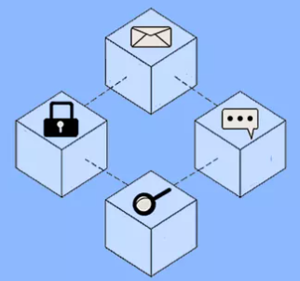



Examples of AI Applications Related to the M&E of SDGs Implementation
Web search engines like Google Search.
Generative or creative tools such as ChatGPT, ClaudeAI, Bard, or AILYZE.
Remote sensing and unmanned aerial vehicles.
Big data analytics for trend and correlation analysis in SDGs.
Blockchain technology for transaction tracking and enhanced resource allocation accountability.
Computer vision, including aerial photo analysis.
Natural language processing (NLP) for textual data analysis.
Machine learning for large dataset analysis of SDG indicators.

Slide 5



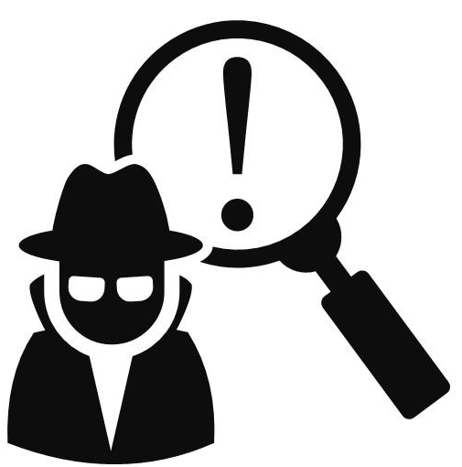
Examples of AI Applications Targeted to Development and Security Experts
Data management capabilities for processing and categorizing information and monitoring dataset access.
Risk mitigation through AI algorithms identifying behavior patterns related to past incidents.
Predictive analytics to analyze emergencies and threats, aiding in risk management and the development of early warning systems.
Fraud detection using machine learning models focused on text mining, social media analysis, and database searches to reduce fraud threats and streamline financial processes.

Slide 6

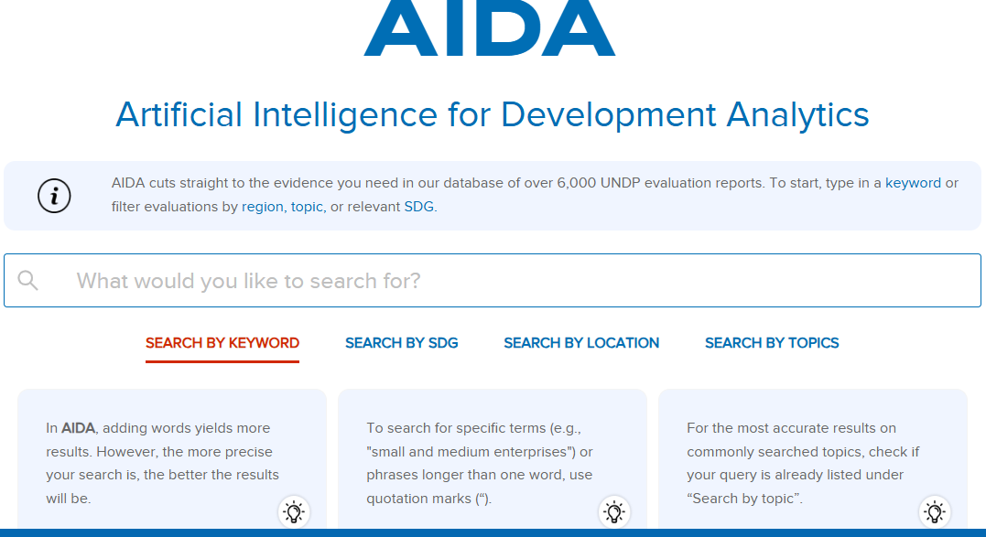
Featured AI Solutions

Slide 7
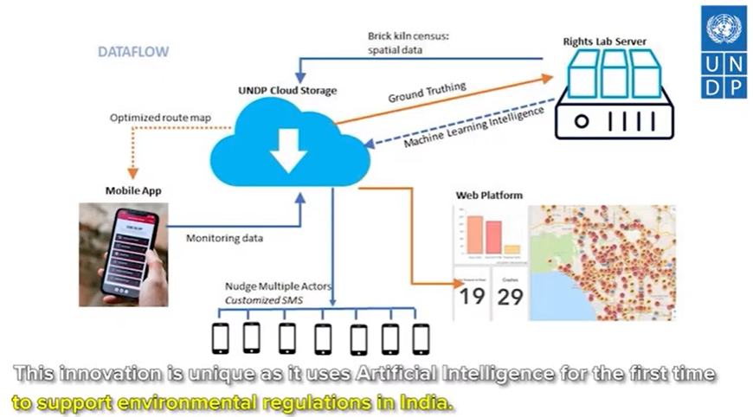
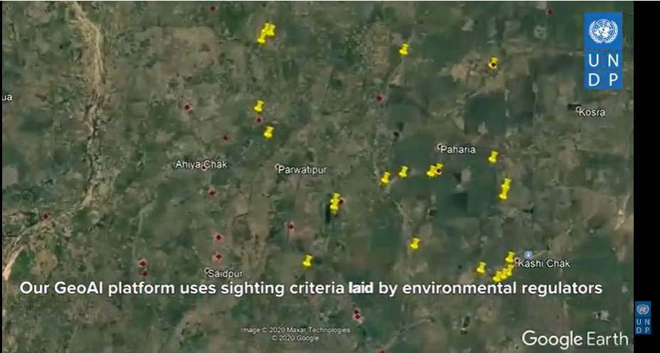
Featured AI Solutions
UNDP India Accelerator Lab in partnership with the University of Nottingham is developing the GeoAI platform to help environmental regulators act on non-compliant brick manufacturing units and address air pollution

Slide 8
Quick Tips to Assess the Risks of AI Applications in Monitoring and Evaluation
1. FRAMEWORK ANALYSIS
1.1 Review existing legal frameworks and regulations related to AI in your country. AI projects should comply with relevant laws, regulations, and ethical guidelines
1.2 Identify regulatory and reputational risks for your organization
1.3 Conduct a risk assessment based on current frameworks, trends, values, future goals, and objectives
1.4 Use it to determine what data you need to collect and how you want to analyze them and process information
1.5 Involve diverse stakeholders in the risk assessment process: AI developers, domain experts, policymakers, and end users
What are the frameworks, rules, regulations, values, and future goals and objectives of your organization?
2. DATA COLLECTION
2.1 Choose the datasets which are suitable for AI model processing and which ones to discard
2.2 Plan where you can find reliable and quality data
2.3 Check the data quality, integrity, and readiness. Choosing the right datasets influences the quality of results
2.4 Ethical considerations: address issues related to AI fairness, transparency, accountability, and responsibility
2.5 Consistently evaluate privacy and security to avoid data breaches or invasions of privacy
Are these the right datasets for a potential AI application?
What are the ethical considerations?
3. MODEL DEVELOPMENT
3.1 Consider whether the AI tools you are planning to utilize can concretely help monitor and evaluate the implementation of the SDGs
3.2 Review any regulatory limits on how AI can be used for certain processes
3.3 Assess how AI will help your organization advance the M&E of the SDGs implementation
3.4 Promote awareness about AI risks within the broader community discussions about the development and deployment of AI systems. Transparency in AI decision-making can build trust and mitigate risks
3.5 Consider costs and benefits for your organization, and the sustainability of the utilization of AI to conduct evaluations
Is this AI application suitable for your evaluation?
4. MONITORING AND EVALUATION
4.1 The implementation and use of AI must be constantly monitored, evaluated, and adjusted. It is critical to consider the changing needs of the organization, the possible drawbacks that this technology may present, and the global landscape
4.2 Evaluate the potential impact and likelihood of occurrence. Some risks may have low probability, but severe societal impact (intended or unintended / positive or negative)
4.3 Use evaluation findings and recommendations to prepare a catalogue of lessons learned and good practices on AI applications
Is the AI application effective, efficient, impactful, and coherent with the values, goals, and objectives of your organization?

Slide 9
Key Takeaways
AI IMPACT
AI enhances evaluations by analyzing data and informing decisions across various sectors.
RISKS
AI in M&E poses risks such as biases, privacy concerns, security vulnerabilities, and others.
MITIGATION
To address risks, implement ethical protocols, monitor AI performance, and maintain human oversight in M&E.

Slide 10
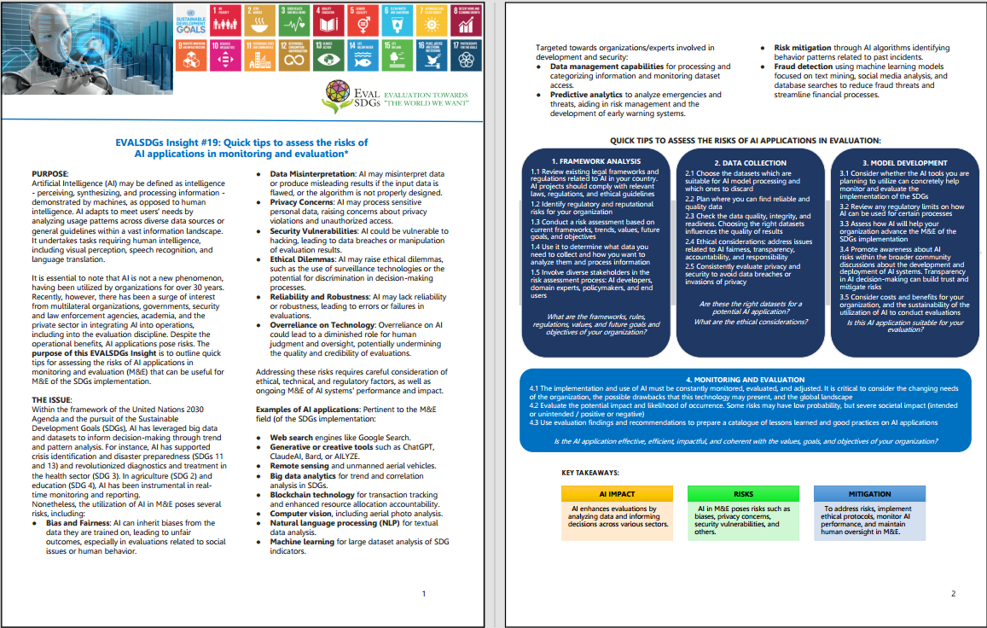
Thank You for Your Attention!
If you have questions or insights, please contact:
Laura Gagliardone
UN Women Headquarters, Programme Coordinator Consultant
EVALSDGs Member
Email: glaura.sorriso@gmail.com
Guidance Group

