Slide 1
Evaluation Lessons Learned from California and Massachusetts – the U.S. EE Leaders

Slide 2
Outline
Energy Efficiency Policy
Programs = Policy Implementation
Evaluation of Programs

Slide 3
California Policy
Massachusetts Policy
Public Utilities Code Section 381 (Public Goods Charge): Created by Assembly Bill (AB) 1890 in 1996
Established a Public Goods Charge (PGC) that consumers pay on electricity consumption for cost-effective energy efficiency, renewables, and research
Public Utilities Code Section 890 – 900 (Gas Surcharge): Created by AB 1002 in 1999
Established a natural gas surcharge to fund cost-effective energy efficiency and other public purpose programs
AB 32 (2006) required California to reduce its GHG emissions to 1990 levels by 2020
SB 100 (2018) requires 100% clean electricity by 2045
AB 1279 (2023) requires 85% emission reduction 2045
Pursuant to G.L. c. 25, §22, as set forth in the Green Communities Act (2008), the Energy Efficiency Advisory Council (“EEAC”) is charged with reviewing the state’s investor-owned electric and gas utilities' (Program Administrators or "PAs") energy efficiency investment plans and budgets (collectively, the “Three-Year Plan”), which is prepared in coordination with the EEAC.
In 2021, the Massachusetts passed An Act Creating a Next-Generation Roadmap for Climate Policy which requires the Electric and Gas Plans to collectively save at least 845,000 metric tons of CO2e in 2030.

Slide 4
Customer Energy Efficiency Programs
A wide range of state energy efficiency policies and program efforts are implemented through the utility sector and/or “public benefits” energy programs, which have the responsibility of administering and delivering electric and natural gas efficiency programs. These programs target numerous customer segments including residential and commercial buildings, industry, and agriculture. (ACEEE)
Including, but not limited to:
Direct monetary incentives for efficient technology
Market interventions to reduce retail costs or financing of efficient technology
Enhancement of energy codes and code enforcement
Training, education, and outreach supporting all the above
Research and technology development

Slide 5
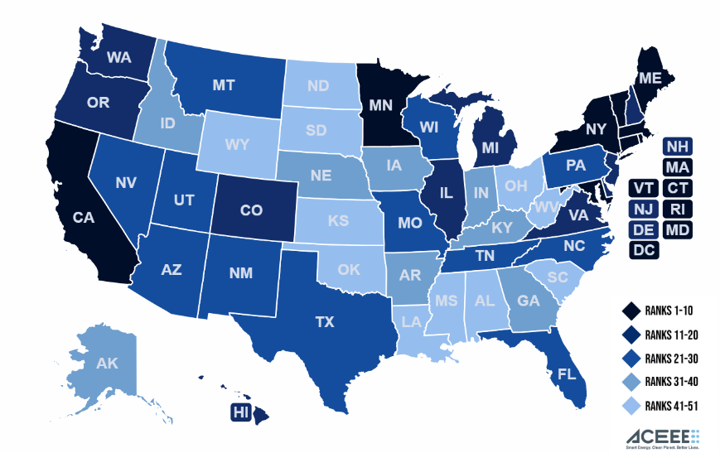
American Council for an Energy-Efficiency Economy

Slide 6


California
Massachusetts
The State Energy Efficiency Scorecard | ACEEE
2020-2022 #1
2017-19 #2
2016 #1 (Tie)
2011-2015 #2
2007-2010 #1
The State Energy Efficiency Scorecard | ACEEE
2020-2022 #2
2017-2019 #1
2016 #1 (Tie)
2011-2015 #1
2007-2010 #2

Slide 7
Strong Evaluation Frameworks
Both states built upon national and regional methods to prove and continuously measure progress to justify spending
IPMVP - Efficiency Valuation Organization (EVO) (evo-world.org)
The CA Evaluation Framework, which provides a consistent, systemized and cyclic approach for planning and conducting
The CA Energy Efficiency Evaluation Protocols, providing guidance to policy makers to plan and structure energy efficiency evaluation efforts.
Regional & National EM&V | Northeast Energy Efficiency Partnerships (neep.org)
SEE Action Evaluation, Measurement, and Verification Resource Portal | Department of Energy
Uniform Methods Project: Determining Energy Efficiency Savings for Specific Measures | Department of Energy
Energy Resources for State, Local, and Tribal Governments | US EPA

Slide 8
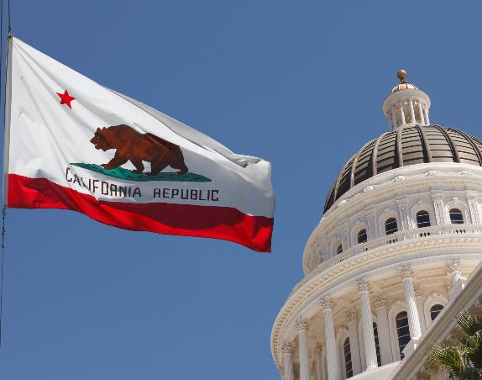
California Evaluations
California has led the nation in energy efficiency programs since the 1970s. Due to the state’s efficiency programs, per capita energy use has remained flat, while the rest of the US has increased by about 33 percent. (CPUC)
Evaluation Studies Public Document Search - view current master evaluation plan, search research plans, draft reports, and provide comments on active documents
CalMAC - California Measurement Advisory Council (CALMAC) - library of program evaluation and research reports on EE and other clean energy programs

Slide 9

Massachusetts Evaluations
Since 1977, Massachusetts widespread use of new technologies and implementation of the state’s building energy code supported, in part, observed declines in energy intensity. Investment in energy efficiency further increased in the last two decades.
Massachusetts Energy Efficiency Advisory Council
  Energy Efficiency Program Results & Reporting – MA Energy Efficiency Advisory Council (ma-eeac.org)
  Evaluation, Measurement, and Verification Studies – MA Energy Efficiency Advisory Council (ma-eeac.org)

Slide 10
Lessons Learned
Rigorous evaluation of the largest impact and largest budget programs ensure economic and emission goals
DATA
Well-tracked market interventions focusing on critical data collected before, during, and after the program continuously improve
A large part of most evaluations is gathering and cleaning data so it can be analyzed and interpreted
Qualitative contextual data always important even with Smart Meter data, realtime metering, and advanced analytics.

Slide 11
Lessons Learned
Behavioral programs with true experimental design have large scale proven savings
Large custom engineering retrofit projects and evaluation more critical after multiple market transformations – lighting, appliances, building codes
Increasing focus on details
  Distribution of impacts – who benefits, who does not?
  Emission impacts
  Recommendations for improvement
Upstream (manufacturer) and midstream (distributor or contractor) program models spurred innovations in evaluation methods originally geared toward downstream (end user)
Some impacts are incrementally too small (can be laboratory but not field measured) or do not persist long enough to be evaluated

Slide 12
Latest Trends
What’s Old is New
Embedded Evaluation
  Often used in pilot programs and for emerging technologies becoming more common for large scale programs
  Early engagement between program design and implementation and evaluation to define data needs
  Re-emergence of market transformation programs aligns with embedding regular measurement of market progress given long term goals that must fit into annual budget cycles
Process Evaluation
  Interviews to understand if program theory and logic can be supported by the market and available data
  Customer and market actor surveys to show where major gaps in awareness and education exist explain lower than expected uptake or impacts
  New program designs often come out of learning why traditional program designs are suboptimal

Slide 13
Questions?
Thank you for your attention
Jarred Metoyer, MSc.
Senior Vice President
Jarred.Metoyer@dnv.com

