Slide 1

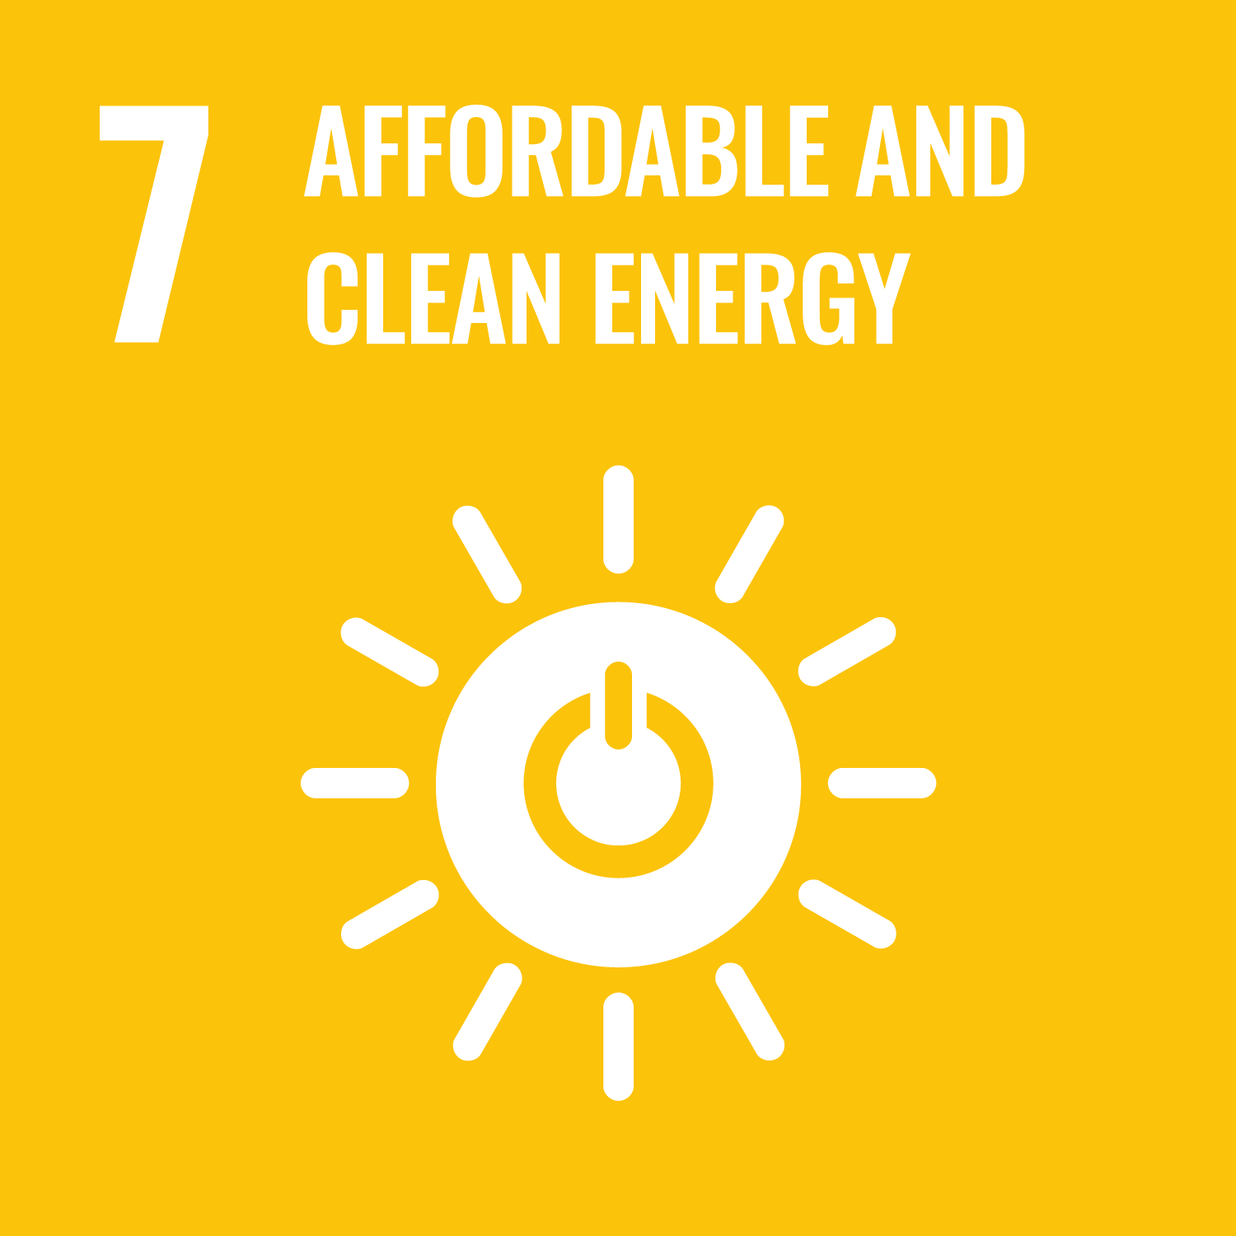

Evaluating SDG 7 progress in Asia and the Pacific
6 June 2024
Michael Williamson
Section Chief, Energy Division

Slide 2

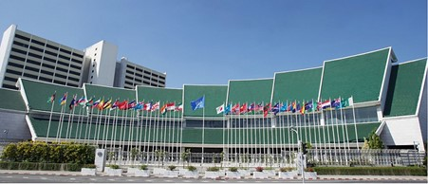
The Economic and Social Commission for Asia and the Pacific
The Commission promotes cooperation among its 53 member States and 9 associate members
The ESCAP secretariat supports inclusive, resilient and sustainable development by generating action-oriented knowledge, and by providing technical assistance and capacity-building services
59% of the world’s population
49% of global energy demand
57% of global fuel-related GHG emissions
The ESCAP secretariat supports countries in achievement of national development objectives and the implementation of the 2030 Agenda for Sustainable Development

Slide 3
Outline
How is the Asia-Pacific region progressing across the SDG 7 targets?
What are some of the uncertainties and challenges in measuring this progress?
Progressing multiple agendas - how sustainable energy is interlinked with other sectors.
A deep dive into energy efficiency - an interesting example of measurement and interlinkages.

Slide 4
1. How is the Asia-Pacific region progressing across the SDG 7 targets?

Slide 5
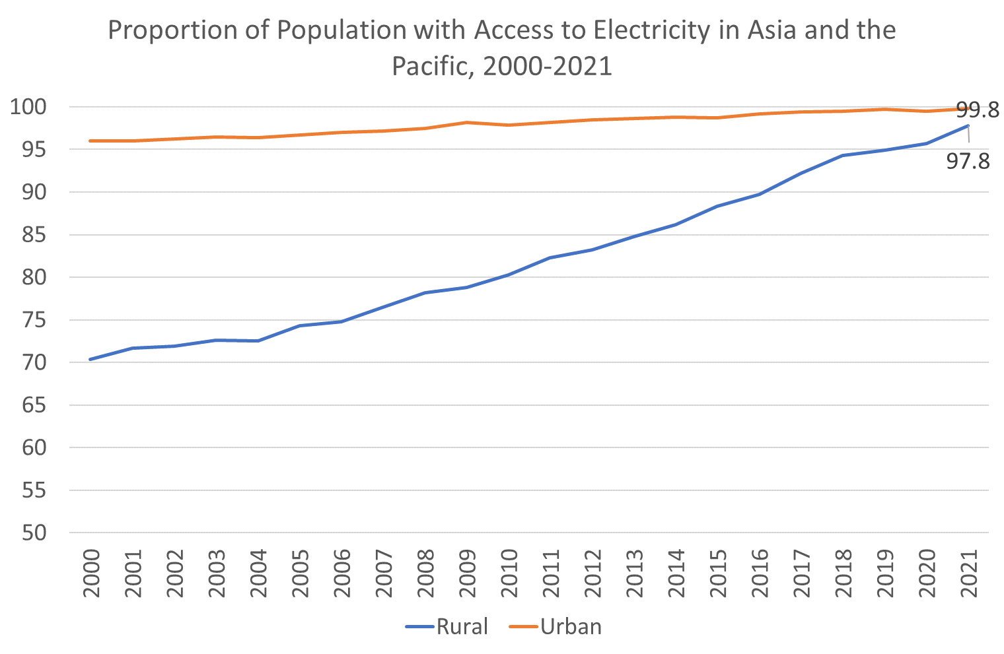
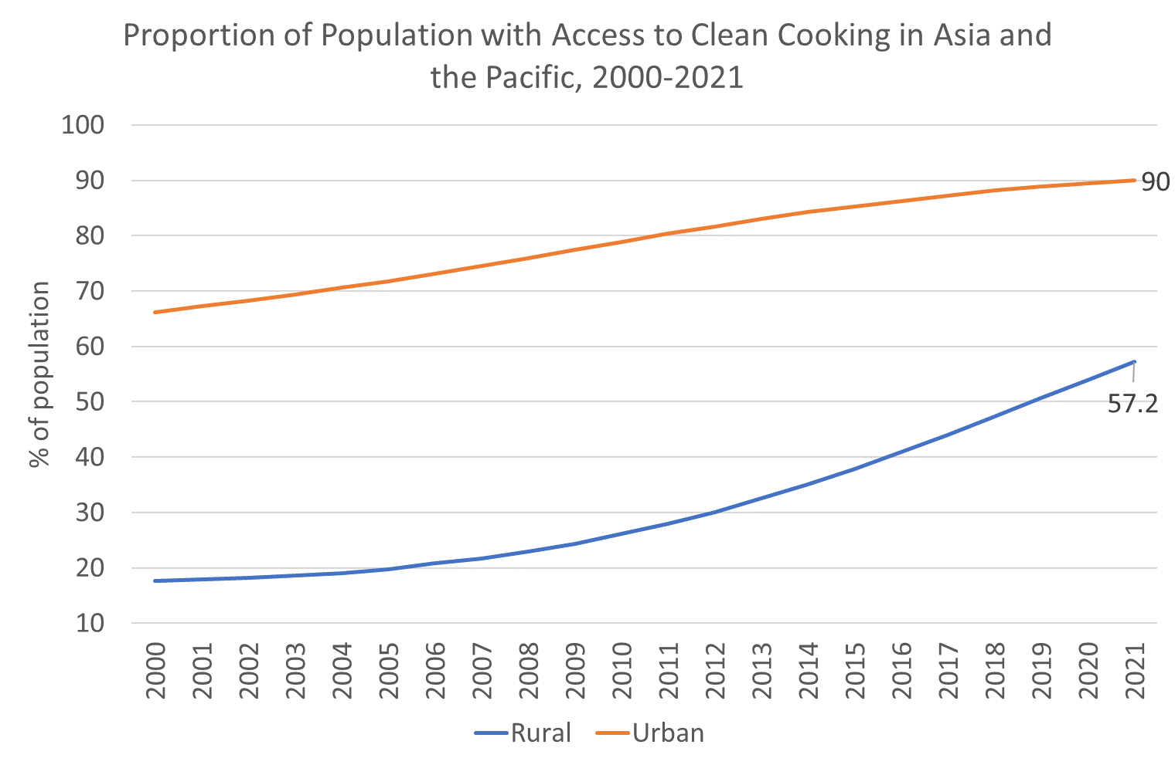
Energy Access – electricity progressing but clean cooking is lagging
98.6% overall
74.4% overall
Remaining electricity access gap in rural areas
Need to focus on quality, reliability and affordability of electricity
Clean cooking access is off-track, especially in rural areas

Slide 6


Driving factors: Electrification
National grid expansions and upgrades
Roll-out of off-grid solutions
More than 98 per cent of the regional population had access to electricity in 2021, up from 87.2 per cent in 2010.

Slide 7
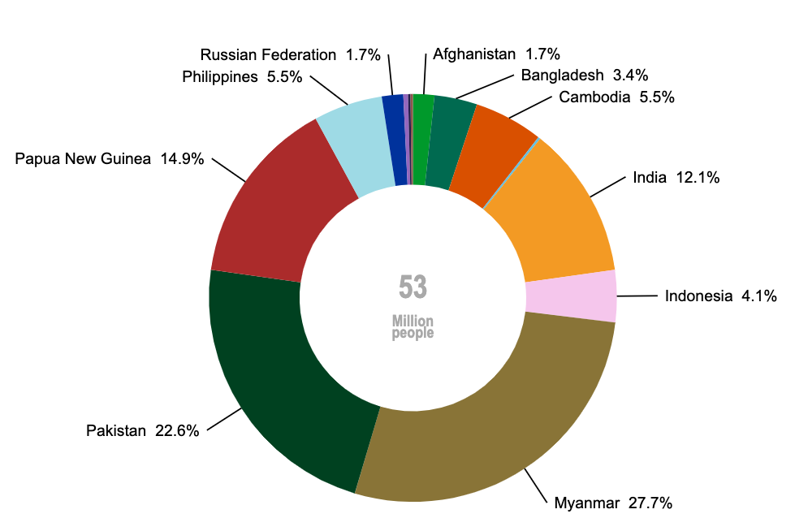
Population without access to electricity, 2021
Much progress. Most of the
53 million people without access to electricity live in just a few countries.
Observation # 1 – just 3 countries are home to 65% of the unelectrified population
Source: World Bank, United Nations Statistics Division

Slide 8
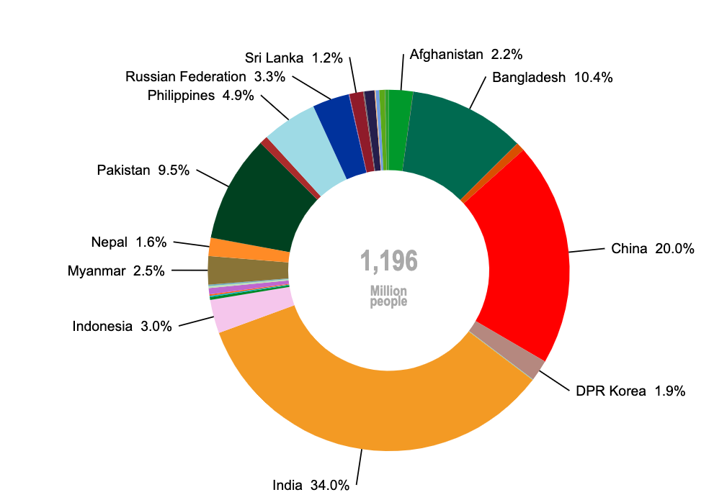
Population without primary reliance on clean cooking fuels and technologies, 2021
Lagging… nearly
1.2 billion
people continue to rely on unhealthy and polluting cooking fuels and technologies.
Observation # 2 – progress in urban areas has stagnated
Source: WHO, United Nations Statistics Division

Slide 9
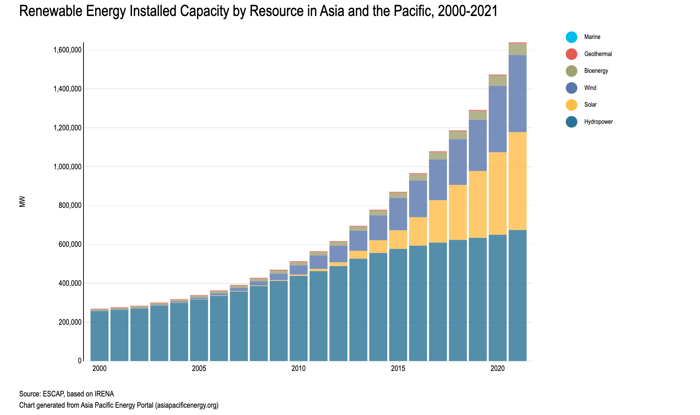
Renewable Energy – gaining… but not fast enough
RE share dropped steadily until 2011 when renewables share began to make a recovery, but has now plateaued.

Slide 10
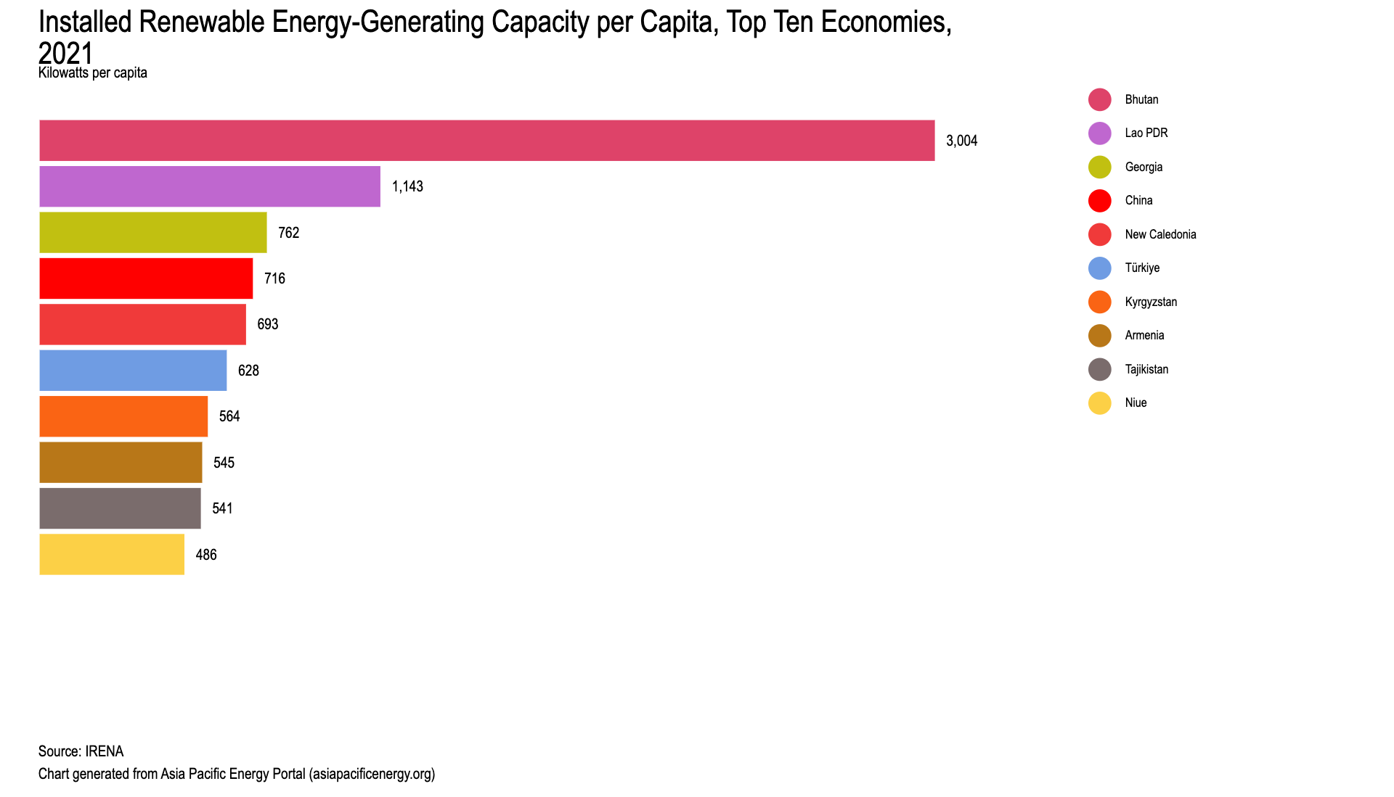
Renewable Energy – gaining… but not fast enough
Significant regional variation in renewable energy resource distribution

Slide 11
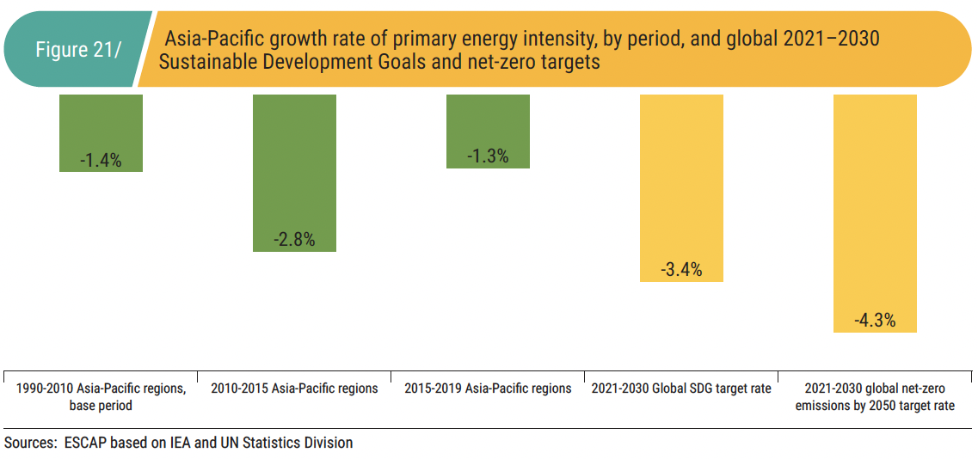
Energy Efficiency
Failing to keep pace… and slowing…
Energy efficiency measured by proxy – energy intensity ($ MJ /GDP) change
1990-2010
2015-2019
2021-2030
TARGETS
2010-2015
SDG
Net zero

Slide 12



Driving factors: Energy Efficiency
Electrification of end uses, including EVs.
Introduction of Minimum Energy Performance Standards (MEPS) and labelling.
Regional initiatives to harmonize MEPS and labels.
Bulk procurement of high-performance lighting and appliances.
Green buildings.
ESCOs.

Slide 13
2. Uncertainties and challenges in measuring SDG 7 progress

Slide 14
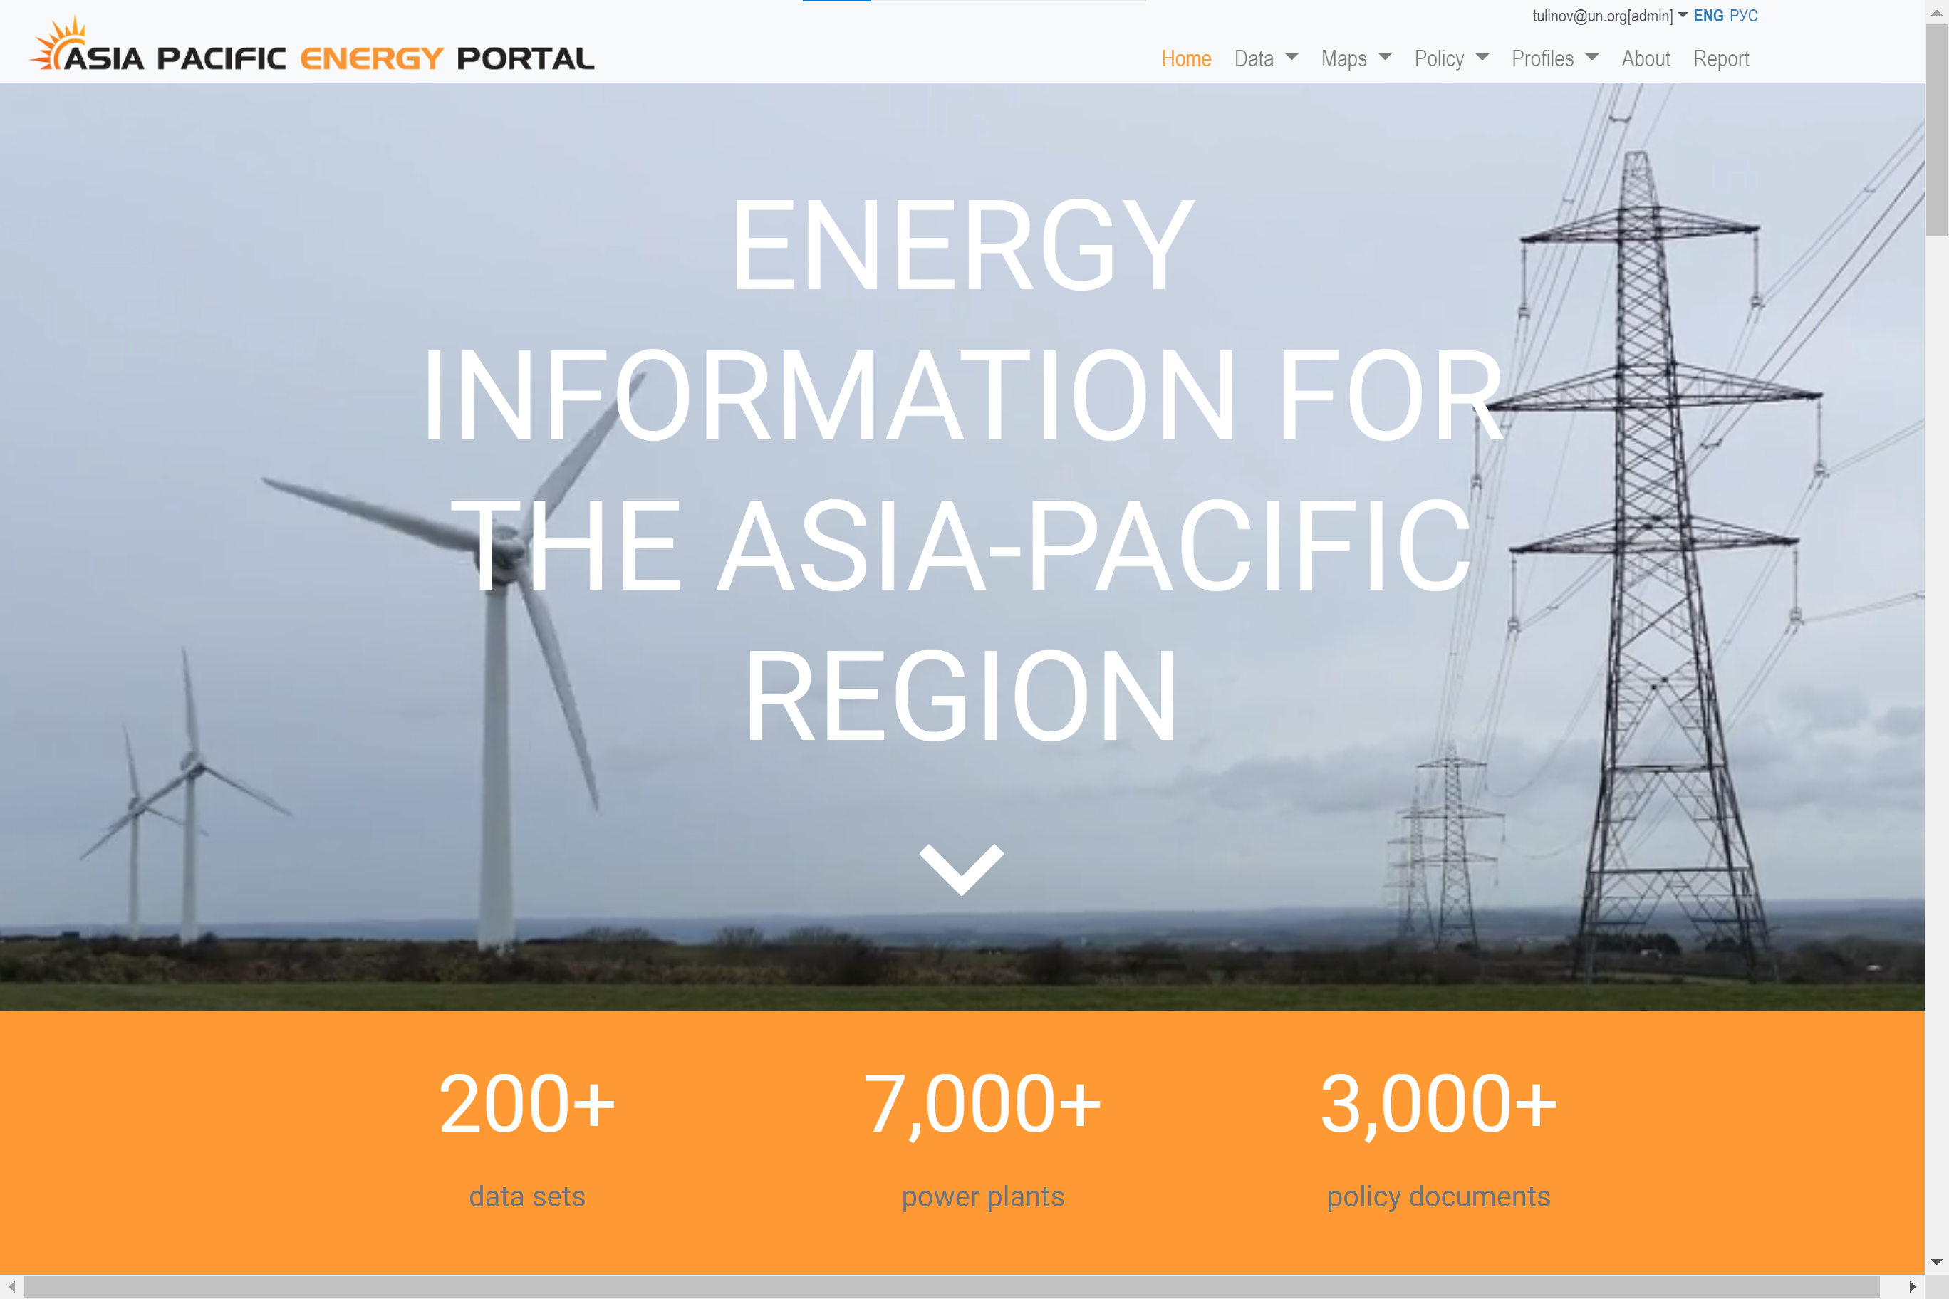
Lag in obtaining energy data through custodian agencies (Asia-Pacific Energy Portal currently 2021, 2022 forthcoming).
Energy access relies on survey data. Recalculation of previous years data points (energy access) can alter published analysis.
Regional averages disguise subregional and national dynamics.
Different ways of viewing renewable energy (modern renewables and traditional biomass).
Proxy indicator for energy efficiency ($GDP/MJ) may inadvertently capture other dynamics within the economy.

Slide 15
3. Progressing multiple agendas - how sustainable energy is interlinked with other sectors

Slide 16
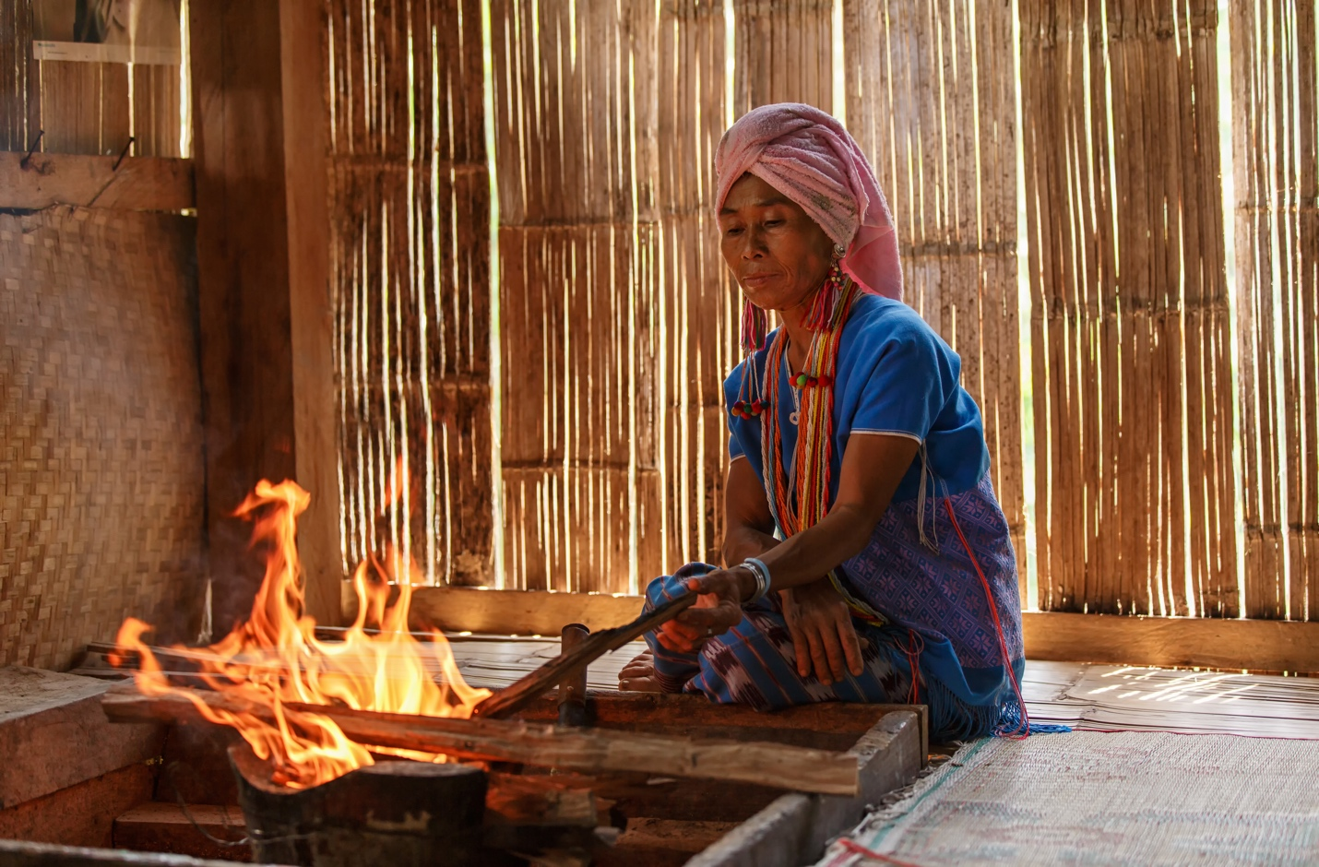
SDG 7 - three separate ideas in one goal:
  Ensure there is energy justice by giving everyone access to modern energy – leading to health and economic opportunities, poverty reducion.
  Make the best possible use of energy by being efficient – preserve resources, reduce harmful impacts and reduce costs.
  Use renewables to combat climate change and pollution, enhance efficiency, build social welfare (and many other reasons).
Measuring the ancillary benefits of energy is therefore relevant and important.

Slide 17
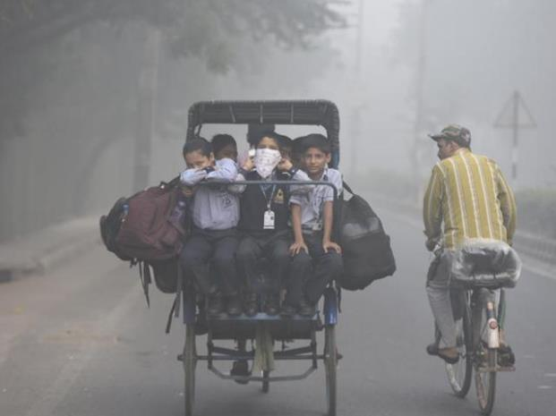
Energy is a means of meeting human needs, therefore its role is to enhance human physical and economic wellbeing.
Industrial scale fossil energy use - led to climate and environmental impacts - with planetary-scale consequences.
Transitioning to sustainable energy can address these challenges and generate co-benefits.
SDG 7 has more interlinkages across the 2030 Agenda than any other SDG.
How can these be measured at the national/regional level?
Image courtesy Hindustan Times

Slide 18
Wayan G. Santika, M. Anisuzzaman, Parisa A. Bahri, G.M. Shafiullah, Gloria V. Rupf, Tania Urmee,
From goals to joules: A quantitative approach of interlinkages between energy and the Sustainable Development Goals,
https://doi.org/10.1016/j.erss.2018.11.016 .
https://www.sciencedirect.com/science/article/pii/S2214629618308107)

Slide 19
4. A deep dive into energy efficiency - example of measurement issues and interlinkages

Slide 20
Issues/questions
Energy efficiency has lagged the target set under SDG 7.
We should be concerned as stalling progress means we have to catch up on lost time.
To what extent do we know what is happening within the energy intensity indicator?
Understand the significance of energy intensity “absolute value” and the “delta”.
What are the differences between country improvement rates and why?
External Factors (non-energy efficiency) Leading to Greater Energy Intensity
Extreme hot or extreme cold
Landlocked or sparsely populated (long distance for transport).
Extractive industries or heavy manufacturing vs. services, tourism, migrant labour.
High urbanization rate.
Development of thermal power

Slide 21
Advancing countries:
Regressing countries:
China
New Zealand
India
Thailand
Indonesia
Malaysia
Kyrgyzstan
Australia
Bangladesh
Japan
Tajikistan
Republic of Korea
Kazakhstan
Uzbekistan
Georgia
Viet Nam
Singapore
Armenia
Philippines
Turkiye
Sri Lanka
Pakistan
Nepal
Mongolia
Myanmar
Iran (Islamic Rep. of)
Azerbaijan
Russian Federation
Cambodia
Brunei Darussalam
Lao PDR

Slide 22
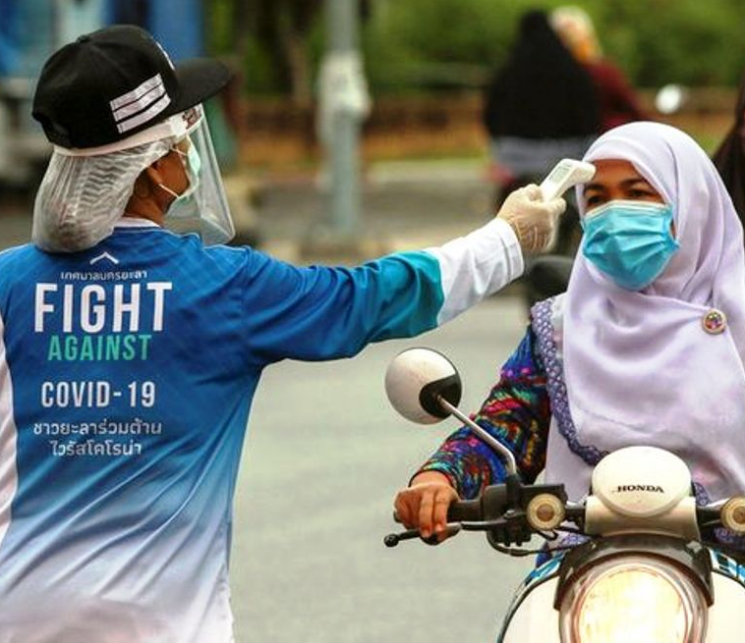
However, reality is more complex….
For example, COVID-19 upended economies in 2020-21.
GDP reduced (denominator), but level of energy use reduction (numerator) depended on economic structure (remittances, manufacturing, services, transport, heating)
numerator
ENERGY INTENSITY = Energy use (MJ)
GDP ($)
denominator

Slide 23
Illustrative case – Nepal COVID-19 impact
Covid-19 hits, migrant workers stop sending remittances, but energy use relatively unchanged

Slide 24
Conclusions
SDG 7 achievement is a “mixed bag” across the vast region that is the Asia-Pacific
Access to electricity is mostly on-track, but focus needs to be put on quality, reliability and affordability, while clean cooking requires increased policy attention.
Within each target there are a myriad of underlying issues that can surface through evaluation.
There are significant interlinkages and ancillary benefits of SDG 7 actions that need to be understood.
At the same time there are data gaps and measurement limitations that prevent us from gaining deeper insights.

