Slide 1
Quantifying the impacts of energy efficient heating: The Warmer Kiwis Programme
Caroline Fyfe
Arthur Grimes
Shannon Minehan
Phoebe Taptiklis
In partnership with:
Allen and Clarke
Massey University
University of Canterbury
University of Otago, Wellington
Victoria University of Wellington

Slide 2
Study design
Original study design: before/after natural experiment with 1 year follow up. However:
2021 recruitment suspended due to the community spread of COVID19 Delta variant
Supply chain issues meant not all 2021 cohort households had heat pump installed by Sep 2021.
Final study design: a cohort study using a DiD approach with 2 years follow up
Setting: an opportunistic sample of houses already signed up for a heat pump subsidy.
  164 households (437 people) were recruited across the three clusters
  56 households (34%) in Climate Zone 1 (Auckland)
  82 households (50%) in Climate Zone 2 (Waikato and Wellington)
  26 households (16%) in Climate Zone 3 (Christchurch)
Notes:
Fix highlighted bits

Slide 3


Study components
Data | 2021 Cohort | 2021 Cohort (ext) | 2022 Cohort
IAQ monitor (Indoor)
CliFlo (Weather)
Electricity
Survey 1 (before)
Survey 2 (after)
Survey 3 (subsequent)
Efergy

Slide 4
Data collection
House characteristics: window, roof, foundation type, glazing, shade, drainage, house age, size
Housing quality: Mould and damp, house condition, curtains, draughtiness
Indoor temperature, relative humidity, carbon dioxide, dew point, lux (half hourly)
Heating and ventilation behaviour, cold perception
Whole house electricity use (half-hourly) n=95
Heat pump electricity use (half-hourly linked and minute unlinked) n=20
Outdoor temperature and humidity
Wellbeing: Life satisfaction, WHO5, health
Demographics: Age, work/study status, sufficient income

Slide 5
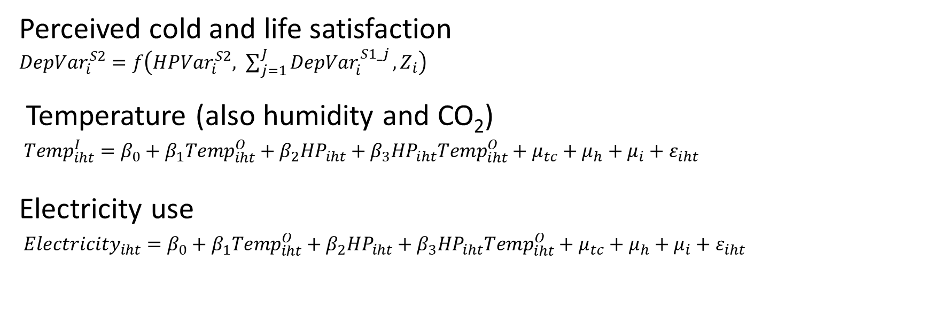
Equation specifications
Perceived cold and life satisfaction
${DepVar}_{i}^{S2}=f\left({HPVar}_{i}^{S2}, \sum_{j=1}^{J}{{DepVar}_{i}^{S1_j}}, Z_{i}\right)$
Temperature (also humidity and CO₂)
${Temp}_{iht}^{I}=β_{0}+{β_{1}Temp}_{iht}^{O}+β_{2}{HP}_{iht}+β_{3}{HP}_{iht}{Temp}_{iht}^{O}+μ_{tc}+μ_{h}+μ_{i}+ε_{iht}$
Electricity use
${Electricity}_{iht}=β_{0}+{β_{1}Temp}_{iht}^{O}+β_{2}{HP}_{iht}+β_{3}{HP}_{iht}{Temp}_{iht}^{O}+μ_{tc}+μ_{h}+μ_{i}+ε_{iht}$

Slide 6
After vs Before Surveys (DiD)
Wellbeing transitions
 | Worsened | Constant | Improved
Life satisfaction | 26 | 24 | 40
Cheerfulness | 18 | 38 | 30
Self-reported health | 17 | 53 | 21
Perceived cold | 4 | 12 | 76
Each cell shows difference in number of responses between houses with heat pump fitted vs houses with no heat pump fitted
Subsequent vs Before survey shows stronger self-reported health benefit:
- 21 improved vs 11 worsened; 42 constant
Regression evidence
Strong impact of heat pump installation in reducing perceived cold (robust across multiple specifications) [included in CBA]
Evidence (p<0.1) that time since heat pump installation positively impacts life satisfaction

Slide 7
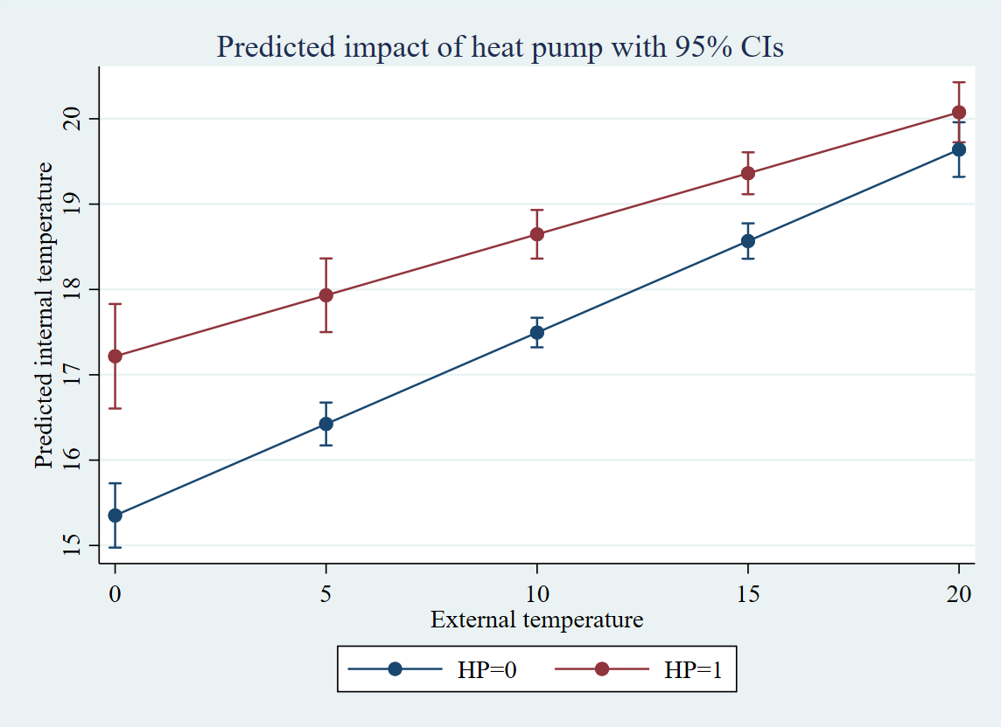
Modelled temperature impacts with & without heat pump (first winter)

Slide 8
Average temperature impact of heat pump by time of day (first winter)
[all significant at p<0.01]

Slide 9
Relative humidity and CO₂ impacts of heat pump (first winter)
Heat pump reduces indoor relative humidity (p<0.01) by:
  ~ 5% of its mean,
  ~ 30% of its standard deviation
  Reduction in indoor humidity is greatest when outdoor humidity is high
Heat pump installation also associated with reduction in indoor CO₂
  Possibly due to greater ventilation if living area door left open

Slide 10
Electricity use impact of heat pump by hour of day (first winter)
Overall impact is 16% reduction (p<0.05) across a full winter’s day (p<0.05 for 7pm – 9pm)

Slide 11
Cost benefit analysis

Slide 12
Cost benefit analysis
Cost benefit analysis of WKH programme was undertaken from:
  a fiscal (government level) perspective
  a societal (population level) perspective.
Base case scenarios:
    5% discount rate to calculate net present value (NPV) of future costs and benefits
    75% additionality,
    fiscal multiplier of x1.2 on government expenditure

Slide 13
Costs
Insulation (80% EECA) fiscal
Insulation (20% householder) societal
Administration insulation fiscal
Insulation incentive fiscal not societal
Heat pump (80% EECA) fiscal
Heat pump (20% household) societal
Heat pump servicing societal
Administration heat pump fiscal
Opportunity cost of next best alternative heater societal negative cost

Slide 14
Benefits
Hospital admissions avoided fiscal
Pharmaceutical prescriptions avoided fiscal
Pharmaceutical prescriptions avoided societal
Increase in survival societal
Net change in wellbeing (perceived cold) societal
Days off work due to sickness societal
Days off work caregiving societal
Days off school due to sickness societal
GP visits avoided societal
Net change in CO2 from difference in kwh electricity consumed societal
Average change in electricity consumption societal

Slide 15
Assumptions
Costs and benefits based on 2021 prices
The heat pump lasts 10 years (length of warranty) at 100% efficiency
The next best alternative lasts 10 years at 100% efficiency
Insulation lasts 30 years at 100% efficiency
Heat pumps installed only in fully insulated houses
Benefits remain consistent for the life of the heat pump and insulation
No extra reduction in days off work/school from heat pump in addition to insulation
Time off work to care for child only required if all adults in household work
Survival increases only for those >65 years with pre-existing circulatory condition
Number of GP visits required equals number of prescriptions dispensed

Slide 16
CBA Outcomes: Base case scenario
Base case BCR | Societal perspective | Fiscal perspective*
Whole programme: wellbeing/ energy benefits | 4.36
Whole programme: health/ energy benefits | 1.89 | 0.80
Heat pump: wellbeing/energy benefits | 7.49
Heat pump: health/energy benefits | 2.15 | 0.52
Insulation: wellbeing/energy benefits | 3.51
Insulation: health/energy benefits | 1.78 | 0.98

Slide 17
CBA Outcomes: Sensitivity analysis
Societal BCR | 2% discount rate | 50% additionality | 100% additionality | $150 p.a. service cost
Societal BCR
Whole programme: wellbeing/energy | 5.70 | 4.11 | 4.29 | 4.15
Whole programme: health/energy | 2.44 | 1.78 | 1.96 | 1.80
Heat pump: wellbeing/energy | 8.46 | 7.27 | 7.60 | 6.96
Heat pump: Health/ energy | 2.43 | 2.09 | 2.18 | 2.00
Insulation: wellbeing/energy | 4.97 | 3.48 | 3.52 | 3.51
Insulation: health/ energy expenses | 2.42 | 1.77 | 1.79 | 1.78
Fiscal BCR
Whole programme: health/energy | 1.09 | 0.77 | 0.81 | 0.84
Heat pump: Health/ energy | 0.59 | 0.51 | 0.52 | 0.52
Insulation: health/ energy expenses | 1.39 | 0.95 | 1.00 | 0.98

Slide 18
Houses are warmer
Even in winter and spring
Heat pumps are worth it

