Slide 1
Evaluating the Māori and Public Housing Renewable Energy Fund: Interim findings from the first winter
Phoebe Taptiklis, Rangimaria Aperahama & Euan Richardson

Slide 2
Public and Māori Housing Renewable Energy Fund
28 million dollars was made available from Covid-19 resurgence funding
Contestable fund means communities developed their own solutions.
Half of the fund goes to State-owned (public) housing, for low-income
tenants.
The other half is available to Māori (indigenous) organisations which
provide housing for their communities.
Many indigenous communities have shared land and house ownership
which can limit their access to finance.
Solar is the majority of solutions, but there are also geothermal and wind

Slide 3
Public and Māori Housing Renewable Energy Fund
Objectives: To improve energy affordability and create warm healthy
and energy efficient homes

Slide 4
Mixed methods – Quant
Quantitative stream uses a “before and after” data collection process
to understand changes to households in terms of:
Electricity use (energy audit and EA records)
Affordability (bills, and household income perception)
Health (colds and flu and days off work/school), and
Wellbeing (life satisfaction, WHO5, satisfaction with house)
Survey includes an energy audit in survey form.
Temperature measurements over 12 months in a subset of houses.
Historical electricity use records are obtained via the Electricity
Authority Registry Hub.

Slide 5
Mixed methods - Qual
Includes case studies which use a more exploratory interview style
to understand community and householders experience.
Qual and Quant streams focus on different communities/projects.
Research is ongoing until 2026

Slide 6
Electricity Authority Data Registry
The Registry system is intended primarily to enable consumers
to switch electricity retailers
The Electricity Authority works primarily to integrate the electricity
System while allowing each participating member (electricity
generators and suppliers) to maintain commercial privilege over their
business decisions such as pricing and management.
Providing data to researchers is a nice consequence of these two
Goals, but is not a specific goal in itself.

Slide 7
Cliflo data
Government-owned weather stations send data to a publicly
accessible database.
In some locations, this is available at hourly increments, allowing us
to match electricity use data with outdoor temperatures.
Data used: Hourly maximum temperature (Tmax)

Slide 8
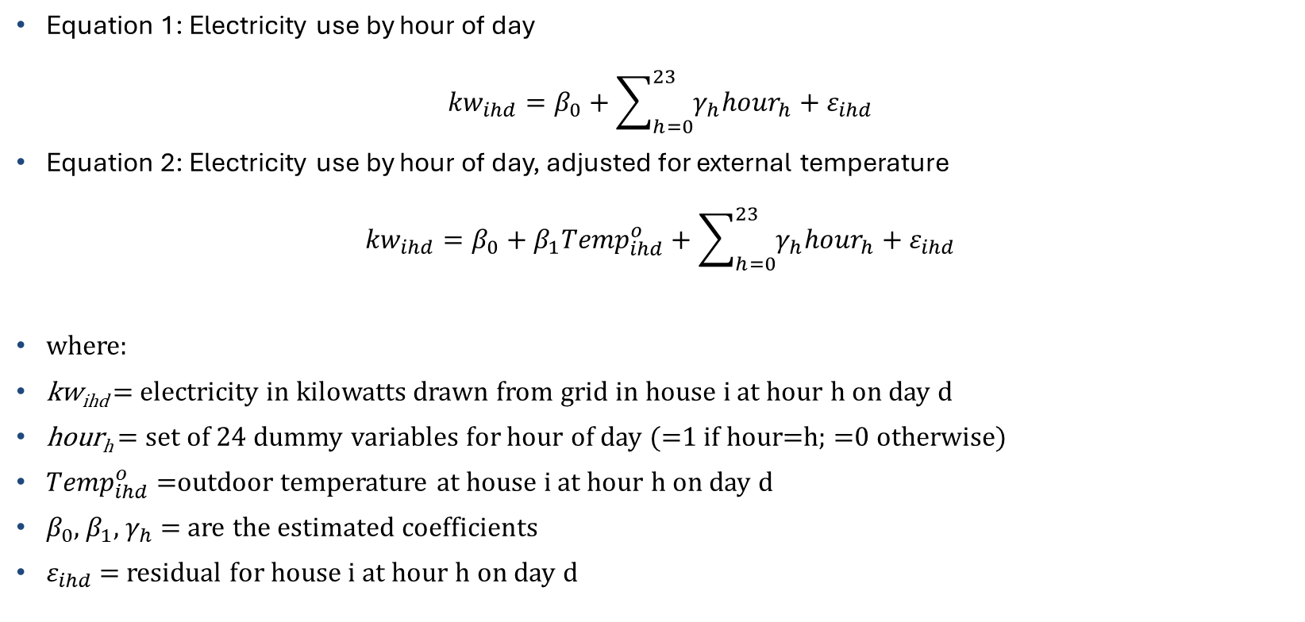
Analysis specifications:
Equation 1: Electricity use by hour of day
$${kw}_{ihd}=β_{0}+\sum_{h=0}^{23}{γ_{h}{hour}_{h}}+ε_{ihd}$$
Equation 2: Electricity use by hour of day, adjusted for external temperature
$${kw}_{ihd}=β_{0}+β_{1}{Temp}_{ihd}^{o}+\sum_{h=0}^{23}{γ_{h}{hour}_{h}}+ε_{ihd}$$
where:
kw_{ihd} = electricity in kilowatts drawn from grid in house i at hour h on day d
hour_{h} = set of 24 dummy variables for hour of day (=1 if hour=h; =0 otherwise)
${Temp}_{ihd}^{o}$ =outdoor temperature at house i at hour h on day d
$β_{0}$, $β_{1}$, $γ_{h}$ = are the estimated coefficients
$ε_{ihd}$ = residual for house i at hour h on day d

Slide 9
Equation 1: EA data only
9 households, June 2022
The same 9 households, June 2023 with solar and battery installed

Slide 10
Equation 2: EA data adjusted with Cliflo data

Slide 11
Conclusions from early results
On average, total household electricity draw down from grid is
reduced by half, despite short daylight hours.
Evening peaks are significantly reduced, almost entirely, suggesting
that solar power is making a significant contribution to keeping warm.
In future analyses we will assess whether households with PV, but
without batteries are able to reproduce these reductions in evening
electricity costs.

Slide 12
Thank you
If you would like to discuss any of the issues in this presentation,
Feel free to contact me on
Phoebe.Taptiklis@motu.org.nz

