Slide 1
Presenter Fayyaz Ahmed Fayyaz
MEL Coordinator Mercy Corps Pakistan
Member of evaluation team of expert Madiba group Germany
Evaluation of SDG7
Towards Sustainable Energy for All

Slide 2
Ensuring Universal Energy Access & Advancing Just, Inclusive & Equitable Energy Transitions
Prepared by : SDG7 TAG
Policy Briefs In Support of The UN High-level Political Forum 2023

Slide 3
Key Updates
.675 billion people (9%) were still without access to electricity in 2021
2.3 billion people (29%) lacked access to clean cooking solutions in 2021.
1.2 billion people (15%) –Asia and the Pacific region were without access to clean cooking solutions in 2021.
Only 5.1% of the Arab region’s total final energy consumption was generated by renewables in 2020.
The rate of energy intensity improvement has slowed in recent years and dropped to 0.6% in 2020.
Worst year for energy intensity improvement since the global financial crisis.
International public financial flows in support of clean energy in developing countries stands
at 10.8 billion $ in 2021, 35% < 2010–2019 average and only about 40% of the 2017 peak of US$ 26.4 billion.

Slide 4
SDG-7 Target Tracker
SDG7.1: Ensure universal access to electricity and clean cooking solutions.
SDG7.2: Substantially increase the share of renewable energy in the global energy mix.
SDG7.3: Double the global rate of improvement in energy efficiency.
SDG7.A: Enhance international cooperation to facilitate access to clean energy research and technology, and promote investment in energy infrastructure and technology.
SDG7.B: Expand infrastructure and upgrade technology for supplying modern and sustainable energy services for all in developing countries.
Of the 140 SDG targets that can be evaluated, only about 15% are on track & too few SDG 7 targets are among them

Slide 5
Advancing SDG-7 Implementation In Support of the 2030 Agenda
Contributing organizations:
International Energy Agency (IEA)
International Renewable Energy Agency(IRENA)
United Nations Statistics Division (UNSD)
The World Bank
The World Health Organization (WHO)

Slide 6
Key Messages
SDG7 Policy Brief is based on the 2023 edition of Tracking SDG7
Energy Progress Report reviews current progress on the key targets of SDG7.
Guide for further policymaking aimed at realizing the SDG7 goal of universal access to affordable, reliable, sustainable and modern energy by 2030.
Findings year’s edition reveal, despite the use of innovative policies and technologies, recent results show that the world is still falling short of achieving those SDG7 goals.
Particularly so in the field of access to affordable and sustainable energy.

Slide 7
Key Messages
Robust frameworks of indicators and statistical data are essential elements in this collaboration.
Cooperative work on accurate data and statistics by the SDG custodial agencies provides transparency with respect to trends, helps track progress towards policy goals and assists in tackling policy issues and determining actions.
Report published by SDG7 custodian agencies: the IEA, IRENA, the UNSD, World Bank & WHO
Provide International community with a global dashboard showing progress on energy access, energy efficiency, renewable energy and the international cooperation undertaken to advance SDG7.

Slide 8
Priority actions recommended for Asia & Pacific Region over 3 years
Increase access to electricity in underserved areas by investing in off-grid and mini-grid solutions that utilize renewable energy sources to reach the last mile.
Implement policies and regulations that support the deployment of clean cooking technologies, such as electric cookstoves, liquefied petroleum gas (LPG) and sustainable bioenergy, reducing reliance on traditional biomass fuels.
Encourage the adoption of energy-efficient appliances and lighting systems through consumer education campaigns and financial incentives.
Promote the development of local renewable energy markets by providing policy and regulatory support and improving access to financing, with a focus on the heat and transport sector.

Slide 9
Priority actions recommended for Asia & Pacific Region over next 3 years
Strengthen regional cooperation and knowledge-sharing to enhance energy security and increase the use of renewable energy sources.
Strengthen national and regional grid infrastructure to improve the reliability of modern energy services and accommodate larger shares of variable renewable energy.
Enhance the availability and quality of energy data and information to support evidence-based decision-making and monitoring of progress towards SDG7.

Slide 10
PROGRESS TOWARDS ACHIEVING
SDG7.1: Ensure Universal Access to Electricity & Clean Cooking Solutions
Access to electricity
Between 2016 and 2021, almost 380 million people gained access to electricity in the Asia and the Pacific region. Over this period, the region’s population increased by 180 million, leading to a rise in the rate of electrification from 94.0 per cent to 98.6 per cent.
In 2021, urban access rates reached 99.8 per cent, while rates in rural areas reached 97.7 per cent.
However, there are a number of challenges with tracking electrification progress, particularly given limitations in household survey data coverage. The binary view of electricity access adopted by SDG7 can obscure important considerations such as affordability, quality, reliability and ultimately, the sustainability of electricity supply.

Slide 11
SDG7.1: Ensure Universal Access to Electricity & Clean Cooking Solutions
PROGRESS TOWARDS ACHIEVING
Priority targets access to electricity
Reaching end-of the-line and off-grid households with affordable, adequate and reliable electricity remains the greatest challenge to the achievement of universal access across the region.
Both the long-term sustainable operation of rural decentralized systems and the provision of energy access to more than the lowest-tier households have proved difficult in some contexts.

Slide 12
PROGRESS TOWARDS ACHIEVING SDG7
SDG7.1: Ensure universal access to electricity and clean cooking solutions
Clean Cooking
Between 2010 and 2021, the regional rate of access to clean cooking rose from 51.1 per cent to 73.9 per cent.
That meant that in 2021, almost 1.2 billion people – nearly one quarter of the population of the Asia and the Pacific region – were without access to clean cooking.
This is despite the fact that progress in expanding access to clean cooking has been quite significant over the last decade. The annual rate of increase in access between 2010 and 2021 was 120 million people – a figure three times the size of population growth, which was 41 million.
Priority targets
To bridge the gap and achieve the SDG7 target, radically increased investment in the promotion and adoption of clean cooking solutions is required.

Slide 13
SDG:7.2 Substantially Increasing the Share of Renewable Energy in Global Energy Mix
Recent progress
Climate change and the growing affordability of renewables are driving many countries to focus their national energy development plans on renewable energy.
Yet, although renewable energy installations are increasing in number, they still constitute a relatively small share of total energy consumption in many countries, due to the overall growth in energy demand. In 2020, modern renewable energy accounted for 12.5 per cent of total final energy consumption (TFEC) in the region. This pushed the overall share of renewables – including both modern and traditional forms – to its highest level so far, at 19.1 per cent.
Since 2020, the combined installed capacity of wind and solar has surpassed that of hydropower, with solar energy in particular experiencing rapid growth. In 2021, the Asia and the Pacific region’s solar installed capacity reached 485 gigawatts (GW), representing a significant increase – approximately 19 per cent – on the previous year.
Renewable energy auctions have been instrumental in driving the adoption of wind and solar power, leading to increased investment and reduced costs in the region.

Slide 14
SDG7.2 Priority Targets
The current rate of progress is not enough to meet the growing demand for renewable energy. Though modern renewables have become a cost effective option on a global basis, the lack of relevant policies to support their rollout as well as the lack of technical and financial capacity, are significant barriers for many countries to achieve the necessary level of renewable energy deployment.
To overcome these challenges, there needs to be increased technical and financial support on a larger scale. This is essential to ensure that all nations can enjoy the benefits of clean energy and that the transition is fair and equitable.

Slide 15
SDG7.3: Doubling the global rate of improvement in energy efficiency
Recent Progress
The annual improvement rate of primary energy intensity in Asia Pacific slowed to 1.3 per cent between 2015 and 2020, compared to the 2.8 per cent level seen during the 2010–2015 period.
Unfortunately, at these levels, the pace of improvement in energy intensity in the region is not keeping up with the 2010–2030 global target rate of 2.6 per cent. In fact, from 2020 to 2030, the region now needs to accelerate its annual energy intensity improvement rate to 3.2 per cent if it is to meet the SDG7.3 target.
Many smaller countries are not achieving sufficient improvement, and this means that further policy attention in this area is required.
Priority targets
Achieving the global SDG7.3 target will require significant scaling up of energy efficiency policies and investments. There are several challenges to achieving this, however. These include low prioritization, limited identification of opportunities, insufficient policy and regulatory support, financing hurdles and inadequate awareness of the benefits of energy efficiency.

Slide 16
Policy Implications & Recommendations
The Asia-Pacific region continues to make notable efforts towards achieving the SDG7 targets, particularly in terms of increasing access to electricity.
Yet, the countries of the region are still falling short on achieving many other aspects of this SDG7.
Greater momentum is required to close the gap in universal access to electricity and to promote clean cooking fuels and technologies.
It is also required to accelerate the deployment of renewable energy and to increase its share in the national energy mix.
Furthermore, greater momentum is also needed in scaling up energy efficiency and electrification in end uses.

Slide 17
Recommended Actions on Priority
Improve enabling environments for clean energy development
Use connectivity as a tool for supporting the energy transition
Mobilize investment and finance
Ensure a just energy transition

Slide 18
Evaluation Community in Asia at squint
Challenges
Opportunities
Vision

Slide 19
1. Challenges
Evaluation experience is limited in most economies in Asia
  Government initiatives (outside of investment banks) often do not include evaluation
  Action plans or policy often focus only on implementation of policies and programs
  Funding of data collection and evaluation of programs and policies is often not available or of low priority
  Expertise (trained evaluators) is often limited
  Evaluation data are often lacking or not standardized

Slide 20
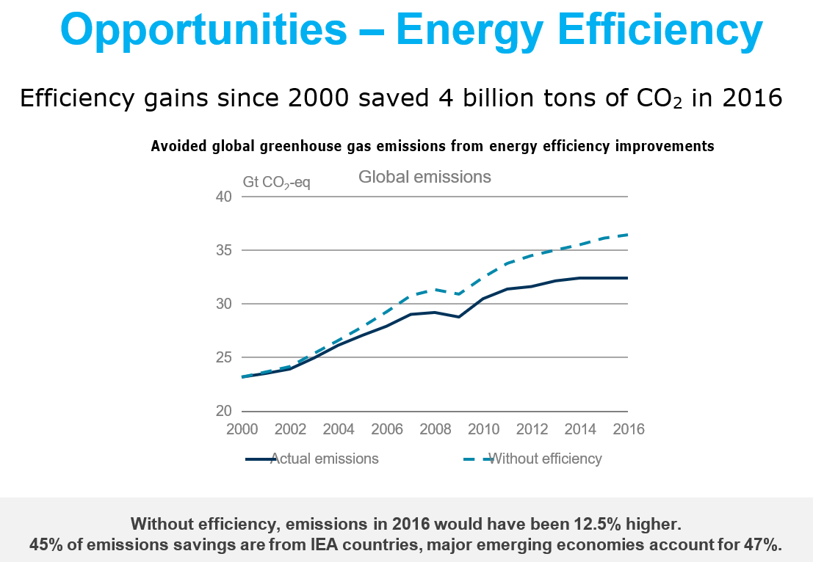

Slide 21
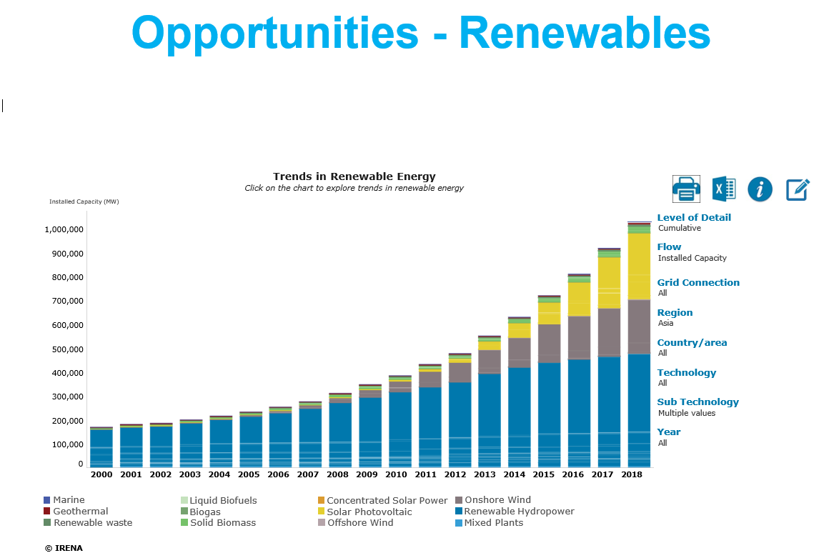

Slide 22
2. Opportunities – Energy Sector Evaluation
Economies are in the process of developing and implementing new energy policies and programs. There are opportunities to:
  Introduce evaluation as part of the process
  Increase expertise in governments for data
  Gathering and evaluation (capacity building)
  Assess private sector energy investments’ toward policy goals
  Increase the body of knowledge on the effects of energy policies and programs
  Improve energy policy and program design and implementation

Slide 23
3. Vision
    Support the strengthening of evaluation leadership and capacity, especially in developing countries
    Foster the cross-fertilization of evaluation theory and practice in Asia
    Encourage the use of comparable evaluation methodologies across countries
    Address international challenges in evaluation

Slide 24
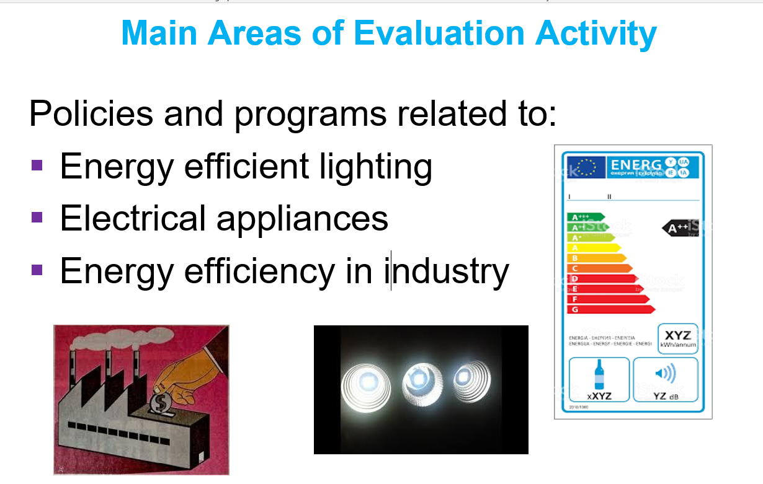

Slide 25
EEAP & Evaluation
    Take a leadership role in expanding the practice of, and capacity for, objective evaluation in the energy efficiency, renewable energy and energy-related (such as water and transportation) program and policy arena
    Using workshops, conferences, websites, webinars and other web-based tools to foster the development of self- sustaining evaluation communities
    Led by Organizing Committee of 8 members,
    35 Evaluation Ambassadors from 24 Countries

Slide 26
Thanks

