Slide 1
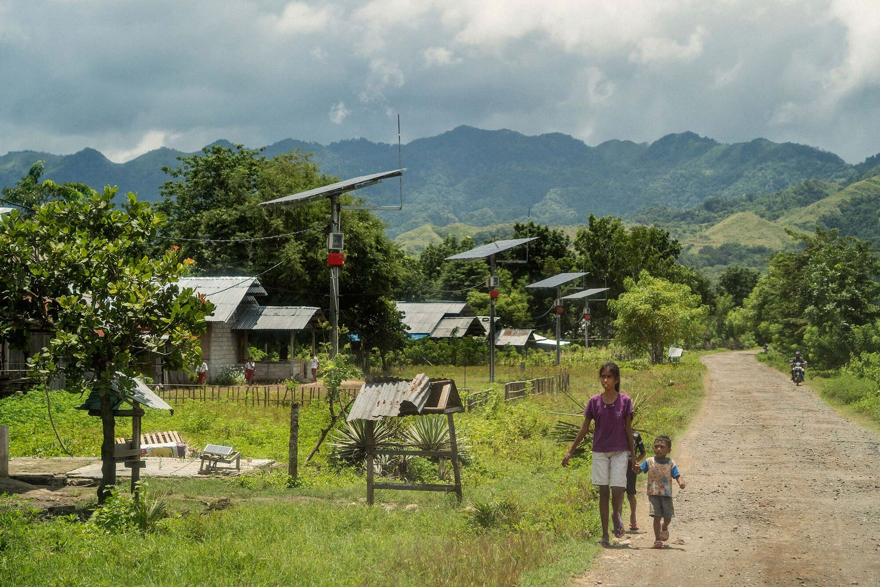
Challenges and Opportunities in Tracking Energy Access in Remote Areas
EEAP Presentation Seminar
Er.Sadeep Acharya
20/03/2024`

Slide 2
About me: Mechanical Engineer involved in
Society of Mechanical Engineering Students (SOMES)
Robotics Club, Pulchowk Campus.
Amnesty International Nepal
Rural Education And Community Health-Nepal(REACH-Nepal)
Nepal Engineering Association
Alternative Energy Promotion Center
Center for Energy studies
Nepal Science and Technology Research Center

Slide 3
Introduction
Energy Evaluation Asia-Pacific (EEAP) is dedicated to advancing the mainstreaming of energy evaluation in the Asia-Pacific region. The organization's mission revolves around building capacities and fostering a community committed to sharing relevant experiences.
By doing so, EEAP aims to contribute to the development and implementation of effective energy policies and programs in the region. The commitment lies in creating a collaborative platform that engages policymakers, evaluators, academia, researchers, and energy professionals to collectively enhance the understanding and impact of energy-related initiatives.

Slide 4
Importance of Addressing Energy Access in Remote Areas:
Ensuring energy access in remote areas is of paramount importance for sustainable development. Remote regions often face challenges such as geographical isolation, lack of infrastructure, and limited financial resources.
By addressing energy access in these areas, EEAP acknowledges the potential for significant positive impacts. Access to affordable, reliable, and sustainable energy is a catalyst for improved living standards, economic development, and environmental sustainability. It contributes to the achievement of broader sustainable development goals, including poverty alleviation, enhanced education, and better healthcare.
EEAP recognizes that by focusing on energy access in remote areas, it can make meaningful contributions to the overall well-being of communities and support the region's progress towards a more sustainable and inclusive future.

Slide 5
Overview of SDG7: Energy Access
SDG7, part of the United Nations' Sustainable Development Goals, centers around ensuring access to affordable, reliable, sustainable, and modern energy for all. Adopted in 2015, it consists of three main targets:
Universal Access (7.1): Ensuring everyone has access to reliable energy services.
Renewable Energy (7.2): Increasing the share of renewable energy in the global energy mix.
Energy Efficiency (7.3): Improving energy efficiency to reduce waste and environmental impact.

Slide 6
EEAP's Role in Energy Policy Evaluation:
Energy Evaluation Asia-Pacific (EEAP) plays a crucial role in supporting the evaluation of energy policies and programs. This involves:
Building Capacities: EEAP works to enhance the skills and knowledge of stakeholders involved in energy policy and program evaluation.
Knowledge Sharing: The organization provides a platform for the exchange of experiences and best practices, fostering a collaborative environment.
Facilitating Collaboration: EEAP encourages partnerships and collaborations among policymakers, evaluators, academia, researchers, and energy professionals.
Country-Driven Evaluation: Recognizing that the evaluation process is country-driven, EEAP supports nations in taking ownership of their sustainable energy initiatives.
Promoting Effective Policies: EEAP aims to contribute to the development of effective and impactful energy policies by leveraging evaluation insights.

Slide 7
Importance of Remote Areas
Significance of Addressing Energy Access in Remote Areas for SDG7:
Addressing energy access in remote areas is pivotal for achieving the targets outlined in Sustainable Development Goal 7 (SDG7). This significance is underscored by several key factors:
Inclusivity and Equity: Remote areas are often marginalized and face challenges in accessing essential services, including energy. Prioritizing these regions ensures a more inclusive approach, aligning with the overarching principle of leaving no one behind.
Universal Access (SDG7.1): The first target of SDG7 emphasizes universal access to energy services. By reaching remote areas, we make substantial progress towards ensuring that all communities, regardless of their geographical location, have access to reliable and sustainable energy.
Renewable Energy Potential: Many remote areas possess abundant renewable energy resources, such as solar and wind. Harnessing these resources not only addresses energy access but also contributes to SDG7.2 by increasing the share of renewables in the energy mix.
Impact on Economic Development (SDG7.b): Enhancing energy access in remote areas directly supports SDG7.b, which focuses on expanding infrastructure and upgrading technology in developing countries. Access to energy facilitates economic activities, job creation, and overall development.

Slide 8
Role of Energy in Improving Quality of Life
Improving energy access in remote areas has a profound impact on the quality of life for the residents:
Healthcare and Education: Reliable energy supports the functioning of healthcare facilities and educational institutions, leading to improved health outcomes and enhanced educational opportunities.
Basic Services: Energy is fundamental for providing basic services such as lighting, heating, and cooking, contributing to a safer and more comfortable living environment.
Communication and Connectivity: Access to energy enables the use of communication technologies, fostering connectivity in remote areas. This connectivity, in turn, facilitates information exchange and access to markets.
Productivity and Livelihoods: Energy access opens avenues for productive activities, empowering communities to engage in income-generating endeavors, ultimately fostering economic self-sufficiency

Slide 9
Challenges in Tracking Energy Access
Tracking energy access, particularly in remote areas, presents various challenges that need to be overcome for effective policy implementation and program success. Here are some key challenges:
Geographical Isolation:
Remote areas often have challenging terrains and are geographically isolated. This makes it difficult and costly to deploy and maintain monitoring infrastructure, hindering accurate data collection on energy access.
Lack of Infrastructure:
Insufficient transportation, communication, and logistical infrastructure in remote areas can impede the installation and maintenance of energy tracking systems. This lack of basic infrastructure complicates the process of monitoring and evaluating energy access.
Data Collection Difficulties:
Limited connectivity and access to technology in remote areas can make data collection challenging. This is crucial for tracking energy consumption patterns, identifying demand, and assessing the effectiveness of implemented energy solutions.
High Implementation Costs: The costs associated with deploying and maintaining tracking systems, especially in remote regions, can be prohibitively high. Budget constraints may limit the implementation of comprehensive monitoring solutions.

Slide 10
Limited Technical Expertise:
Remote areas often lack skilled personnel and technical expertise required for the installation and maintenance of monitoring devices. This can result in a lack of reliable data and hinder the effectiveness of energy tracking efforts.
Extreme Weather Conditions:
Harsh weather conditions prevalent in remote areas, such as extreme temperatures, heavy rainfall, or storms, can pose challenges for the reliable operation of monitoring equipment. This may lead to frequent breakdowns and data inaccuracies.
Data Privacy and Security Concerns:
Ensuring the privacy and security of collected data is a significant concern. Implementing effective tracking systems requires addressing these issues, particularly in remote areas where oversight and regulation may be limited.
Limited Financial Resources:
In remote communities with limited financial resources, investing in advanced tracking technologies or maintaining existing systems can be challenging. This financial constraint can hinder the implementation and sustainability of energy tracking initiatives.

Slide 11
Cultural and Social Factors:
Cultural differences and social dynamics in remote areas may affect the willingness of communities to adopt and cooperate with energy tracking initiatives. Understanding and addressing these factors are crucial for successful implementation.
Data Standardization and Compatibility:
Ensuring that collected data is standardized and compatible with existing systems is essential for effective analysis and decision-making. Inconsistencies or lack of standardization can undermine the reliability of the data.

Slide 12
Opportunities for Remote Energy Access:
Abundant Renewable Energy Potential:
Description: Many remote areas have untapped renewable energy resources, such as solar, wind, hydro, or biomass.
Opportunity: Leveraging these resources for clean and sustainable energy solutions, reducing dependence on traditional and often unreliable sources.
Innovative Technologies:
Description: Advancements in technology have led to the development of off-grid solar systems, micro grids, and energy storage solutions suitable for remote environments.
Opportunity: Implementing these innovative technologies for decentralized and reliable energy access, overcoming infrastructure challenges.
Community Engagement:
Description: Involving local communities in the planning, decision-making, and implementation processes of energy projects.
Opportunity: Empowering communities to take ownership of energy initiatives, ensuring solutions align with their needs, preferences, and cultural contexts.

Slide 13
Public-Private Partnerships (PPPs):
Description: Collaboration between governments, private sector entities, and non-governmental organizations.
Opportunity: Mobilizing resources, expertise, and funding through PPPs to support the development and sustainability of energy projects in remote areas.
Supportive Policies:
Description: Governments can create policies that incentivize and support investment in remote energy projects.
Opportunity: Encouraging private sector involvement, attracting investments, and fostering a conducive environment for the growth of sustainable energy solutions.

Slide 14
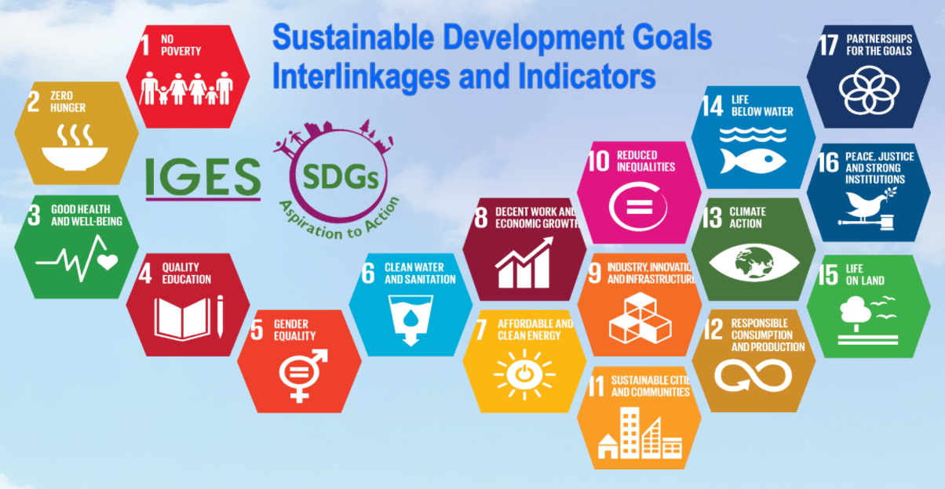
Interlinkages with Sustainable Development Goals (SDGs):
Achieving SDG7 Targets Impacts Progress in Other SDG Dimensions:
Emphasis: Fulfilling the targets of SDG7, which focuses on energy access, has profound implications for advancing progress across various other SDG dimensions.

Slide 15
Interlinkages between Energy Targets and Other SDGs:
SDG1 - No Poverty:
Interlinkage: Energy access is a key driver for poverty alleviation, enabling income-generating activities and improving overall economic conditions.
SDG3 - Good Health and Well-being:
Interlinkage: Reliable energy supports healthcare facilities, ensuring the availability of medical equipment, refrigeration for vaccines, and overall improved health services.
SDG4 - Quality Education:
Interlinkage: Access to energy is essential for powering educational institutions, facilitating e-learning, and providing a conducive environment for students and teachers.
SDG5 - Gender Equality:
Interlinkage: Energy access can empower women by reducing the time spent on manual tasks, providing opportunities for income generation, and enhancing overall gender equality.

Slide 16
SDG6 - Clean Water and Sanitation:
Interlinkage: Energy is crucial for water pumping, purification, and sanitation services, contributing to achieving clean water and sanitation goals.
SDG8 - Decent Work and Economic Growth:
Interlinkage: Energy access supports economic activities, fostering job creation, entrepreneurship, and overall economic growth.
SDG11 - Sustainable Cities and Communities:
Interlinkage: Energy is fundamental for developing sustainable infrastructure, promoting clean and efficient urbanization, and enhancing the overall livability of cities.
SDG13 - Climate Action:
Interlinkage: Increasing the share of renewable energy (SDG7.2) contributes directly to mitigating climate change and achieving SDG13 targets.
SDG15 - Life on Land:
Interlinkage: Sustainable energy practices can help preserve ecosystems, reduce deforestation, and contribute to the conservation of biodiversity.
SDG17 - Partnerships for the Goals:
Interlinkage: Collaborative efforts in achieving energy access (SDG7) involve partnerships between governments, private sectors, and civil society, aligning with the spirit of SDG17.

Slide 17
Distributed Renewable Energy Sources for Rural Communities:
Technology Solutions for Remote Areas:
Solar Energy:
Description: Photovoltaic systems harness energy from the sun, providing a sustainable and decentralized power source.
Benefits: Solar panels can be installed on rooftops or as standalone units, offering a reliable and clean energy solution for remote areas. Solar water pumps can be used for the water lifting's.
Biogas Systems:
Description: Biogas is produced through the anaerobic digestion of organic waste, such as agricultural residues or animal manure.
Benefits: Biogas can be used for cooking, heating, and electricity generation, providing a renewable energy source while addressing waste management challenges.

Slide 18
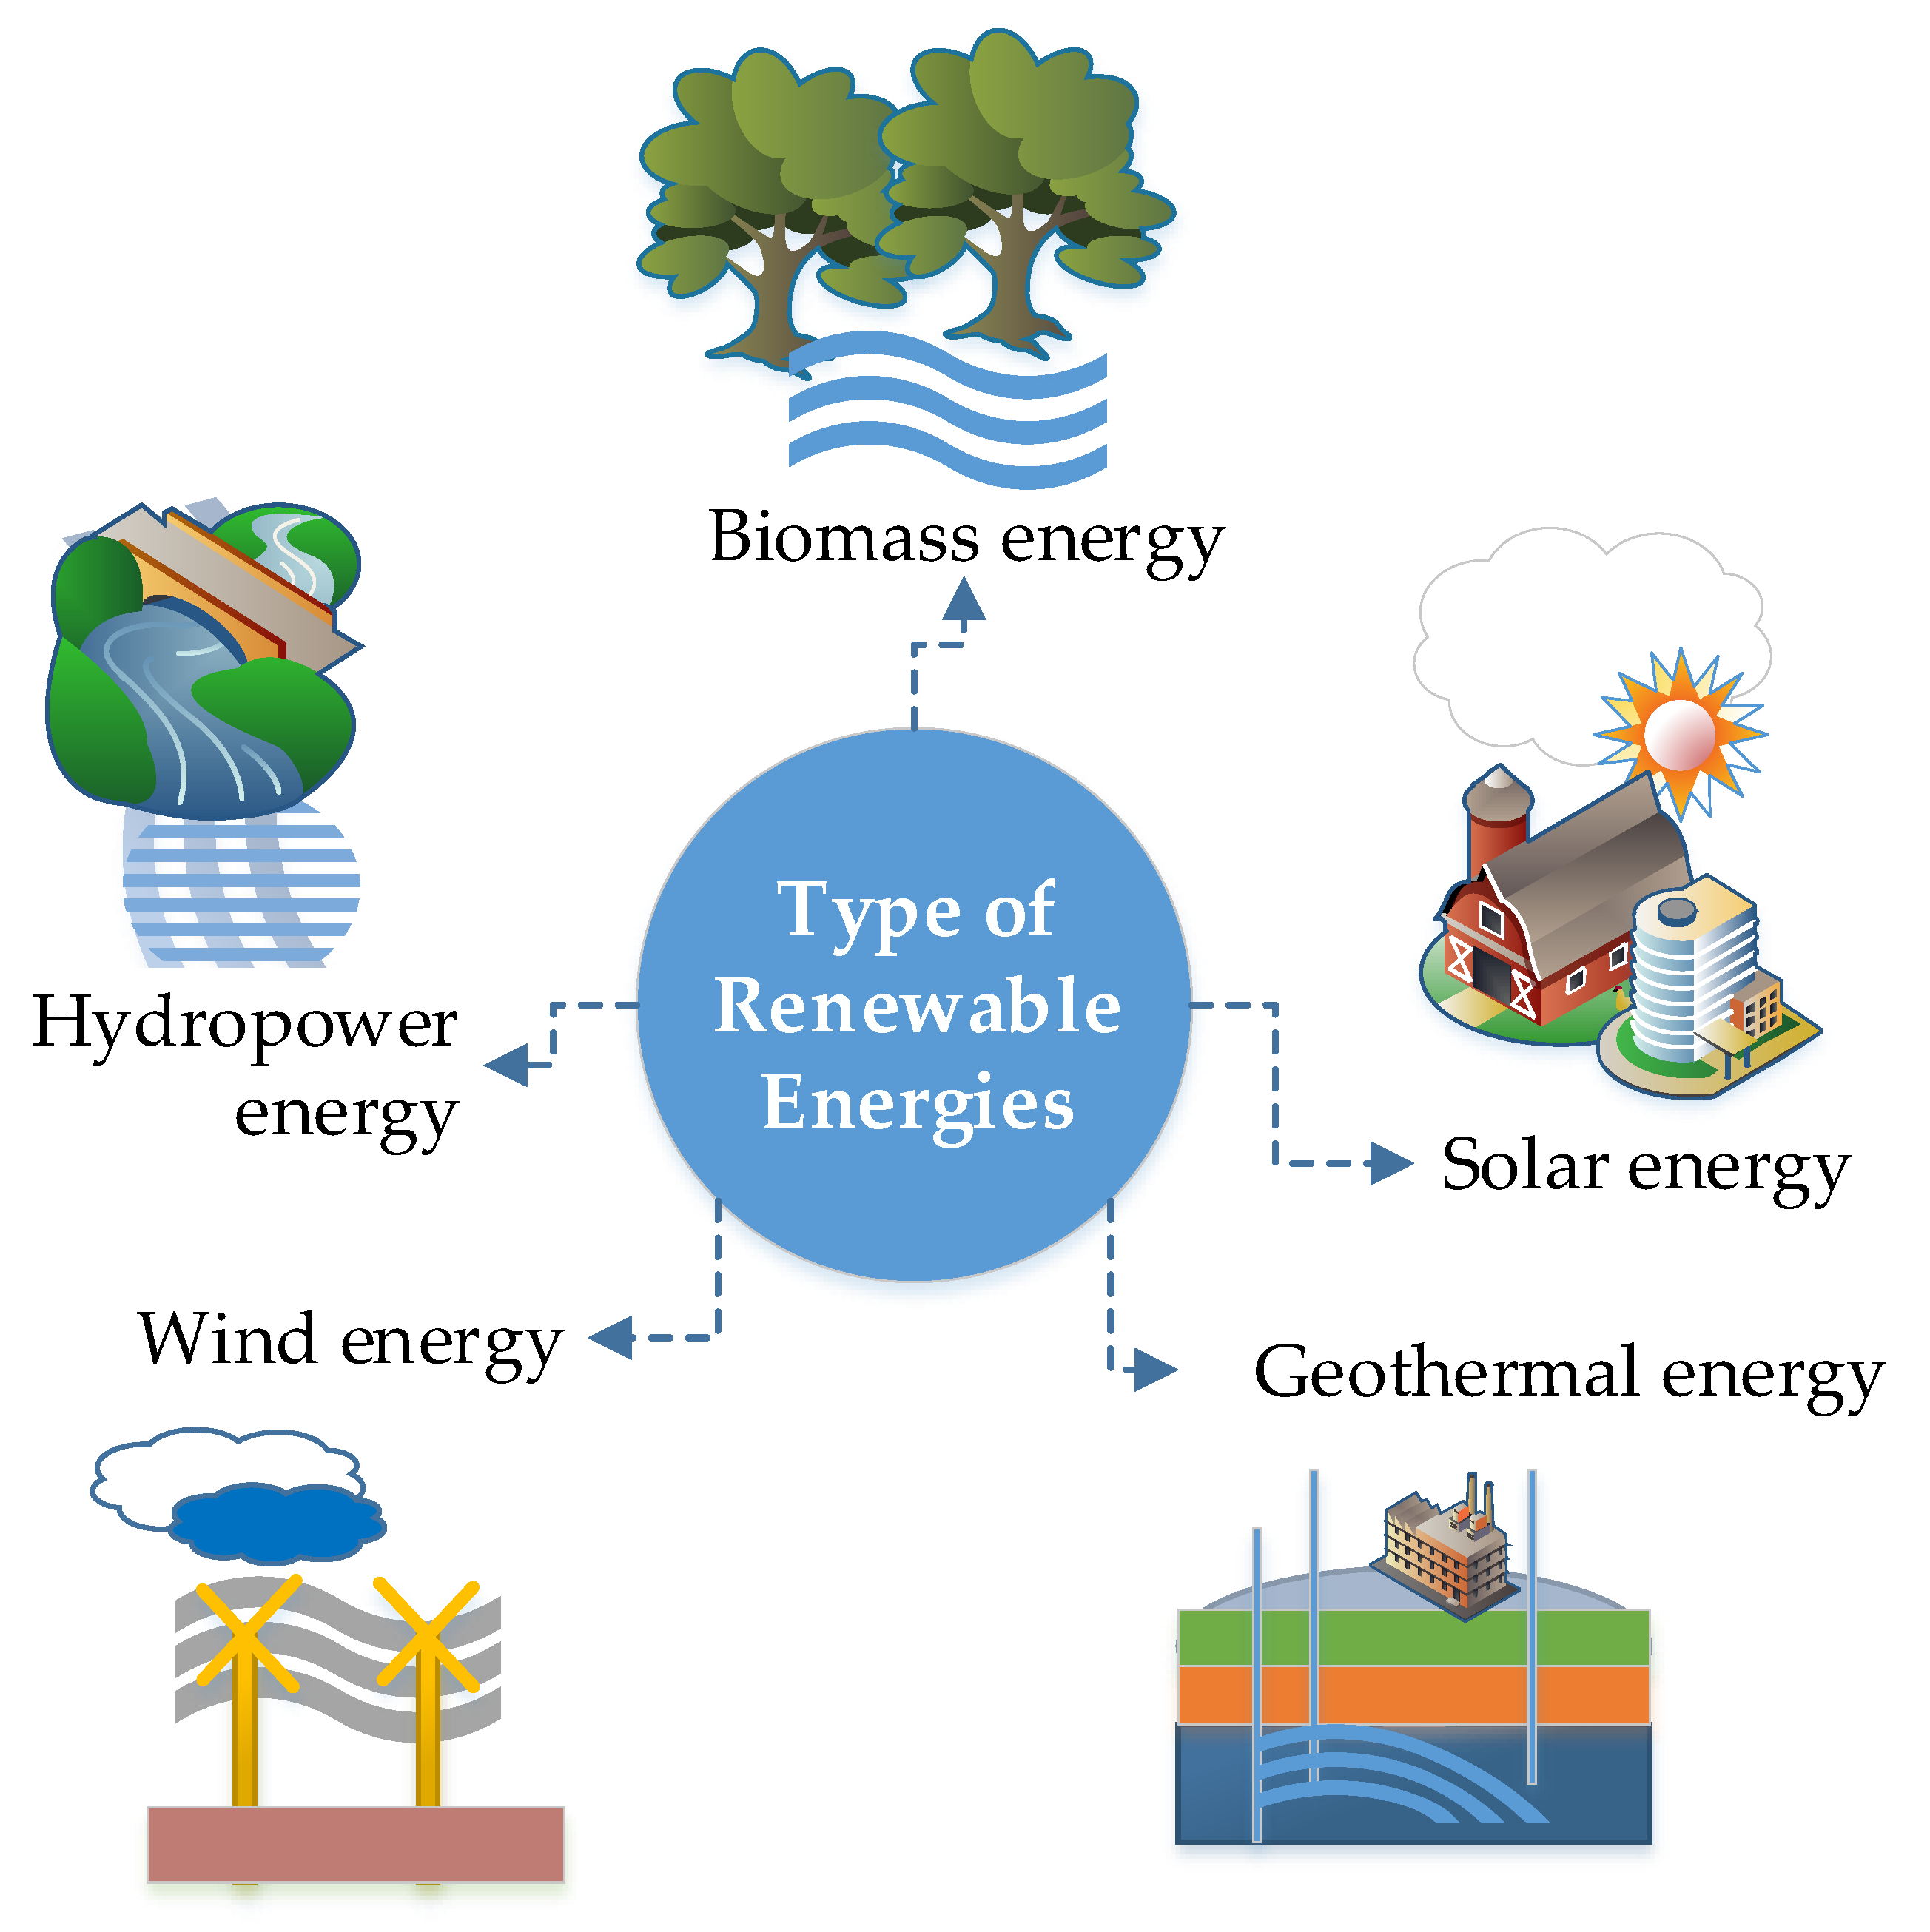
Microgrids:
Description: Small-scale, localized grids that can operate independently or in conjunction with the main power grid.
Benefits: Micro grids are well-suited for remote areas, allowing for the integration of renewable energy sources and ensuring a more reliable and sustainable power supply.
Small Hydropower:
Description: Harnessing energy from small rivers or streams to generate electricity.
Benefits: Small hydropower systems are environmentally friendly and can provide a consistent power supply to remote communities.

Slide 19
Win-Win' Strategy of Energy Efficiency:
Energy efficiency involves using less energy to accomplish the same tasks, reducing energy waste and optimizing resource utilization.
Benefits:
Cost Savings: Improved energy efficiency often results in reduced energy consumption, leading to cost savings for both individuals and communities.
Environmental Impact: Lower energy consumption translates to reduced environmental impact, contributing to sustainability goals.
Reliability: Energy-efficient technologies often enhance the reliability of energy systems, especially crucial in remote areas.

Slide 20
Examples of Energy-Efficient Technologies:
LED Lighting: Replacing traditional bulbs with energy-efficient LED lighting systems.
Energy-Efficient Appliances: Using appliances with high energy efficiency ratings.
Smart Grids: Implementing intelligent energy distribution systems to optimize energy use.

Slide 22
Community Awareness and Education:
Importance: Promoting energy efficiency practices and educating communities on the benefits of reducing energy waste.
Community Engagement: Involving local residents in energy-saving initiatives fosters a sense of ownership and responsibility.
Government Policies and Incentives:
Role: Governments can play a crucial role by implementing policies that incentivize energy-efficient practices and technologies.
Public-Private Collaboration: Collaborations between governments and private sectors can lead to the development and implementation of energy-efficient solutions.

Slide 23
Role of Data and Monitoring Tools:
Real-Time Tracking of Energy Access:
Importance:
Provides real-time insights into energy consumption patterns.
Facilitates proactive responses to changes in demand or system performance.
Tools:
Smart meters, remote sensors, and IoT devices for continuous monitoring.

Slide 24
Importance of Evaluating Energy Projects:
Assessing the effectiveness and impact of implemented energy projects.
Benefits:
Informs decision-making for future projects and policy adjustments.
Ensures resources are allocated efficiently and goals are met.
Evaluation Tools:
Key Performance Indicators (KPIs), impact assessments, and community feedback mechanisms.

Slide 25
Conclusion:
In conclusion, addressing energy access in remote areas poses both challenges and opportunities that require strategic and collaborative solutions. The journey toward sustainable energy solutions necessitates a careful balance of innovation, collaboration, and continuous evaluation.
In achieving sustainable energy solutions in remote areas, the integration of these elements is vital. Collaboration fosters a shared commitment to overcoming challenges, innovation drives the development of effective technologies, and continuous evaluation ensures adaptability and improvement. By reinforcing these principles, we can navigate the complexities of tracking energy access in remote areas and work collectively towards a future where energy is accessible, reliable, and sustainable for all.

Slide 26
Let's recap the key takeaways:
Challenges:
Geographical Isolation: Difficult terrains and limited accessibility hinder implementation.
Lack of Infrastructure: Absence of basic facilities complicates energy access initiatives.
High Implementation Costs: Financial constraints impact the deployment of tracking systems.
Limited Technical Expertise: A shortage of skilled personnel and technical know-how poses challenges.
Cultural and Social Factors: Local contexts influence the success of energy tracking initiatives.

Slide 27
Opportunities:
Renewable Energy Potential: Abundant resources like solar and biogas present sustainable solutions.
Innovative Technologies: Off-grid solar, microgrids, and energy storage address infrastructure limitations.
Community Engagement: Involving local communities ensures tailored and impactful solutions.
Public-Private Partnerships: Collaborative efforts attract resources and expertise.
Supportive Policies: Government support encourages investment in remote energy projects.

Slide 28
Reinforcement:
Collaboration is Key: Success hinges on collaborative efforts among governments, private sectors, and local communities.
Innovation Drives Progress: Embracing innovative technologies ensures adaptability and efficiency.
Continuous Evaluation is Essential: Rigorous monitoring and evaluation are critical for gauging effectiveness and informing future strategies.
Empowering Local Communities: Involving communities in decision-making fosters sustainable and culturally sensitive solutions.
Policy Support Accelerates Progress: Government policies play a pivotal role in creating an enabling environment for sustainable energy development.

Slide 29
Q&A Session:
Thank you for your attention. Now, I invite any questions or discussions you may have. Please feel free to ask about the challenges and opportunities in tracking energy access, EEAP's role, technology solutions, or any related topics. Your engagement is crucial in fostering a deeper understanding of the complexities and nuances of sustainable energy development in remote areas. Let's open the floor to your inquiries and insights.

Slide 30
Thank you ☺

