Slide 1

Evaluation of SDG 7 –
Prospects and Challenges
Michael Williamson,
Energy Division,
ESCAP
18 January 2024

Slide 2
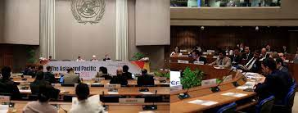
SDG 7 National Roadmaps…a need raised by ESCAP member States
Ministerial declaration from the second Asian Pacific Energy Forum (APEF) held in April 2018
“support members and associate members in the implementation of the present Declaration by… assisting countries, upon request, in developing national road maps for the implementation of Sustainable Development Goal 7 and in mainstreaming the global targets related to energy into national policies, plans and strategies.”

Slide 3
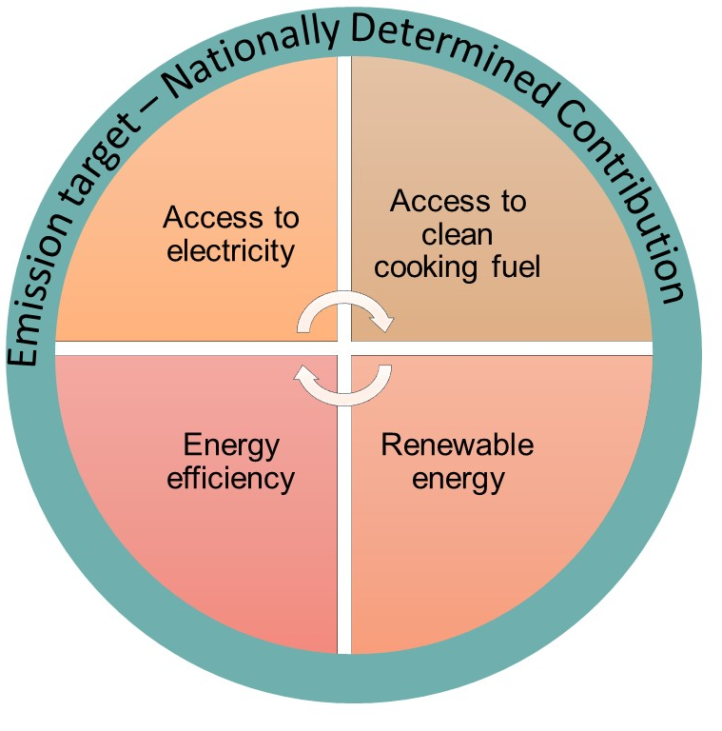
Need for an integrated approach to the 2030 energy transition
SDG7.1
  The choice of technology to gain universal access to electricity and clean cooking fuel will impact on SDG7.2, SDG7.3 and NDC
SDG7.3
  The level of energy efficiency achievement will impact on the share of renewable energy (SDG7.2) and NDC
SDG7.2
  The share of renewable energy in the fuel mix will determine the level of achievement of NDC
NDC
  The emission reduction target will guide above all, particularly SDG7.2 and SDG7.3

Slide 4
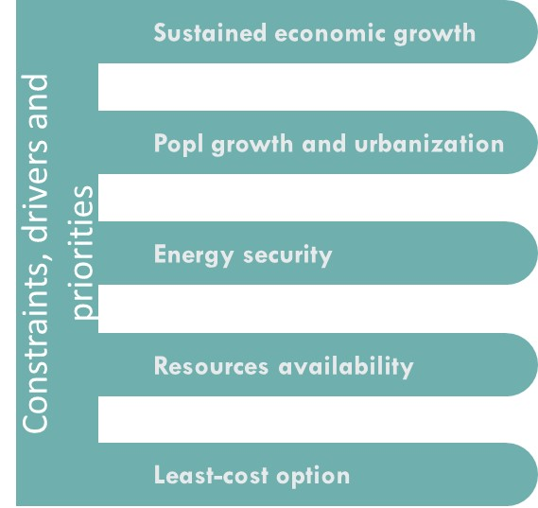
An integrated approach to 2030 energy transition
The approach should also consider
  A sustained economic growth
  Future changes in demographics
  Available energy resources in the country
Should aim to
  Maximise the energy security
  Identify least-cost options to achieve the targets
Present
  A collection of technologies and policies needed to achieve SDG7 and NDC targets
Notes:
Other factors, drivers and constraints
Demographic and macro-economic factors such as…….
Energy security is an essential part of the roadmap

Slide 5
SDG7 Road Map initiative – the Journey
2018
Ministerial Declaration from APEF
2019
Methodology development
Testing and trial
2020
3 national Road Maps
Interests from national and local levels
2021
6 national Road Maps
3 local Road Maps
2022
4 national Road Maps
5 sub-national Road Maps
NEXSTEP training course developed

Slide 6

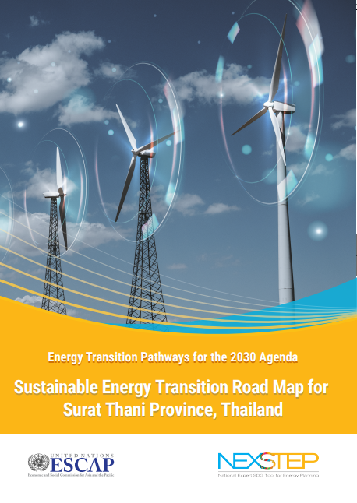

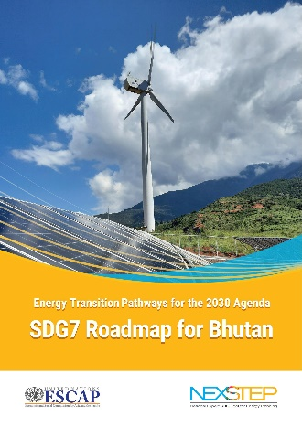
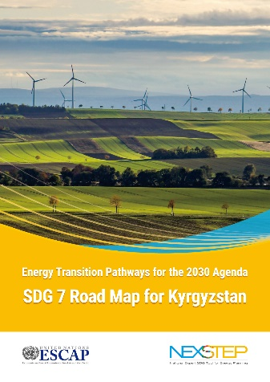
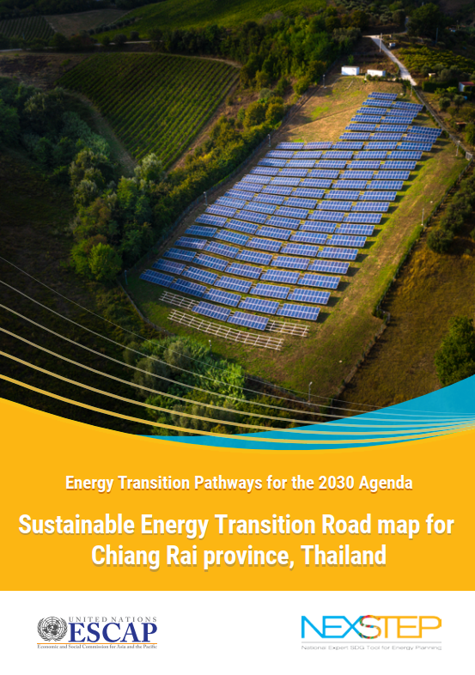
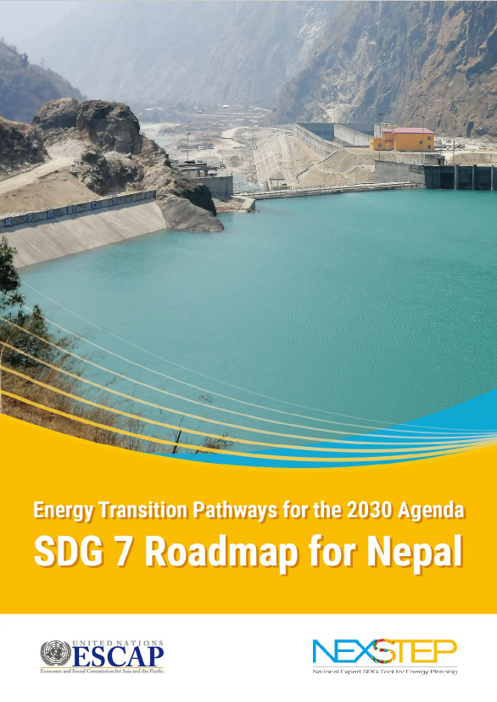


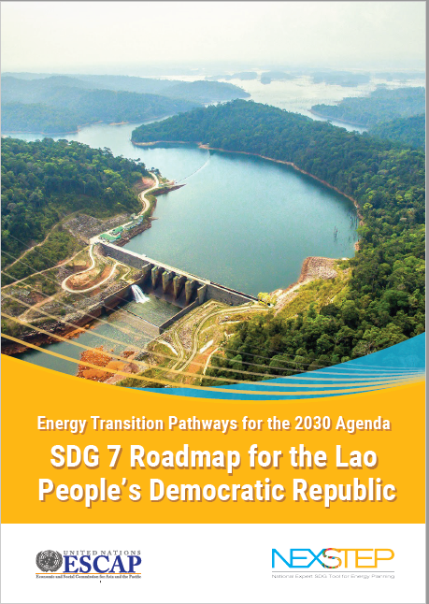

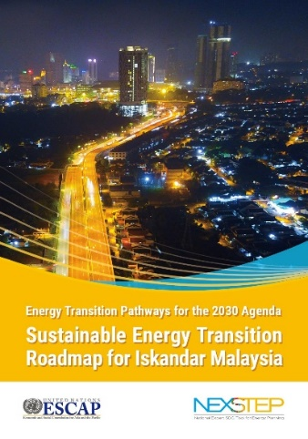


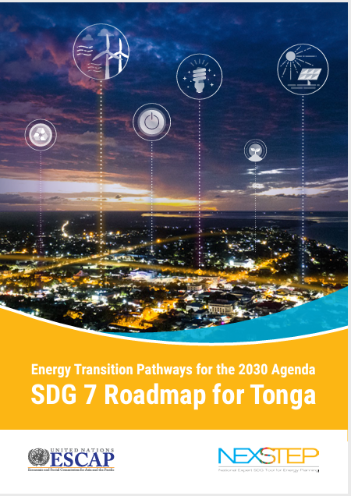
SDG 7 Road Maps
Available at https://nexstepenergy.org/
National level
Sub-national level
Bhutan
Fiji
Georgia
Indonesia
Lao PDR
Nepal
Tonga
Kyrgyzstan
Kiribati
Micronesia
Mongolia
Pakistan
Thailand
Viet Nam
City of Jakarta, Indonesia
Iskandar, Malaysia
City of Borongan, Cauayan and Ormoc of Philippines
Provinces of Thailand - Surat Thani, Udon Thani and Chiang Rai
Ongoing
Armenia
Kazakhstan
Timor-Leste
Uzbekistan
Notes:
23 = 14 countries + 8 cities

Slide 7
Common Findings Across Countries
Access to clean cooking fuels and technologies
  About 80% of countries need to introduce accelerated actions and policy measures to ensure universal access to clean cooking by 2030
Space heating
  Some Road Maps have found that space heating is an important area
Decarbonization of the power sector
  Increasing the share of RE in the power sector can bring multiple benefits – including emissions reduction, local air quality improvement and reduction in power sector investments
Electric vehicles
  Almost all Road Maps have suggested accelerated uptake of EVs
Energy efficiency through MEPS
  Prevent energy wastage and reduces energy sector investments
Notes:
As of 2020, 1.3 billion people without access to electricity

Slide 8


Road Maps – Adoption in National Policies
SDG 7 Road Map has informed goals and targets for the Fiji’s National Energy Policy 2021-2030
The SDG 7 Road Map has been used as a foundation to develop the Tonga Energy Road Map (TERM) Plus 2021-2035

Slide 9
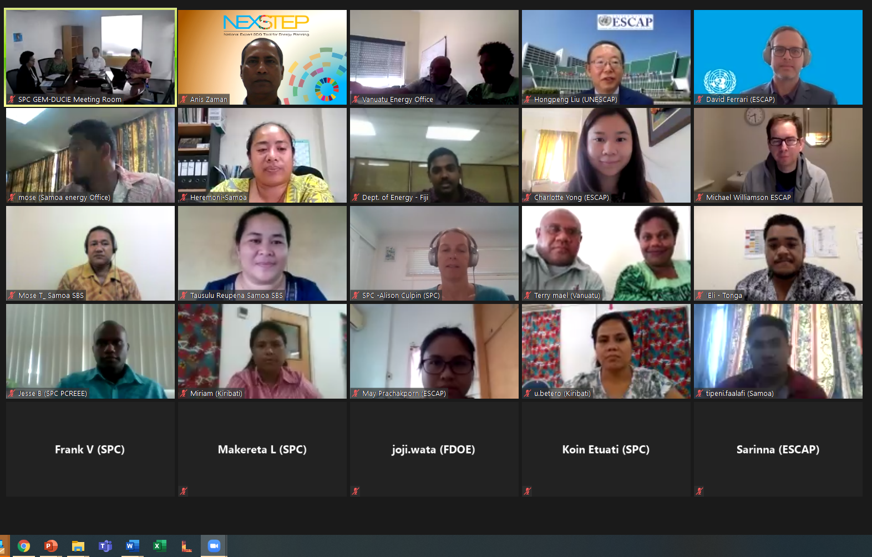
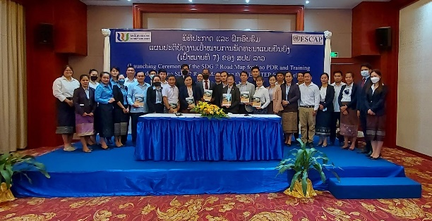
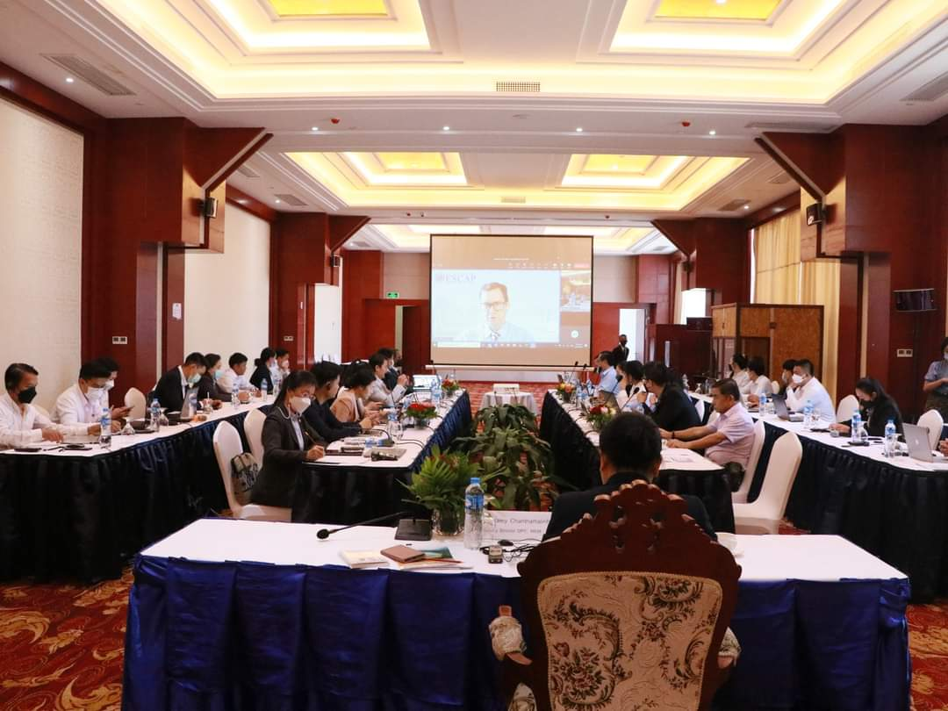
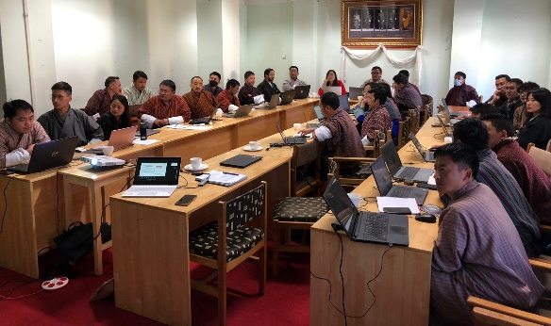
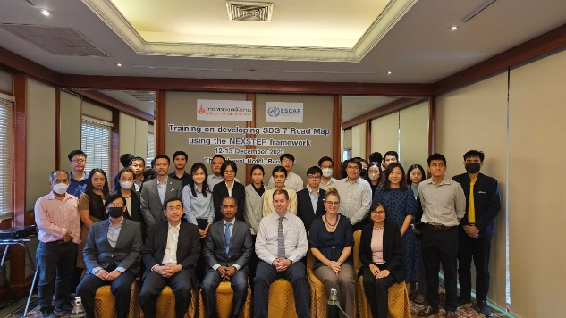
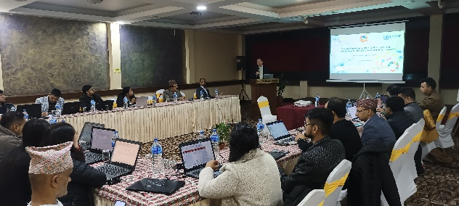
NEXSTEP training
ESCAP has been developing capacity of policymakers on energy emissions modelling through the NEXSTEP training
Training has been completed for
  Pacific – 36 participants (from 5 countries)
  Lao PDR - 30 participants
  Bhutan - 30 participants
  Nepal – 35 participants
  Thailand – 32 participants

Slide 10
Implementing recommendations- examples
Bhutan - clean cooking pilot program
Georgia - analytical study on identifying enabling policy mechanisms to increase RE and EE measures in SME sector
Lao PDR - discussion to support clean cooking pilot program
Tonga - supported the development of a GCF readiness proposal for Tonga to improve energy efficiency

Slide 11
Evaluating Impact of SDG 7 Roadmaps – converting analysis into action
Challenges
  Turning a “policy recommendation” into a “policy action” require long time (very little time left for the 2030 SDG deadline)
  Some recommendations require substantial funding – needs external support.
  Least developed countries have low in-house capacity – need ongoing support.
  How do we evaluate the impact of the SDG 7 roadmap vis-a-viz other policy drivers? What is the counter-factual?
Opportunities
  Regional and global partners can work together with the national leaders to fast-track policy development.
  Countries can develop bankable projects using analyses like SDG 7 Road Maps. Funding agencies and donors can come forward to support bankable projects
  Targeted capacity building programs should be developed and delivered to countries.

Slide 12
Change isn’t easy - challenges to implementing national policy changes
Capacity to identify appropriate policy changes - LDC and SIDS lack capacity to undertake needed analysis to identify appropriate policy changes
Political motivation - development and implementation of policy interventions, in many cases, can be politically driven – not always based on analytical decisions
Resources availability - small developing economies have competing development priorities where often energy sector doesn’t make it to the list
Monitoring of progress - implementing policies without measuring their progress not viable. No mechanism to monitor progress of implementation - developing one at the national level could be very expensive. Development of a universal mechanism with the options for countries to record their ongoing progress of SDG7 could be considered.

Slide 13

Evaluation – at what level? Who?
Need to consider at what level should evaluation be focused. Policy; Programs; Projects? Arguably policies and derivative programs instituted by government that support SDG 7 achievement should be evaluated.
Imperative to know what works, what does not work, and what needs to be improved. Need to consider carefully the ancillary benefits of policy/program given cross-cutting nature of energy.
Capabilities and resources at the national, sub-national and local levels for conducting evaluations often limited. External experts ay lack context.
How to boost capacity for monitoring and evaluation a key question.
Stakeholders required - Government, private sector, civil society and academia.

Slide 14
Thank you

