Slide 1

TRIBHUVAN UNIVERSITY
INSTITUTE OF ENGINEERING
Pulchowk, Lalitpur, Nepal
Pathway to clean cooking transition in Nepal: Evaluation of Policies governing
household biogas plant
Navin Kumar Jha
IOE, Pulchowk Campus

Slide 2
Content
Brief CV
Status of SDG#7 in Nepal
Major challenges
Household biogas plant potential to address SDG#7
Policy tools and institutional framework
SWOT analysis
Strategies

Slide 3
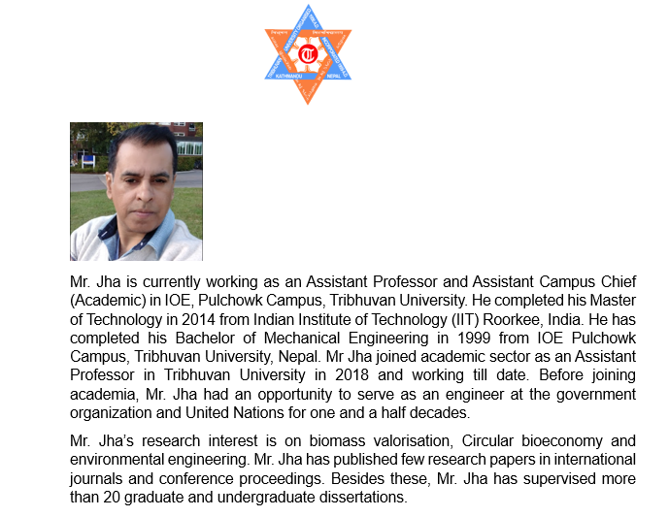

Slide 4

Status of SDG#7 in Nepal

Slide 5
Nepal committed to achieve SDG by 2030
proposed roadmap through different policy tools at all tiers of government
In 2019,
Mainstreaming SDGs in Planning Process through three years periodic plan
90% of household had access of electricity in 2019
Around 70% household depends upon solid biomass for cooking fuel
Liquid Petroleum Gas (LPG) for cooking and heating was 26.6%
per capita electricity consumption 260 KWh (Target was 230 KWh),
Confident to reduce the dependence on firewood to 30 per cent
Status of SDG # 7 in Nepal

Slide 6
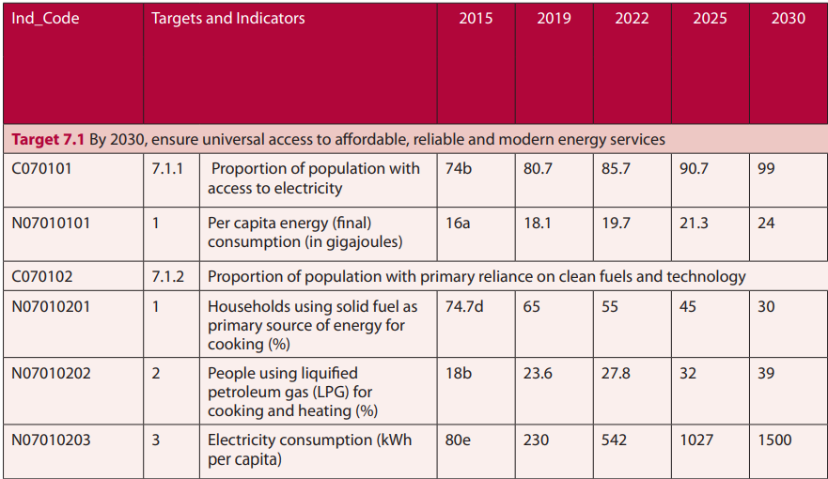

Comparing the status of SDG #7 in 2019 and 2022

Slide 7
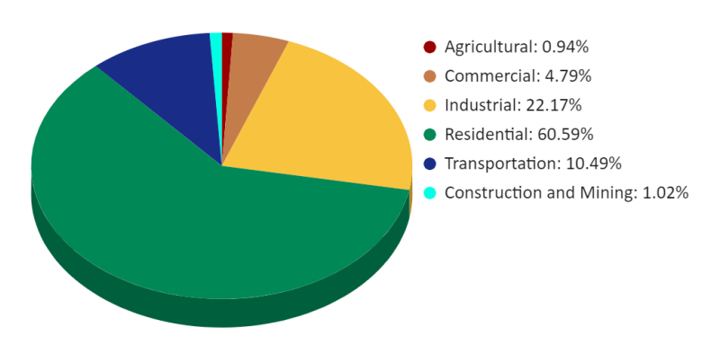
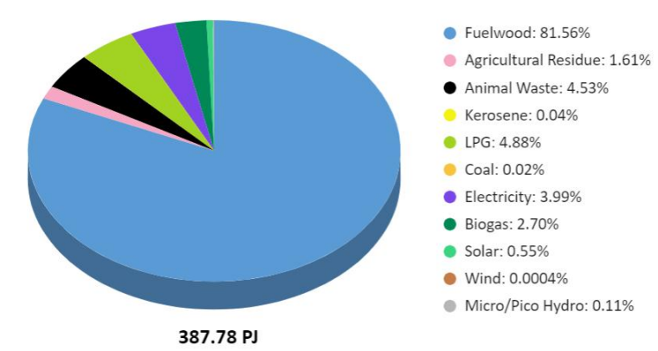
Sectoral Energy Consumption of Nepal in 2022
Source: Energy Synopsis Report, 2023 WECS, Nepal
Solid biomass remains the predominant cooking fuel in Nepal.
Around 80% of households relying on solid fuels (fuel wood) for cooking.
This dependency is even more pronounced in rural areas
Severe adverse environmental impact
Major barrier to achieve SDG#7 and other associated SDG

Slide 8
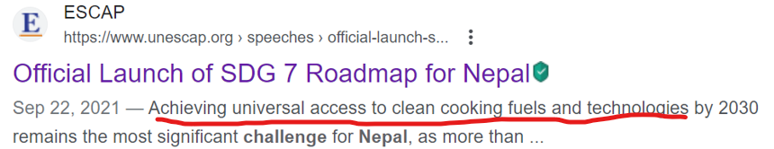
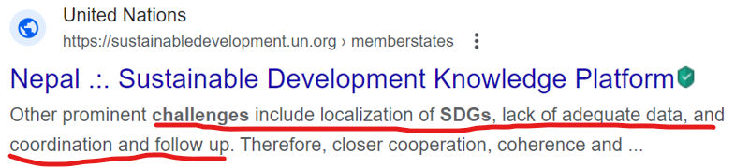
Major Challenges
Strong domination of country’s cooking fuel sector by fuelwood, agricultural residue and dung cake (around 52% ).

Slide 9
Household biogas plant potential to address SDG#7
Government alongwith developing partner are promoting household biogas plant with different policy tools to facilitate clean cooking transition
Aim to lower down the dependency on solid biomass
Biogas is a cleaner form of cooking fuel
Technology with domestic waste to energy
Huge potential:
Theoretically 3043.58 million m3 /year of biogas production from livestock manure
equivalent to 110 million Liquid Petroleum Gas (LPG) cylinder
it is more than four times than the current consumption of LPG cylinders in Nepal
20 times higher than the current generation of biogas from household biogas plants
Nationwide dissemination
Example as best practice

Slide 10
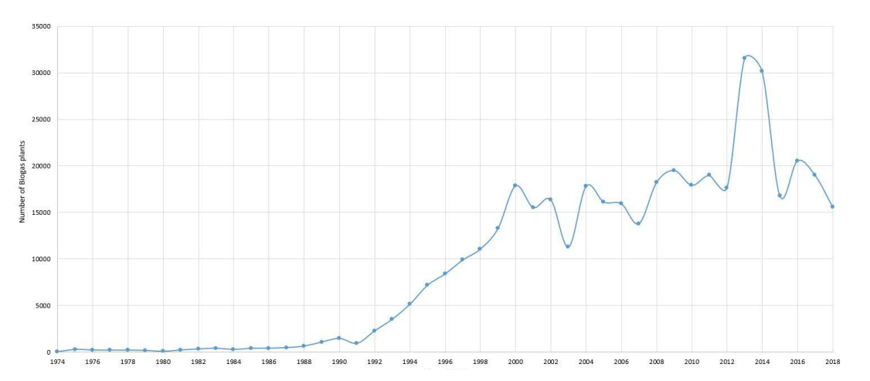
Household biogas plant potential to address SDG#7 (Source: AEPC, Nepal)

Slide 11
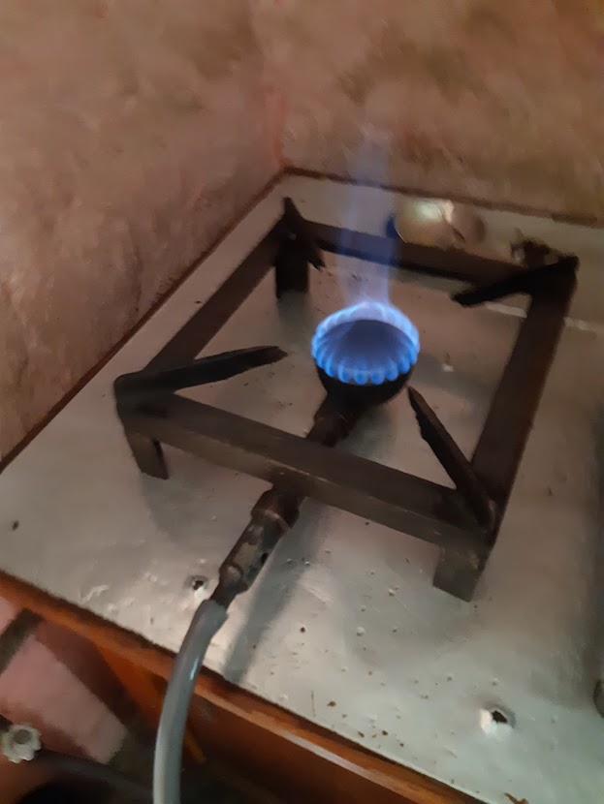
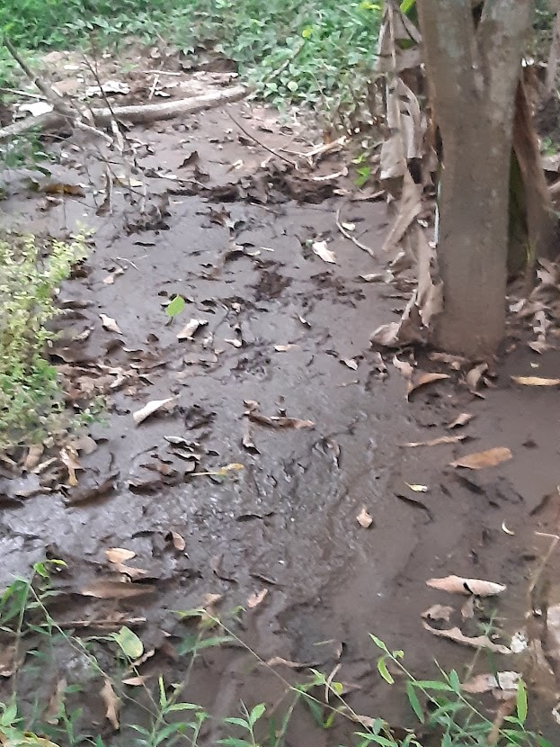
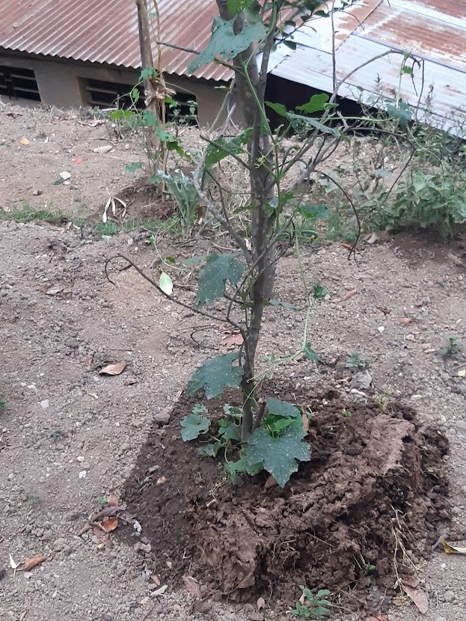
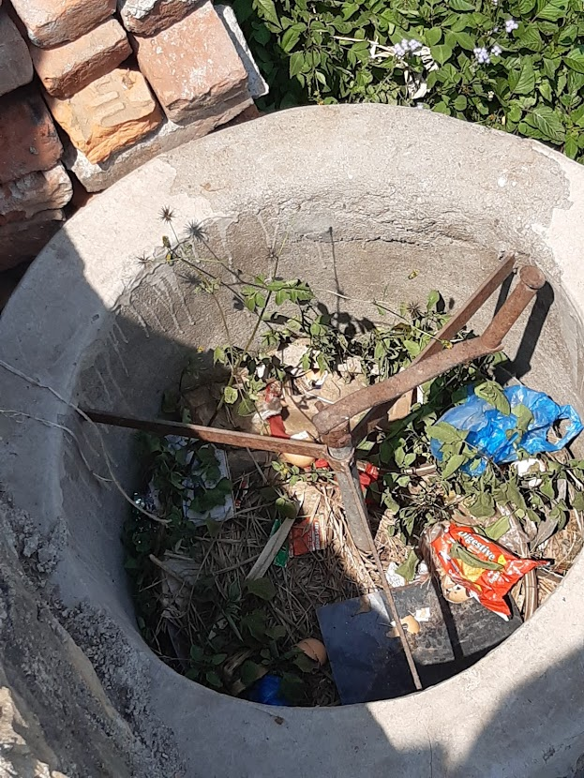
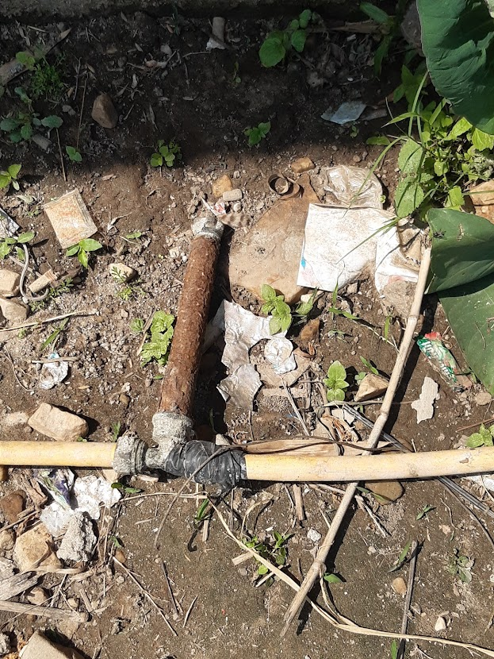
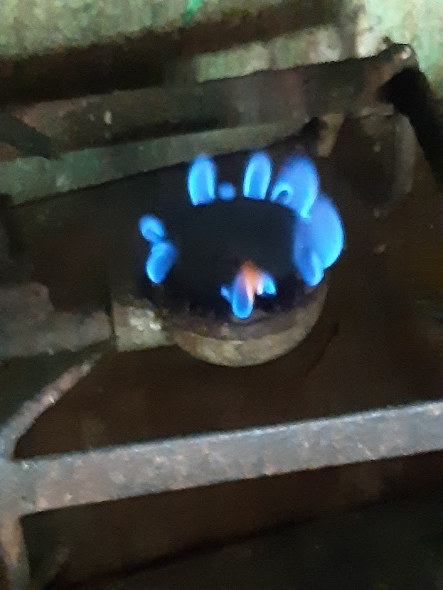
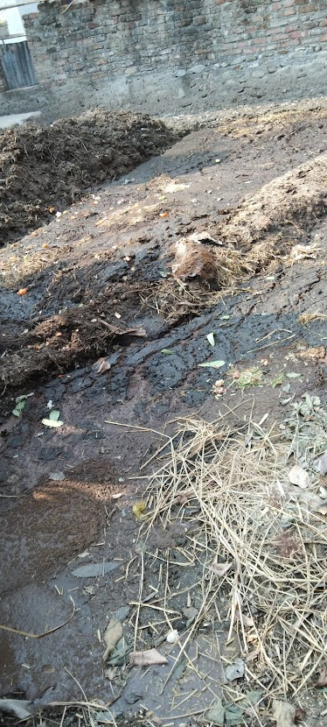






Status of Household Plant
Expected
Reality

Slide 12
Why this ?
Exploring the root cause from policy perspective
(SWOT Analysis)
Household biogas plant potential to address SDG#7

Slide 13
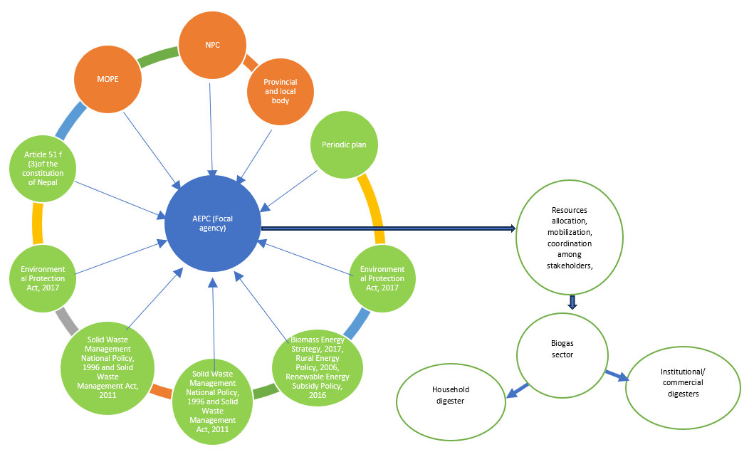
Policy tools and institutional framework

Slide 14
Policy tools and institutional framework
Category of Stakeholder | Intervention point stage | Stakeholders Remarks
External External External Internal | Planning | Line ministries NPC Donor agencies AEPC
Internal Internal Internal Internal External | Design and construction | AEPC Pre rostered construction companies HBD user Local masonary manpower Financial institution
Internal | Operation | HBD user
Internal | Maintenance | HBD user Pre rostered construction companies
Internal | Application of biogas and digester | HBD user

Slide 15
NPC (Apex planning body) propose periodic plan, strategies, action plan.
MoEWRI is the thematic ministry
AEPC focal agency for execution, a part of MoEWRI
Policy tools:
Article 51 (3) of the constitution
Biomass Strategy, 2017
RE subsidy policy, 2016
Solid waste management national policy, 1996
Solid waste management Act, 2011
Environmental protection Act, 2017
Policy tools and institutional framework

Slide 16
Strength
Huge potential:
Theoretical potential is 3043.58 million m³ /year
Equivalent to 110 million Liquid Petroleum Gas (LPG) cylinder1 ),
which is more than four times than the current consumption of LPG
20 times higher than the current generation of biogas from HBP
Suitable candidate to address SDG 7
Environmental friendly nature
Option of bio fertilizer and may address other SDGs

Slide 17
Strength
Huge potential:
Theoretical potential is 3043.58 million m³ /year
Equivalent to 110 million Liquid Petroleum Gas (LPG) cylinder1 ),
which is more than four times than the current consumption of LPG
20 times higher than the current generation of biogas from HBP
Suitable candidate to address SDG 7
Environmental friendly nature
Option of bio fertilizer and may address other SDGs

Slide 18
Lower biogas yield due to scarcity of feed material and other technical reason forcing HBD user to rely on alternate cooking fuel
Insufficient feed material due to declining rate of cattle holding
Province government is promoting livestock through subsidy (lack of coordination between ministry)
Internal and external migration are making the rate decline
Lack of depth feasibility study before dissemination of HBD.
Lack of any policy tool regarding technical enhancement
Technical knowhow was also found crucial for HBD sustainability (AEPC, HBD user)
Scope of alternate feed material (Biomass strategy)
No specific awareness/ training regarding HBD operation after installation
Weakness

Slide 19
Weakness
Limited technical knowhow with HBP operator Scarcity of skilled manpower (W4)
Negative sentiment towards biogas
Poor fertilizer quality of digestate and hence demotivate HBD user
Periodic plan, AEPC and other stakeholder has highlighted the application of digestate as a fertilizer
Subsidy policy and other policy tools silent on it

Slide 20
Opportunities
Favorable policy tools and matured regulatory body
Provision of subsidy
Carbon trading opportunity
Involvement of local elected body as a facilitator
State’s commitment to achieve SDG and linkage of biogas sector with SDG in budget
MSW based commercial biogas plants at early stage and plenty of scope
Quality universities and research centers available in the country for research & development (O7)
Abundantly available variety of waste resources

Slide 21
Threats
Abandonment/ failure rate is high due to lack of maintenance
One time subsidy does not cover the maintenance expenses (RE subsidy policy)
Subsidy is based on initial size of the digester not performance based
Lack of awareness about the maintenance mechanism
Communication gap among stakeholders (AEPC, pre rostered company, HBD user)
Lack of ownership (based on HBD user’s perception)

Slide 22
Threats
Responsible stakeholder: Pre rostered company, HBD user, AEPC, CDM
Governing policy tools: Third party evaluation of installed HBD under CDM
Biogas user survey on annual basis.
Based on qualitative not quantitative (mainly on assumption)
Lack of synergy among policy tools
- administered by different institutions
- New federal system (three tiers of government) still in transition
- Limited resources with local body
Lack of coordination between academia and policymaker, among stakeholders during policy formulation

Slide 23
Strategies
Making bio fertilizer competitive imposing premium pricing policy (S5-T5)
Motivating waste segregation culture through awareness campaign and coercion policy
Introducing innovative technology
Extending carbon trading opportunity beyond biogas
Developing performance indicator and inking with other SDG
Synergy among stakeholders: focal agency should link subsidy with performance and with other ministry’s subsidy
Alignment of laws to introduce innovative technology codigestion etc
Adjustment of mandatory maintenance scheme in the policy tools
Ex ante feasibility study should be provisioned to assess the sustainability of feed material
Local body should be strengthened and empowered
improving rural access to credit financing and researching local

Slide 24

Thank you

