Slide 1
Lessons Learned in the Monitoring of EV
Energy Evaluation Asia Pacific
Date: 12/10/2023
Javier Rojas – Project Manager E-Mobility

Slide 2
Energy Evatuation Asia Pacific
Date: 10/10/2023
Agenda
> Mi Taxi Eléctrico Program.
> First Experience – Pilot
> Service Scope
> Lessons Learned

Slide 3
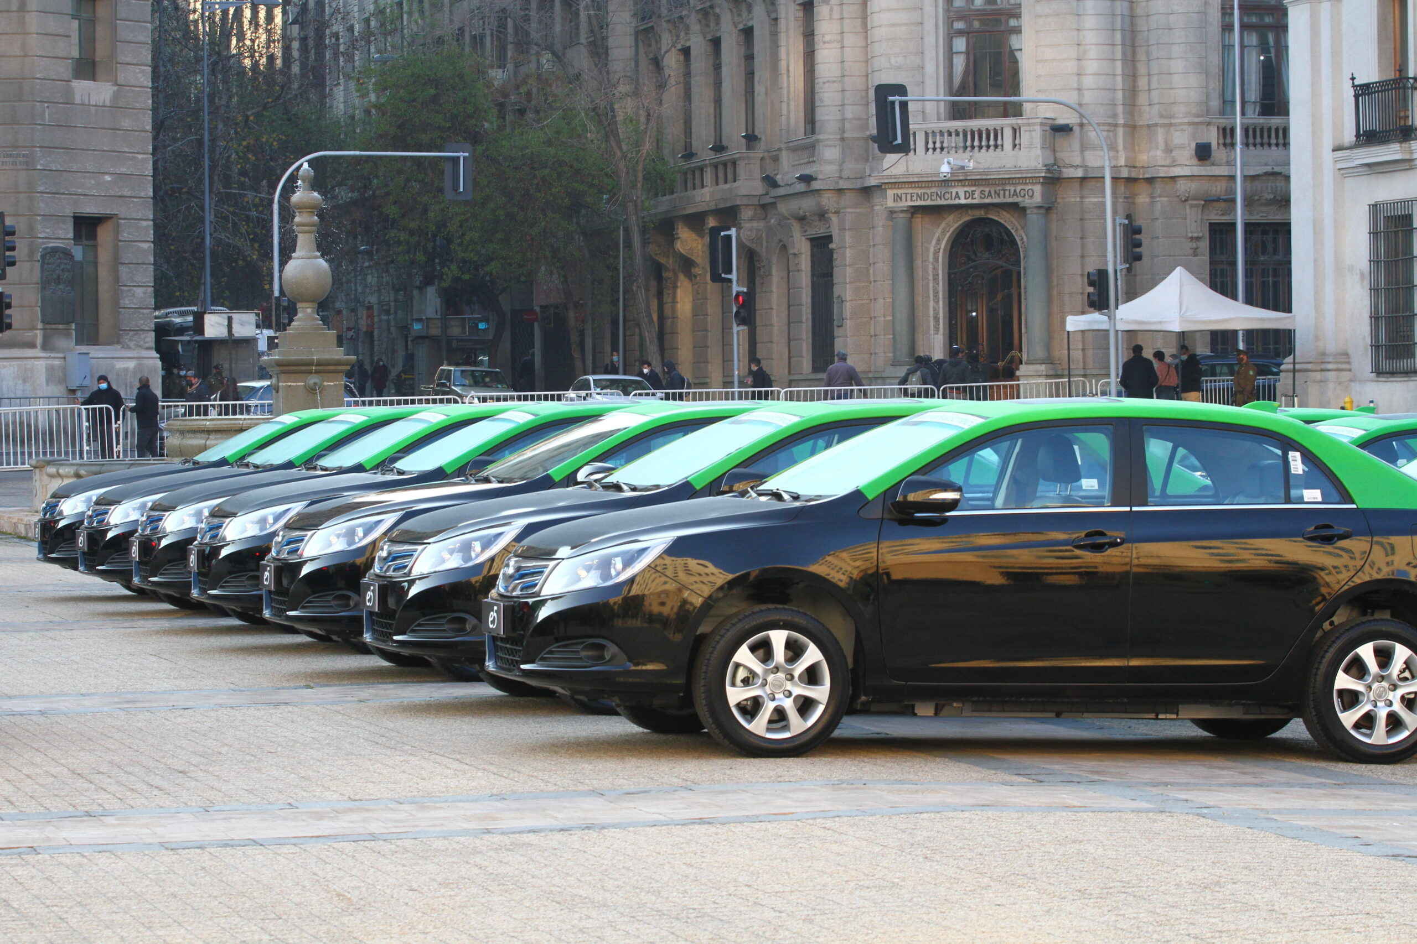
Mi Taxi Eléctrico Program
Energy Evaluation Asia Pacific
The goal is to trigger the replacement of 50 internal combustión engine (ICE) taxis with electric vehicles (Evs) in the city of Santiago.
The objective is to promote the adoption of e-mobility within the light duty public transportation sector, thereby reducing energy consumption and pollution from high-mileage fleets (>50,000 km/year ~ >30.000 mi/year).
The project involved an investment of $650.000 USD from the Ministry of Energy

Slide 4
Benefits of the Program
Energy Evaluation Asia Pacific
1
2
3
Purchase of the Vehicle
Charging Infrastructure
EV Monitoring
Single supplier with a special price for the purchase of 50 units.
Up to $8,600 USD in financing for the purchase (~25%).
Provision of a charger free of charge to the beneficiary.
All registration and energization procedures included.
Real-time data collection from the EV.
Monthly reports on the fleet and each EV performance.

Slide 5
First Experience – Monitoring Pilot
Energy Evaluation Asia Pacific
Before monitoring the EVs of the program, we started with a pilot. We monitored 6 models for 4 months to understand the tecnology.
We looked for startups that had an early-stage work in EV monitoring and experienced companies. We chose a national startup due the flexibility and adaptability of the service.
This experience generated the initial knowledge about EV monitoring within the team. It allowed us to work with flexible timelines and objectives, on partner companies’ EVs.
Notes:
De aquí nacieron los primeros aprendizajes,
- sensores
- tasa de muestreo
- especificaciones de comunicación CAN

Slide 6
Monitoring the Program’s EVs
Energy Evaluation Asia Pacific
We asked for a solution that wouldn't interfere with the vehicle, aiming to preserve the warranty.
The job was done by Movia, a chilean startup focused on data intelligence, who worked in all the tasks of the service.
The know-how of the startup enabled them to decode the CAN specifications and generate specific KPIs for the service required.
Notes:
Esto se realiza por eurística, haciendo pruebas. Se miran los datos y se contrasta con lo que se lee en el tablero.

Slide 7
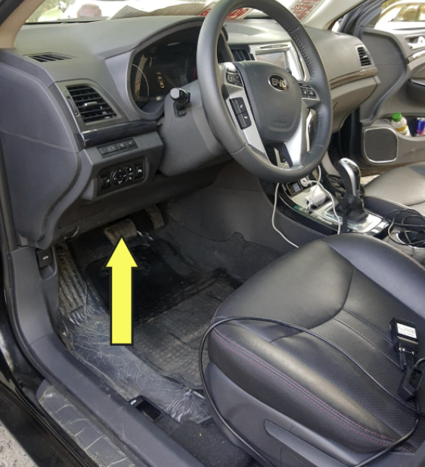
Monitoring the Program’s EVs
Energy Evaluation Asia Pacific
Data was collected from the CANbus system of the vehicle by contactless devices.
The main indicators we could collect from the CANbus were:
Speed
State of Charge
Odometer
Voltaje
Current
Power
Notes:
Con esto s epueden generar los demás datos

Slide 8
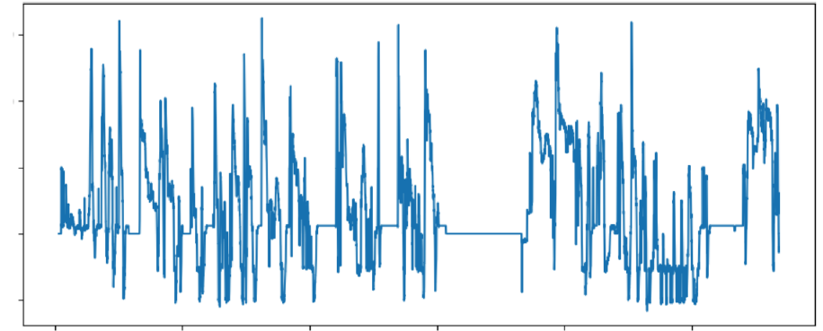
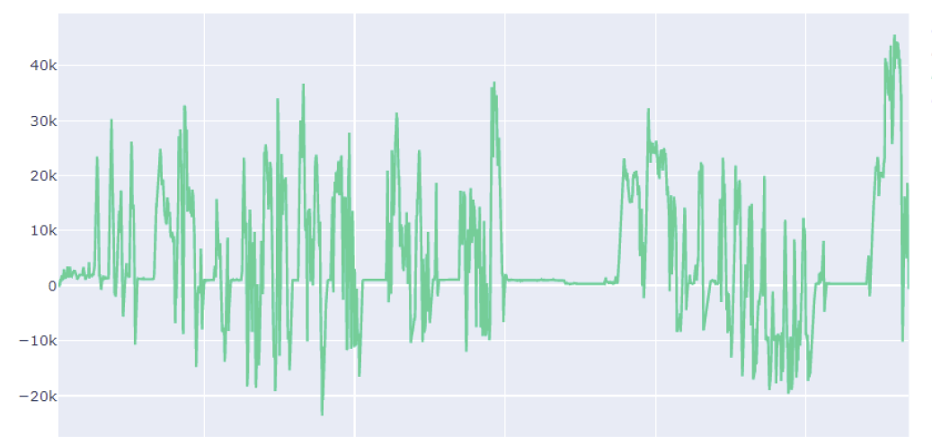
Lessons Learned - Decoding
Energy Evaluation Asia Pacific
Example of Current in the EV
The CANbus network produces data every 100 ms. That means 180.000 data points each second (50 EV, 6 variables per vehicle).
Due the amount of data points, the signal behaves as a continuos, but the data collection is discrete.
Because of that, there is a loss of information depending on the moment of the measurement, which can result in discrepancies of up to 20%.
Example of Power in the EV
Notes:
Ejemplo energía cargada+regenerada y energía consumida.
Integral de la potencia es la energía. Ejemplo de los 2 puntos no mide nada.
Se pierden peaks

Slide 9
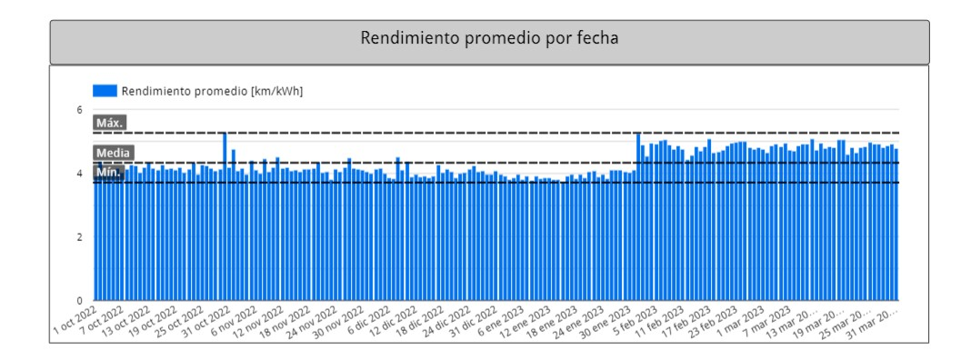
Lessons Learned – Data Analysis
Energy Evaluation Asia Pacific
The calculation methodology was proposed by the startup, providing daily data for each vehicle.
While it streamlines daily tasks, it doesn't allow for the analysis of data in shorter intervals and makes it harder to adjust assumptions (e.g. oil price)
Depending on the measurement precision, the obtained values can vary. An example of this is the difference between values obtained by the startup and those obtained with the OEM's measurements.
Average performance by date
Notes:
we couldn’t analyze daily routines of the drivers

Slide 10
Key Measurements - Energy
Energy Evaluation Asia Pacific
314
107
446
MWh charged
MWh regenerated
MWh consumed
Notes:
De aquí nacieron los primeros aprendizajes,
- sensores
- tasa de muestreo
- especificaciones de comunicación CAN

Slide 11
Key Measurements - Emissions
Energy Evaluation Asia Pacific
123.500
300
Liters of Gas
Ton CO2
Saved
Saved
Notes:
De aquí nacieron los primeros aprendizajes,
- sensores
- tasa de muestreo
- especificaciones de comunicación CAN

Slide 12
Summary
Energy Evaluation Asia Pacific
Monitoring EVs funded with tax payer money is key in mesuring the succes of a public policy.
One of the most important steps was the monitoring pilot. That experience gave us the technical knowledge that allowed us to execute the service effectively with our beneficiaries’ cars.
Working with local startups gave us the freedom to adjust the service to our requirements and allowed us to get involved in more technical aspects.
Maintaining consistency in the measurement methodology is crucial for consistent results. Ideally, collaborating with the OEM from the begining is strongly recommended.
Notes:
De aquí nacieron los primeros aprendizajes,
- sensores
- tasa de muestreo
- especificaciones de comunicación CAN

Slide 13
Lessons Learned in the Monitoring of EV
Energy Evaluation Asia Pacific
Date: 12/10/2023
Javier Rojas
jrojas@agenciaSE.org

