Slide 1
Perform, Achieve & Trade (PAT) Program
Evaluation of Industrial Energy Efficiency Program of India
Energy Evaluation Asia Pacific (EEAP)
August 30, 2023
Soumya Garnaik
Specialist & COP Lead (GBI & Energy Efficiency)
Global Green Growth Institute (GGGI)

Slide 2
Energy Efficiency in India - Transition
1970-2001
2001 - 2008
2008 …….
Pre EC Act Era
Post EC Act Era
Post NMEEE Era
Voluntary Initiatives by Industry
Enactment of EC Act (2002)
NAPCC (June 2008)
Voluntary Professional Involvement (NPC,TERI & PCRA)
Establishment of BEE (March 2002)
NMEEE (Aug 2009)
Launch of EE Programs (2006)
Amendment of EC Act (2010)
Launch of Programs (2011...)
Not much impact on energy intensity
Savings not reported
Impact on energy intensity felt after 2007
Savings reported
Higher impact on energy intensity
National Targets
NAPCC : National Action Plan on Climate Change
NMEEE : National Mission on Enhanced Energy Efficiency
TERI: The Energy Research Institute
EC Act : Energy Conservation Act
EE: Energy Efficiency
PCRA : Petroleum Conservation and Research Association
BEE: Bureau of Energy Efficiency
NPC: National Productivity Council

Slide 3
01
Non-fossil energy capacity to reach 500 GW by 2030
India’s Commitments in COP26
02
Meet 50% its energy requirements with renewable energy by 2030
03
Reduce carbon emissions by one billion tons from now to 2030.
04
Reduce the carbon intensity by 45% by 2030, over 2005 levels.
05
Achieve Net-Zero Emission by 2070

Slide 4
Evaluation of Perform, Achieve & Trade (PAT) Program of India

Slide 5
Regulatory Framework
Energy Conservation Act, 2001
Perform, Achieve & Trade
  A market based regulatory instrument to reduce specific energy consumption in industries, to enhance the cost effectiveness through tradable energy saving certificates
  Section 14 (g): Establish norms
  Section 14 (n): Direction to Industries
  Section 14A: Energy Saving Certificates
  Section 26: Penalty & Enforcement
  Section 27: Adjudication
Norms for Energy Intensive Industries
Standards & Labeling of Appliances
Energy Conservation Building Code
Expectation
Unlock energy efficiency market opportunity of over $ 5000 mn
Establish energy management systems in industries
Skill development and creation of employment opportunities
Create a conducive environment for competitiveness in industrial business
Lessons learned may help other countries design and implement market-based approaches to augment emission reduction programs.
Demand Side Management
Certification of Energy Professionals

Slide 6
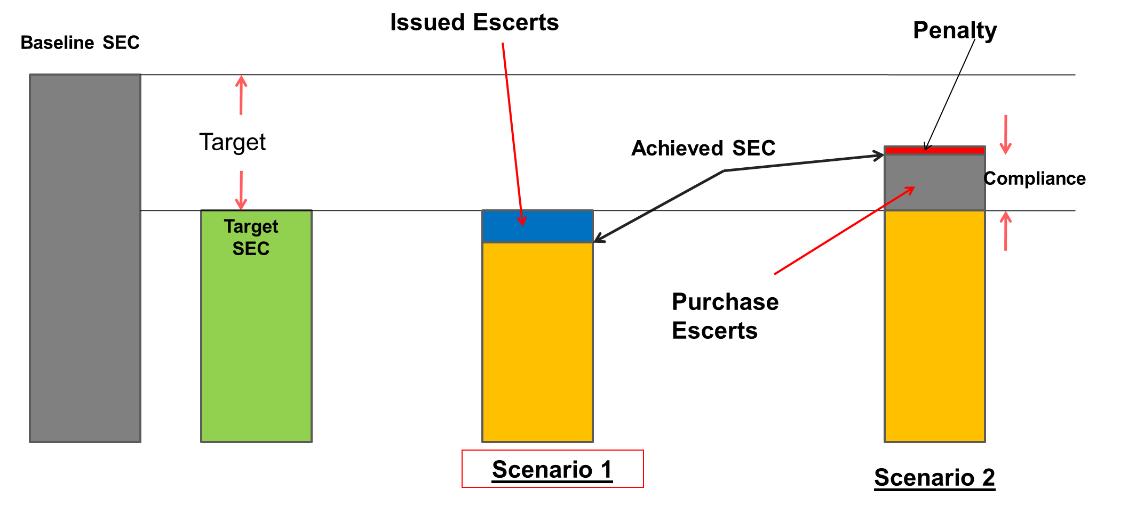

Evolution of PAT Program
Regulatory Provision
Consultation
Process
Target & Compliance Mechanism
Over 100 consultation Workshops with all stakeholders
Technical Committee
Independent Verifiers
Constitution of Sectoral Technical Committees u/s 8 of EC Act
Over 50 agencies empanelled for M&V
Plant Boundary
Electricity (KWH)
Baseline SEC
PROCESS
SEC
FO (Ltr)
Product (Kg)
Reduction in SEC
NG (SCM)
E
Coal (KG)
P
Target SEC
Others (KG or Ltr)
Expressed in %
SEC = E / P
Y1
Y2
Y3

Slide 7
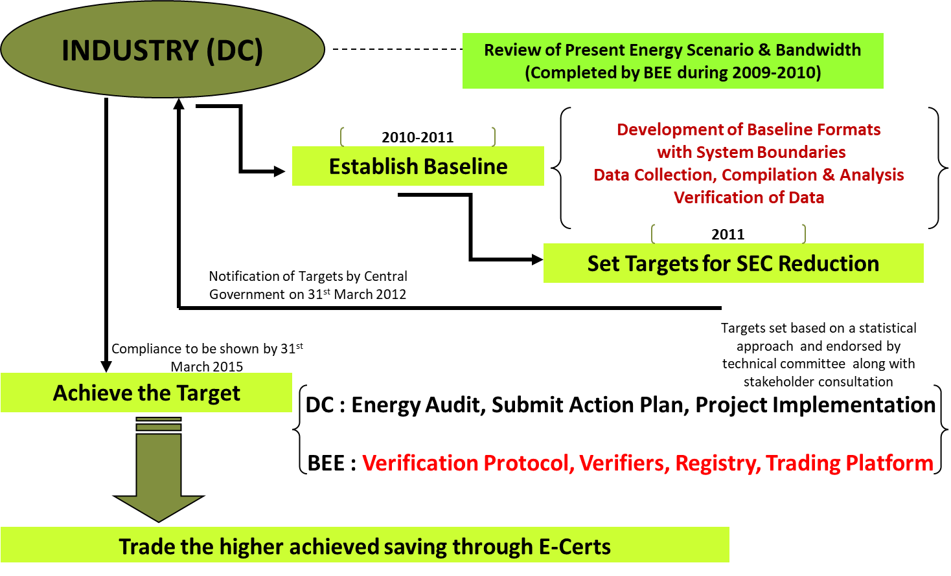
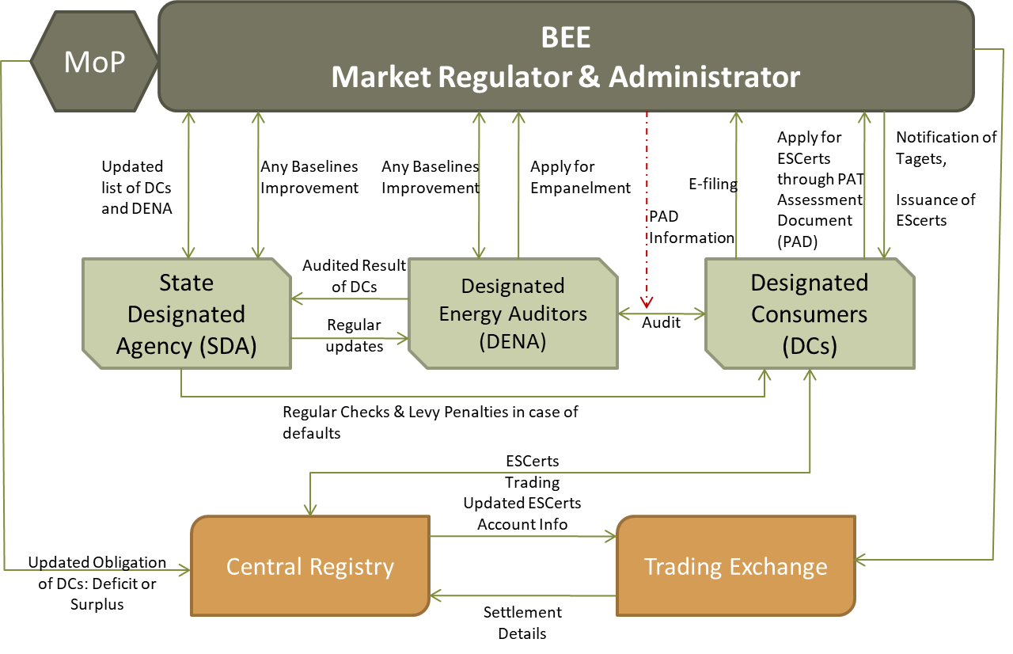
Program Framework & Institutional Structure

Slide 8
PAT : Sectoral Coverage
All numbers in mtoe
PAT-1 Cycle (2012-2015)
  Listed in Schedule of EC Act
  Intensity or quantity of energy consumed
  Amount of investment needed
  Capacity to invest
  Availability of energy efficient technology
Consumption = 165 mtoe @ 2010 base year
Saving Target = 6.68 mtoe
  Aluminum;
  Fertilizers;
  Iron and Steels;
  Cement;
  Pulp and Paper;
  Chlor-Alkali;
  Sugar;
  Textile;
  Chemicals;
  Railways;
  Port Trust
  Transport Sector (Industries and Services)
  Petrochemical, Gas Crackers, Naphtha Crackers and Petroleum Refinery
  Thermal Power Stations, Hydel Power Stations, Electricity transmission companies and distribution companies;
  Commercial Buildings or Establishment
1333 DCs
10
144
67
29
85
31
22
90
PAT-1 Cycle (2012-2015)

Slide 9
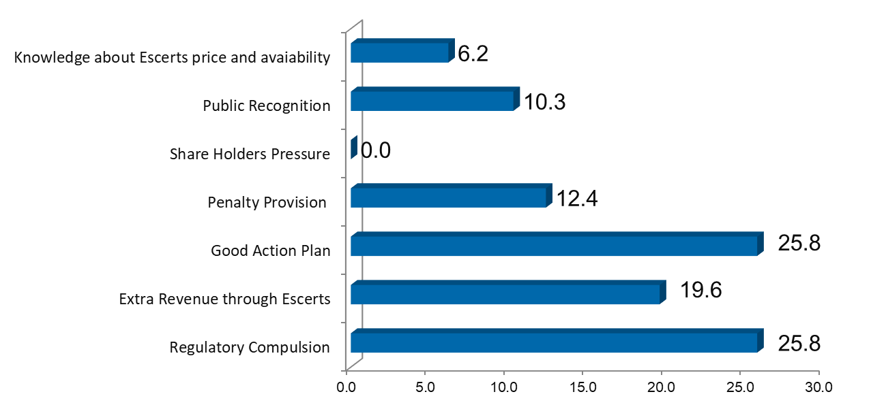
Achievements in PAT Scheme (After 1st Cycle)
Sector | No. of DCs | Targeted Energy Saving (mtoe) | No. of DCs reported to the compliance |  | Achieved Energy Saving (mtoe)
TPP | 144 | 3.211 | 123 |  | 3.06
Aluminum | 10 | 0.456 | 10 |  | 0.73
Iron & Steel | 67 | 1.486 | 60 |  | 2.10
Cement | 85 | 0.815 | 75 |  | 1.44
Fertilizer | 29 | 0.478 | 29 |  | 0.83
Pulp & Paper | 31 | 0.119 | 26 |  | 0.26
Textile | 90 | 0.066 | 82 |  | 0.12
Chlor-Alkali | 22 | 0.054 | 22 |  | 0.13
Total | 478 | 6.686 | 427 |  | 8.67
Driving Factors for DCs for PAT Compliance
Figures in (%)
Although 67% DCs feel that the target is stringent for 3-year compliance period, 74% DCs have exceeded the target.
About 30 % more achievement than the National Target

Slide 10





Achievements from PAT-I (2012-2015)
.
Energy Saving
8.67 million tonnes of oil eq. (MTOE)
~1.25% of India's total primary energy consumption
31 million tonnes of CO2
1.93% of India’s emissions
Emission Reduction
5000+ Engineers and operators
14000+ Energy Auditors & Managers
200+ Accreditations
Skill Development
Savings
Rs 9,500 Crores (~ $1.40 Billion) from saved energy consumption
Rs 26,517Crore (~ $4.07 Billion) Invested
Encouraged investments for energy efficient technologies etc. primarily domestically manufactured
Investment

Slide 11
Achievements from PAT-II (2016-2019)
.
Energy Saving
14.08 million tonnes of oil eq. (MTOE)
~1.57% of India's total primary energy consumption
68.43 million tonnes of CO2
2.4% of India’s emissions
Emission Reduction
12000+ Engineers and operators
17500+ Energy Auditors & Managers
285+ Accreditations
Skill Development
Savings
Rs 42,020 Crores (~ $6.0 Billion) from saved energy consumption
Rs 30,000 Crore (~ $4.3 Billion) Invested
Encouraged investments for energy efficient technologies etc. primarily domestically manufactured
Investment

Slide 12



Escerts Trading Mechanism and Status
Bureau of Energy Efficiency PATNET
Main Data Depository
Reports
Transaction confirmation report by 17:30
ESCerts Traded in PAT Cycle I & II
Sr. No. | PAT Cycles | Trading Sessions | ESCerts Traded | Business in INR Crores
1. | PAT Cycle -1 | 17 | 1.3 million | 100
2. | PAT Cycle -2* | 22 | 1.4 million | 250
 | TOTAL | 39 | 2.7 million | 350
Sell Bid ( 13:00- 15:00)
Confirmation & Shortages, if any (by 16:00)
Registry
Power Exchange
DC Buyer
Transaction Approval by 17:30
DC Seller
Sell and Buy Bids for Verification by 15:30
Buy Bid ( 13:00- 15:00)
Market Clearance(Volume & Price) by 17:00
Transaction confirmation report by 17:30
A/C Update of concerned eligible entity which DCs can see through PATNet
Sell and Buy Bids for Verification by 15:30

Slide 13
Some Observations after PAT-1 Cycle (Sample Survey)

Slide 14
Some Observations after PAT-1 Cycle (Sample Survey)

Slide 15
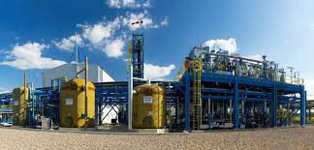

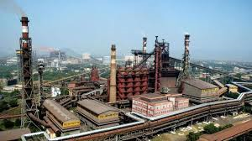
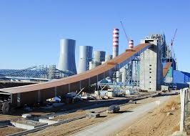

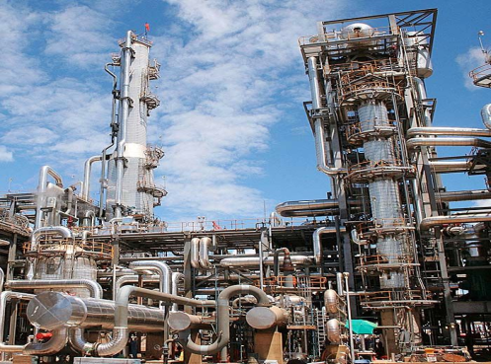
Success & Concerns
Change in management outlook towards EE
Proactive Investments in EE
Technology Intervention
Data Monitoring & Accounting
Engagement of Certified Energy Auditors/Managers
Scheme Administration and Facilitation
Data Quality
Methodology (Complexity)
Verifiers ( Quantity & Quality ), M&V
Prediction of Escerts Quantity & Price

Slide 16


Thank You
Soumya.garnaik@gggi.org
Soumya Garnaik
@Soumya_Garnaik

