Slide 1




Evaluation of Renewable Energy Policies in India
- A Journey through India's Renewable Energy Policy
August 2023

Slide 2

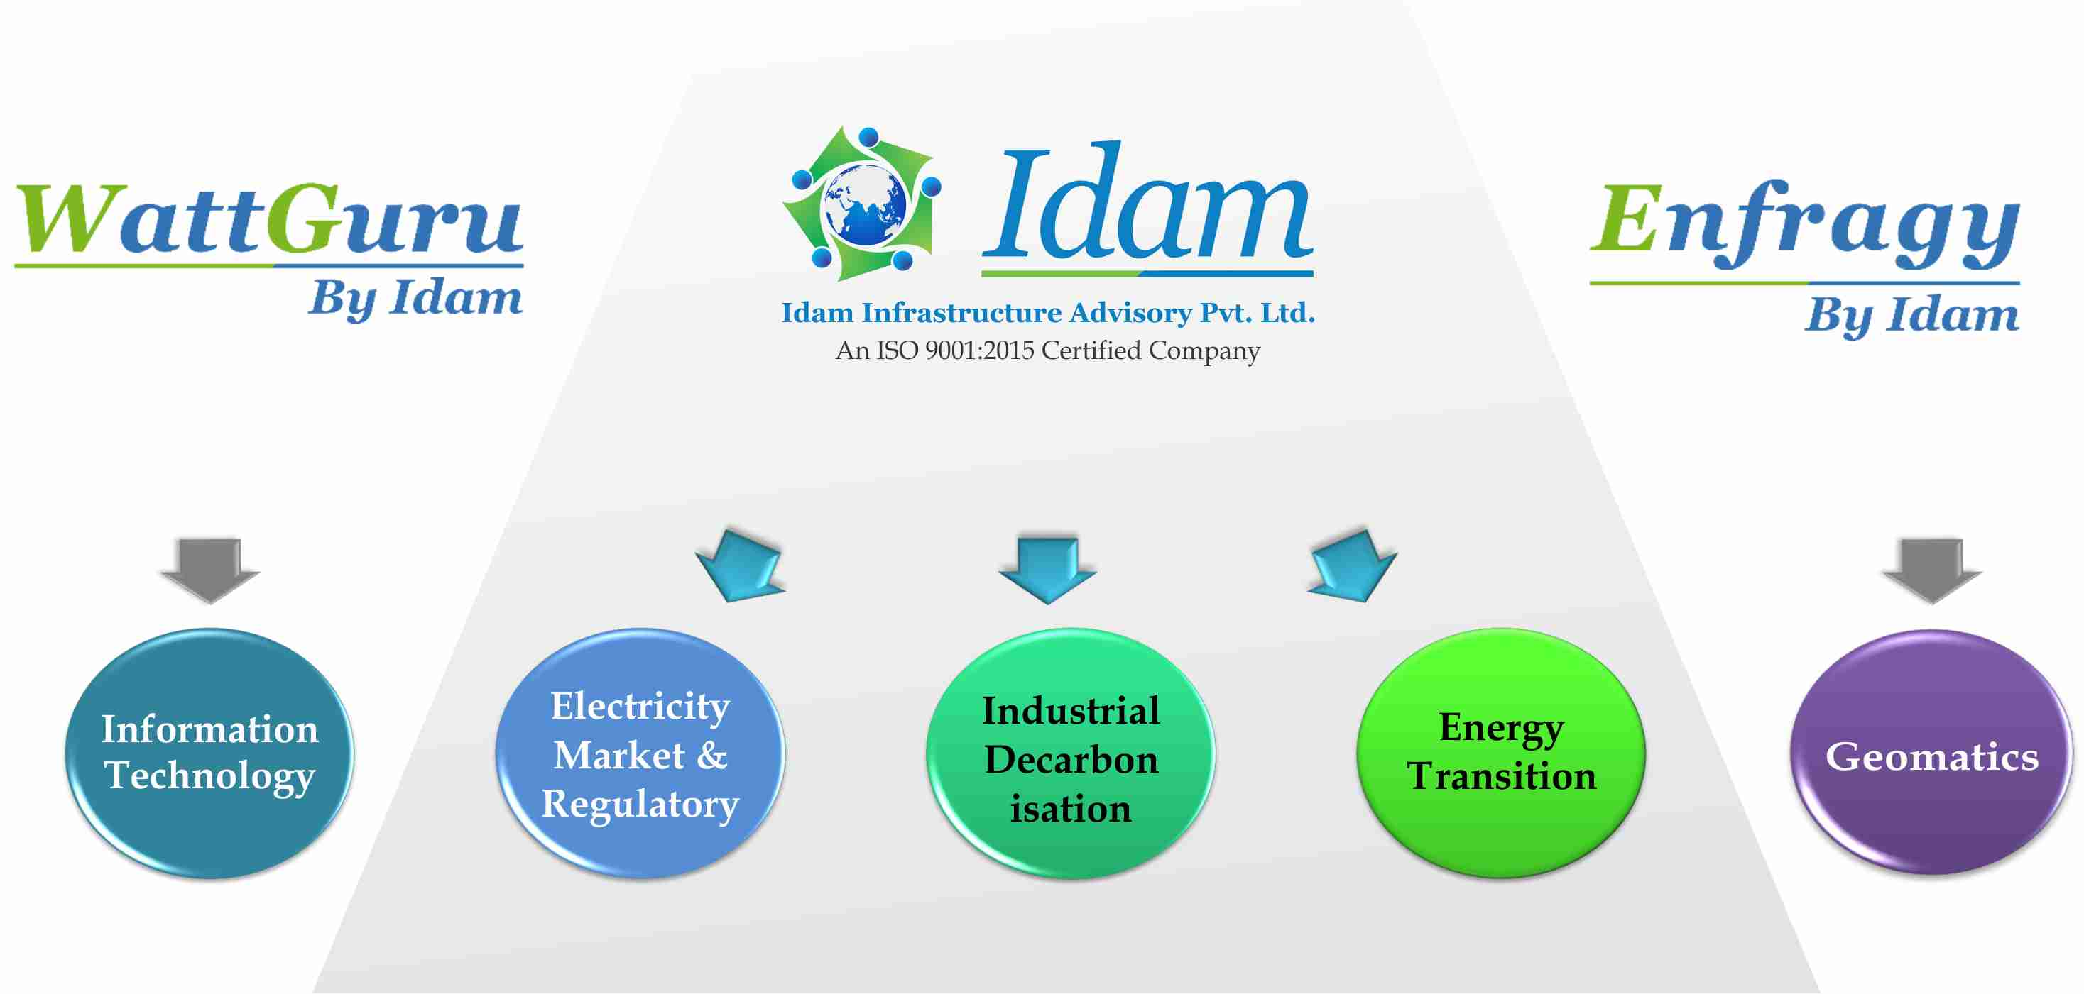
इदम् - ‘This’ ‘This Earth at This Time’
Space
Earth
Air
Water
Fire
The word 'Idam' in Sanskrit means 'This' and is used as a pronoun to refer earth and/or time as 'This Earth' or 'This Time‘. We interpret it as ‘This Earth at This Time’ or ‘Firmly Grounded’. Of course, that does not mean we are immobile, but it means that we are "Realistic". We believe this represents our corporate ethos. Our logo has Earth at the center, surrounded by five basic elements or panchmahabhutas according to Hindu Literature, i.e., air, fire, water, earth and space. The fins represent continuous churning around the earth ensuring that the earth is always stable.

Slide 3


















































Key Clientele
Government Sector
Funding Agency
Public Sector
Private Sector

Slide 4
Renewable Energy in India
Installation Capacity
177 GW Renewable Energy capacity has been installed as on 31.07.2023
As per REN21 Renewables 2022 Global Status Report, India stands 4th globally in RE Installed Capacity.
The installed RE capacity (including large hydro) has increased from 76.37 GW in March 2014 to 177 GW in July 2023. i.e., an increase of 2.31 times.
Total Solar Power Capacity has increased from 2.63 GW in March 2014 to 71.14 GW in July 2023, i.e., an increase of 27.04 times.
The installed Renewable energy capacity (including large hydro) has increased by around 128 % since 2014.
Need for RE integration
To reduce the dependency of fossil-based energy as a climate change mitigating strategy, energy security, energy access, & more.
India's growing energy demand, commitment to sustainable development, and the potential for renewable energy to address various challenges.
Table 1- Installed Capacity (as on 31.7.2023)
Sector | Installed Capacity (GW)
Solar Power | 71.14
Wind Power | 44
Bio Energy | 10.81
Small Hydro | 4.98
Large Hydro | 46.85
Total | 177.78
Source: CEA Installed Capacity Report

Slide 5
Long History of Renewable Energy Sector in India
Formation of Department of Non-Conventional Energy Sources (DNES) on 6th September 1982
Formation of Ministry of Non-Conventional Energy Sources (MNES), 1992
Parliament enacted The Electricity Act 2003
MNES was renamed as Ministry of New and Renewable Energy (MNRE), 2006
Formation of Commission for Additional Source of energy, 1981
The objective of this department was to make policy and Structure to support R&D in renewable sector.
The objective of this department was to provide funding for strengthening research, development and demonstration in the area of RE Technologies
The first country to have Ministry devoted to development of Renewable Energy
S (3) – National Electricity Policy & plan
S 61(h) – Feed In Tariff
S (66) – Development of Market
S 86(1)(e) - Renewable Purchase Obligation,
Connectivity to the grid
Promotion of cogeneration and RE
The objective of the Ministry is to develop and deploy new and renewable energy to supplement the energy requirements of the country.

Slide 6
Early Initiatives for growth in RE sector
National electricity policy, 2006
Amendment to tariff policy 2011
SERCs shall fix separate RPO for purchase of energy by the Obligated Entities from Solar Energy Source
Tariff policy, 2006
It specify that, "share of electricity from renewable sources would need to be increased progressively, purchase for distribution companies will rely on competitive bidding basis. Commission needs to determine an appropriate differential tariff to promote these technologies, as they will take sometime to compete with conventional sources on basis prices”
Appropriate Commission (State Electricity Regulatory Commission) shall fix Renewable Purchase Obligation (RPO)
Fix the technology specific tariff for different renewable sources of energy.
Solar RPO to go up to 0.25% by the end of 2012–13 further up to 3% by 2022
Purchase of energy from non-conventional sources of energy to take place more or less in same proportion across different States
Renewable Energy Certificate (REC) Mechanism was included to enhance RE capacity.
Amendment to tariff policy 2018
MoP in consultation with MNRE announced the long-term trajectory for RPO.
On 25th May 2018, the MNRE created an RPO compliance cell to monitor RPO targets.
Table 1: Amended Tariff Policy, RPO trajectory
Year | Solar Energy | Non-Solar Energy | Total
2016-17 | 2.75% | 8.75% | 11.50%
2017-18 | 4.75% | 9.50% | 14.25%
2018-19 | 6.75% | 10.25% | 17.00%
2019-20 | 7.25% | 10.25% | 17.50%
2020-21 | 8.75% | 10.25% | 19.00%
2021-22 | 10.50% | 10.50% | 21.00%
Notes:
These RPO targets are mentioned in tariff policy 2018 amendment and the latest RPO targets are mentioned in later slide of policy panorama (deployment).

Slide 7

Paris Agreement Commitment was real game changer for RE Sector
Keep Global warming well below 2C, put all efforts to keep it below 1.5º C
INDIA’s NDCs
To reduce the emissions intensity of its GDP by 33 to 35 percent by 2030 from 2005 level.
To achieve about 40 percent cumulative electric power installed capacity from non-fossil fuel based energy resources by 2030 ….
Developed countries to provide financial and technical support
Each member country to submit NDCs and strive to achieve it
India and France jointly launch International solar alliance
Alliance of 121 solar resource rich countries.
Provide a dedicated platform for cooperation among solar resource rich countries
Reach global peaking of GHG emissions asap and undertake rapid reductions thereafter
PARIS AGREEMENT
Global review every 5 years to assess the collective progress
India running one of the largest renewable energy expansion mission – 175 GW by 2022

Slide 8
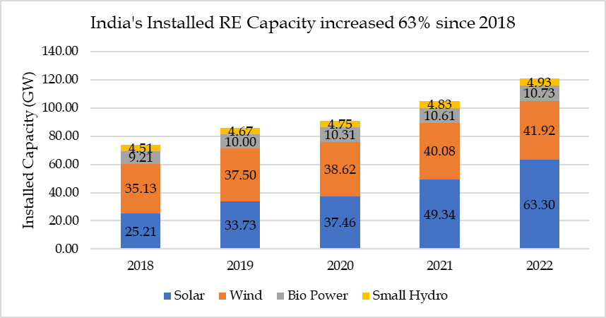
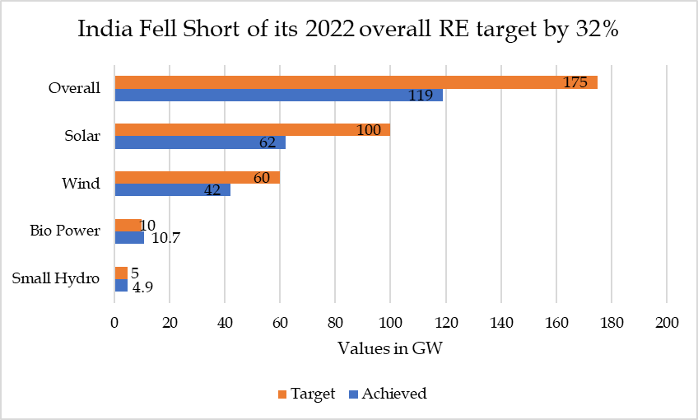
175 GW RE target - Achievements and hurdles
Source: CEA Installed Capacity Report, 2018-22
As of March 2022, total installed RE capacity reached 119 GW (excluding large hydro), 68% of the 175 GW target.
Bio power and small hydro met targets.
54 GW out of 60 GW is achieved from solar utility projects
Lack of progress in rooftop solar deployments (7.4 GW out of 40 GW)
Wind capacity additions in the last six months was less than 1 GW

Slide 9
Analysis of 175 GW Capacity addition target (2/2)
State by State Progress
As per the December 2022 targets given to each states, following were the achievement of the states in percentage:
Less than 50%
More than 50%
Slightly less than 100%
100%
Maharashtra (48%)
Uttar Pradesh (32%)
Madhya Pradesh (46%)
Andhra Pradesh (50%)
Punjab (35%)
Haryana (28%)
Uttarakhand (52%)
Sikkim (66%)
Gujarat (97%)
Tamil Nadu (75%)
Telangana (248%)
Rajasthan (119%) and
Karnataka (107%)
Andaman and Nicobar (129%)
Shortfall in capacity addition target
Maharashtra- 11 GW
Uttar Pradesh- 10 GW
Andhra Pradesh- 9 GW
Madhya Pradesh- 7 GW
13 states and UTs with near-zero new RE capacity deployment in the last 6 months of the target

Slide 10
Status of RPO compliance in FY 2022-23
Sl. No. | State |  | RPO Compliance
 |  | WPO | HPO | Other RPO | Total RPO
1 | Chandigarh | 0.0% | 0.0% | 76.2% | 76.2%
2 | Delhi | 0.0% | 0.6% | 23.8% | 24.4%
3 | Haryana | 0.0% | 0.9% | 20.8% | 21.7%
4 | Himachal Pradesh | 0.0% | 2.7% | 76.0% | 78.7%
5 | Jammu Kashmir & Ladakh UT | 0.0% | 0.0% | 56.9% | 56.9%
6 | Punjab | 0.2% | 0.0% | 27.3% | 27.6%
7 | Rajasthan | 0.0% | 0.0% | 18.3% | 18.3%
8 | Uttar Pradesh | 0.0% | 0.4% | 14.8% | 15.2%
9 | Uttarakhand | 0.0% | 3.0% | 57.4% | 60.4%
10 | Chhattisgarh | 0.1% | 1.2% | 11.9% | 13.3%
11 | Daman & Diu and Dadra & Nagar Haveli | 0.2% | 0.4% | 2.4% | 2.9%
12 | Goa | 0.8% | 0.4% | 16.1% | 17.3%
13 | Gujarat | 3.5% | 0.2% | 16.5% | 20.3%
14 | Madhya Pradesh | 0.1% | 0.0% | 22.3% | 22.4%
15 | Maharashtra | 0.0% | 0.0% | 17.1% | 17.1%
16 | Andhra Pradesh | 3.3% | 0.0% | 25.1% | 28.5%
17 | Karnataka | 6.4% | 0.0% | 40.3% | 46.7%
18 | Kerala | 0.0% | 0.0% | 36.3% | 36.3%
Sl. No. | State |  | RPO Compliance
 |  | WPO | HPO | Other RPO | Total RPO
19 | Lakshadweep | 0.0% | 0.0% | 0.2% | 0.2%
20 | Puducherry | 0.0% | 0.0% | 6.6% | 6.6%
21 | Tamil Nadu | 5.8% | 0.0% | 19.7% | 25.5%
22 | Telangana | 0.0% | 0.0% | 20.2% | 20.2%
23 | Andaman & Nicobar | 0.0% | 0.0% | 10.9% | 10.9%
24 | Bihar | 0.1% | 0.1% | 15.9% | 16.0%
25 | DVC | 0.0% | 0.0% | 10.6% | 10.6%
26 | Jharkhand | 0.0% | 0.0% | 30.0% | 30.0%
27 | Odisha | 0.1% | 0.1% | 25.3% | 25.4%
28 | Sikkim | 0.0% | 3.7% | 84.7% | 88.4%
29 | West Bengal | 0.1% | 0.0% | 15.9% | 15.9%
30 | Arunachal Pradesh | 0.0% | 3.5% | 15.3% | 18.8%
31 | Assam | 0.0% | 2.7% | 20.4% | 23.2%
32 | Manipur | 0.0% | 0.2% | 33.8% | 34.0%
33 | Meghalaya | 0.0% | 3.2% | 56.7% | 59.9%
34 | Mizoram | 0.3% | 0.4% | 42.1% | 42.7%
35 | Nagaland | 0.0% | 5.2% | 31.3% | 36.5%
36 | Tripura | 0.0% | 0.1% | 13.5% | 13.6%
WPO | HPO | Other RPO | Total RPO
0.81% | 0.35% | 23.44% | 24.61%

Slide 11
Primary reasons for shortfall in RE capacity addition
Wide variation in achievement of different states. During Oct 2021 and March 2023 -
  Rajasthan installed 4827 MW RE capacity (all solar)
  Gujarat installed 1845 MW of RE capacity
  All other states combinedly installed 2530 MW of RE capacity
  13 states and UTs with near-zero new RE capacity deployment
Ambition of the state matters and not necessarily RE potential.
Each major sector had its own challenges –
  Utility scale solar – COVID resulted in significant delays in project implementation
  Rooftop solar – Wide gamut of policies and Discom resistance
  Wind – Reverse auction didn’t yield desired result
Issues with respect to land acquisition for RE projects as well as transmission infrastructure
Aggressive bidding by several developers results in unviable prices – Winner’s curse
Policy flip flop on BCD/CVD on imported panels resulted in increase in prices

Slide 12
Analysis of 175GW by 2022 Policy
Wide variation in state achievement
Reflection of RPO achievement
State targets at variance from national
Variations in State Regulations
Issue is stark in case of rooftop solar
Need standard set of regulations across all states
Unintended consequences of incentives
Tx charge waiver resulted in lopsided development
Resource rich states started imposing constraints on land and infra
Unsuitable Procurement mechanism
Reverse auction mechanism didn’t work in case of wind power procurement, resulted in unviable bids

Slide 13
Ambition raised to 500 GW of non-fossil capacity by 2030
500 GW RE installed capacity by 2030
50% of energy requirement from non-fossil fuel sources by 2030
CO2 emissions reduction of 1 Billion tonnes (from now) by 2030
Economy-wide CO2 intensity reduction by 45% (from 2005) by 2030
Net zero emissions by 2070
Government declares plan to add 50 GW of renewable energy capacity annually for next 5 years to achieve the target of 500 GW by 2030
Announced at 26th session of conference of parties (CoP 26) in Glasgow

Slide 14
Policy Panorama - (1/4)
Deployment
Renewable Purchase Obligation (RPO)
Manufacturing
Production Linked Incentive (PLI) schemes,
Operational
Resource Adequacy
Renewable Generation Obligation
Tariff Based Competitive Bidding
Energy storage
Green Hydrogen etc.
Deviation settlement mechanism (DSM)
Capacity Targets
Green Energy Open Access
Forecasting and scheduling
Transmission Capacity Expansion

Slide 15
Policy Panorama – Deployment (2/4)
Tariff Based Competitive Bidding
Renewable Purchase Obligation (RPO)
DISCOM
OBLIGATED
ENTITIES
Open Access Consumer
AMENDMENT
Captive Power Producer
Under section 63 of Electricity Act 2023
AMENDMENT
REVISED
Under section 86(1) of Electricity Act 2003
Under Para 6.4(1) of Tariff Policy 2016
Table: RPO trajectory
OBJECTIVE
Year | Wind RPO | HPO | Other RPO | Total
2022-2023 | 0.81% | 0.35% | 23.44% | 24.61%
2023-2024 | 1.60% | 0.66% | 24.81% | 27.08%
2024-2025 | 2.46% | 1.08% | 26.37% | 29.91%
2025-2026 | 3.36% | 1.48% | 28.17% | 33.01%
2026-2027 | 4.29% | 1.80% | 29.86% | 35.95%
2027-2028 | 5.23% | 2.15% | 31.43% | 38.81%
2028-2029 | 6.16% | 2.51% | 32.69% | 41.36%
2029-2030 | 6.94% | 2.82% | 33.57% | 43.33%
To facilitate renewable capacity addition
Power at competitive price
Improves bankability.
OBJECTIVE
To facilitate renewable capacity addition
Diversification Energy mix
Ensuring in achieving RE targets of country
Ensuring reasonable returns.
Provides framework for inter/intra-state sale-purchase
PREVIOUSLY
NOW
Solar
As per latest Notification dated 22.07.2022 targets given till 2030
MNRE has given “Guidelines for Tariff Based Competitive Bidding Process for Procurement Power from Grid Connected Wind Power Projects” on 2nd August 2023
Non- Solar
Wind RPO
HPO
Other RPO
Source: Ministry of Power, GOI

Slide 16
Policy Panorama – Manufacturing (3/4)
PLI Scheme
3 baskets are allocated for bidding
Implemented in two tranches
Basket No. | Code | Description
1 | P+W+C+M | Stage-I: Manufacturing of Polysilicon +Stage-2: Manufacturing of Ingots-Wafers +Stage-3: Manufacturing of Solar Cells +Stage-4: Manufacturing of Modules or Fully integrated manufacturing of Thin Film plant or Fully integrated plant of any other technology
2 | W+C+M | Stage-2: Manufacturing of Ingots-Wafers +Stage-3: Manufacturing of Solar Cells +Stage-4: Manufacturing of Modules or similar level of integration of any other technology
3 | C+M | Stage-3: Manufacturing of Solar Cells +Stage-4: Manufacturing of Modules or similar level of integration of any other technology
Tranche I
Allocated Capacity: 8737 MW
Financial Outlay: ₹4,493 crore
Tranche II
Allocated Capacity: 39600 MW
Financial Outlay: ₹14,007 crore
15400 MW (P+W+C+M)
16800 MW (W+C+M)
7400 MW (C+M)
Indosol – 6000
Reliance – 6000
First Solar - 3400
Waree - 6000
Avaada - 3000
ReNew - 4800
JSW - 1000
Grew - 2000
Vikram - 2400
AMPIN - 1000
Tata Power Solar - 4000
PLI Scheme has proved to be a watershed event in India's Renewable landscape resulting in around 48 GW domestic module manufacturing capacity within next 3 years.
Facilitate manufacturing capacity of 40 GW solar modules by companies including Reliance Industries, Adani group, Tata group, and others.
Similar PLI Scheme is being implemented for BESS Manufacturing in India.˘

Slide 17
Policy Panorama – Operational (4/4)
Green Energy Open Access
Forecasting & Scheduling
Deviation Settlement Mechanism
Accelerate RE programs
Plan for improved grid discipline
Accountability by mandating Wind & Solar Forecasting & Scheduling
RE generators are not penalized due to over or under injection.
OA Transaction reduced from 1 MW to 100 kW for green energy
Small consumers to purchase RE power through OA.
DSM Regulations of many states
CERC procedure for F&S and Imbalance handling for RE Generating Stations including power parks at inter-state level.
The transaction limit
  Non-captive consumers : Minimum 100 KW
  No limit for captive consumers
To make RE power plants use better practices of forecasting
Deviation (%)= (Actual- Schedule)/AvC
Enables better integration of growing renewable capacity.
India added 1.2 GW of solar OA installations in 2021, which grew 22 % to 513 MW during January-March 2022.
Stepping stone towards achieving India's commitment to 500 GW of non-fossil fuel energy by 2030.
Empowering the realization of GoI goal for 2030.

Slide 18

What is further needed to ensure success of 500GW target?
Consistency of policies and regulations across states – Centralization of Rules
01
Improvement in Financial Health of Discoms
02
Further Policy Reforms
Quick and cheap development of diurnal and long duration storage
03
Compliance of RPO Mechanism by all Obligated Entities
04
05
Land reforms
06
Strong evolved power market including market for capacity credits
18

