Slide 1
Evaluation of Energy Efficiency Programs in India
Aditya Chunekar (aditya@prayaspune.org)
30th August, 2023
EEAP Webinar on Evaluation of Energy Programs in India

Slide 2

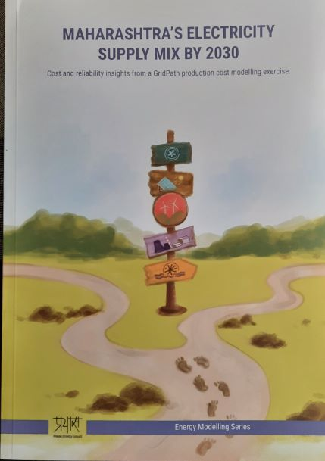
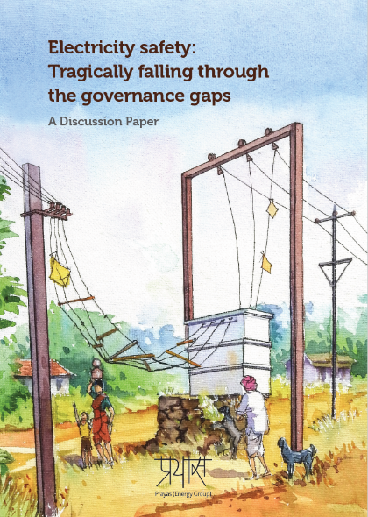
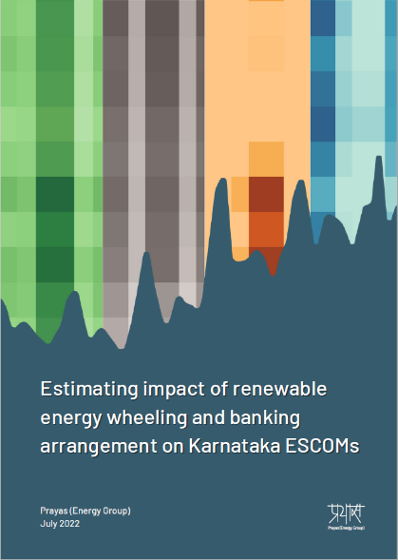

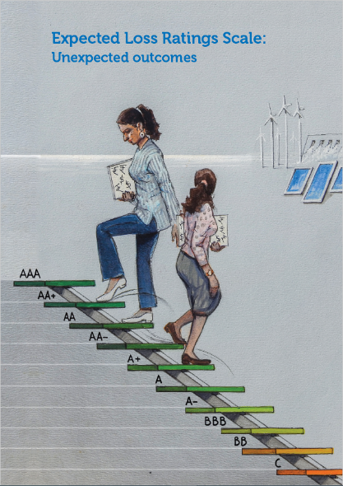

Prayas (Energy Group)
Electricity Supply and Distribution
Energy Data, Modelling, tools
Renewable energy and Storage
Energy (Policy, Planning & Governance)
Energy transition, Climate change
Energy demand, efficiency, access
Coal thermal generation
Analysis
Policy and Regulatory engagement
Capacity building
https://energy.prayaspune.org/

Slide 3
Energy Efficiency in India
Bureau of Energy Efficiency (BEE) is the nodal agency for Energy Efficiency and Conservation policies and regulations in India, established in 2002 under the Energy Conservation Act
Key responsibilities
  Notifies energy efficiency standards for appliance, equipment and processes at national level
  Identifies designated consumers and sets energy efficiency targets
  Create a cadre of Energy Auditors and Managers
  Conduct any other activities to promote energy efficiency and conservation
Standards & Labeling (S&L) and Perform, Achieve, and Trade (PAT) are two flagship programs. Account for 91% of total savings achieved by BEE

Slide 4
Energy Efficiency in India
Energy Efficiency Services Ltd.
  Large, public sector Energy Service Company (ESCO)
  Specializes in bulk procurement (LED bulbs, Smart meters, Electric Buses)
State Designated Agencies (SDA)
  Responsible for implementation of EC Act at state level
  Focus on monitoring and verification
State Electricity Regulatory Commissions (SERCs)
  SDAs are required to file reports of violation of EC Act to SERC
  SERC’s adjudicating officer conducts inquiry and decides penalties
  Direct Electricity Distribution companies to undertake Demand Side Management (DSM) programs
Electricity Distribution Companies

Slide 5
Evaluation of BEE policies/programs in India
EC Act does not mention evaluation. Focus on monitoring and verification
BEE publishes an annual report titled “Impact of Energy Efficiency Measures”
About 44 Mtoe savings in 2021-22, about 6% of total primary energy supply (about 740 Mtoe)
About 73% from PAT and 18% from S&L*
Savings from S&L are based on production data for appliance/ equipment and assumptions for baseline & usage
Limited focus on process evaluation and market effects
* Excludes savings from UJALA program run by EESL

Slide 6
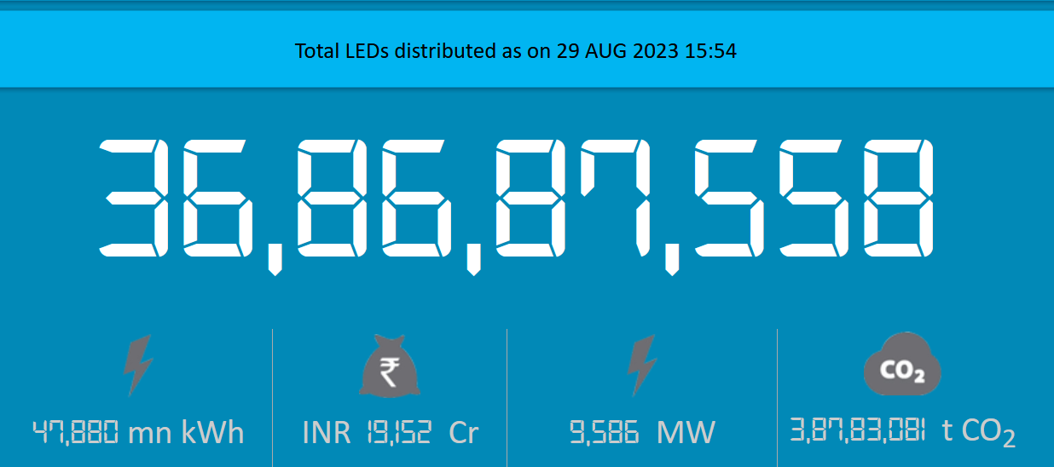
Evaluation of EESL Programs
UJALA – Program for LED bulbs
About 386 million LED bulbs have been sold under the program
  Substantial price drop due to bulk procurement (Rs 310 to Rs 38)
  Bulbs sold through temporary kiosks bypassing the retail supply chain
  Use of deemed savings approach with no link to payment
  Most bulbs bought with upfront payment, few through on-bill financing, and some through carbon credit

Slide 7
Evaluation of EESL programs
Study to assess impacts of UJALA program (link)
Combination of desk and field research
Field research included:
  Surveys of 1029 households in Pune, Lucknow, and Puducherry
  Surveys of 150 retailers selling LED bulbs in the above cities
  Interviews with manufacturers and lighting industry experts
  Interviews with representatives from EESL, the public sector implementation agency
  Interviews with representatives from 9 electricity distribution companies (DISCOMs).

Slide 8
Evaluation of UJALA (example of process improvement)
Some bulbs failed but very few got replaced

Slide 9
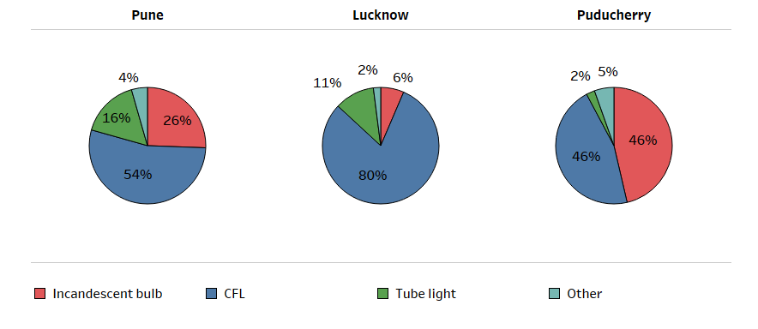
Evaluation of UJALA (example of process improvement)
What did LED bulbs replace?

Slide 10
Evaluation of Utility DSM programs
Most State Electricity Regulatory Commissions (SERC) have issued Demand Side Management (DSM) regulations
Many pilots but no large-scale adoption
Very few SERC approved running Utility DSM programs
Model regulations by Forum of Regulators (FoR) required SERCs to issue guidelines for Evaluation, Measurement, and Verification (EM&V)
Distribution Companies are also required to conduct EM&V
Limited progress

Slide 11
Way Forward
More program data in public domain
Residential Energy Consumption Survey
Evaluation to be part of policy/program design
SERCs to issue regulations on evaluation for Utility DSM programs

Slide 12
Thank you! aditya@prayaspune.org

