Slide 1
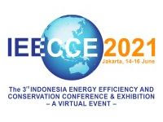
EEAP Webinar
Energy Evaluation in Asia Pacific: Latest Updates
Hosted by
The 3rd Indonesia Energy Efficiency and Conservation Conference & Exhibition (IEECCE)
Energy Evaluation Country Context
- Sri Lanka -
Thusitha Sugathapala
Senior Lecturer, University of Moratuwa, Sri Lanka
16th June 2021

Slide 2
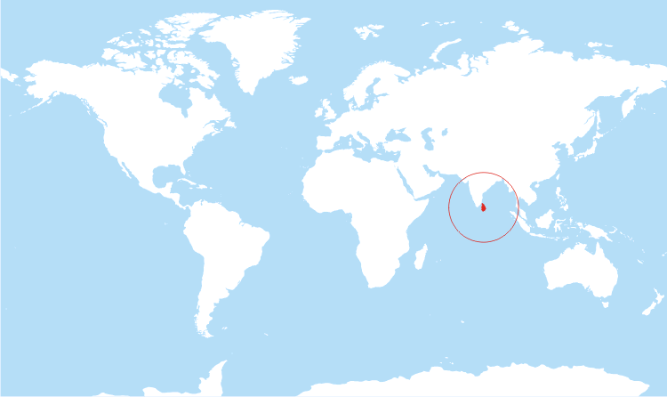
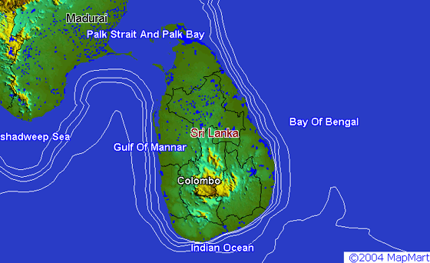
  ENERGY SECTOR OF SRI LANKA
  At a Glance:
      Source Diversity (Both REs and Fossils)
        Biomass – Heat (Domestic, Commercial, Industry)
        Hydro & other REs (Solar, Wind, Biomass – Electricity)
        Coal – Electricity & Oil – Electricity, Heat, Transport
      100% Access to grid electricity
      Governance – Strong national government driven.
        Sri Lanka Sustainable Energy Authority - SLSEA (for RE, EE, KM)
        Public Utility Commission of Sri Lanka - PUCSL (Independent regulator)
      National Plans & Future directions
        Economic viability (as a driver for development)
        Energy Security;
        Environment Sustainability.
        National Policy Framework:
        Vistas of Prosperity and Splendour;
        National Energy Policy & Strategy

Slide 3
  ENERGY SECTOR OF SRI LANKA
  Key Drivers and Targets:
      The 2030 Agenda
        Localization of SDGs and targets
        Indicator framework
        Public Service Delivery Strategies to mainstream SDGs.
      The Paris Agreement
        Enhanced NDCs - main input from electricity sector (25% mitigation target)
        National MRV framework.
      Overall Policy Targets
        70% RE for grid electricity and 20% reduction from DSM (by 2030)
        Electric mobility.
SDGs
Thus a high priority is given by the government for the energy sector in sustainable development and in meeting the climate change mitigation

Slide 4
  ENERGY EVALUATION
  National Level Energy Evaluations and Disseminations:
      Information management (SLSEA):
        Sri Lanka Energy Balance: Analysis of Energy Sector Performance
      Electricity sector planning (Ceylon Electricity Board)
        Long-term generation expansion plan: Technical, Financial & Environmental
      Sector regulation (PUCSL)
        Economic, technical & safety of the industry, with stakeholder engagement.
  Transparency & Accountability:
      Linking to National targets/Global commitments
        Localized SDGs, targets and indicators
        Enhanced NDCs – MRV & ETF.
      National Evaluation Framework
        National Evaluation Policy (NEP) of Sri Lanka.
Thus the Energy Evaluation becomes central in realizing the Policy effectiveness and Sectoral evolution

Slide 5
  ENERGY EVALUATION
  Gaps and Challenges:
      Limited interagency coordination and stakeholder mobilization
      Lack of comprehensive methodology & framework for evaluation.
  Way Forward:
      Need comprehensive and integrated strategy for energy evaluation and communication:
        Mandate the provisions in MRV & ETF of the Paris Agreement and NDCs
        Effectuating the guiding principles of 2030 Agenda and SDGs
        Operationalize the provisions in the NEP
        Facilitated by capacity building on methods & tools.
Thank You

