Slide 1
3rd INDONESIA Energy Efficiency & Conservation Conference EEAP WEBINAR 2021 ENERGY EVAL UATION in ASIA PACIFIC: LATEST UPDATES | 14-16 June 2021
What update do we have?
Your current government's viewpoints on the role of energy in sustainable development and in meeting the climate change mitigation,
(2) The importance of properly and transparently evaluating the government energy policy and development programs for public accountability,
(3) How the proper evaluation procedures are to be conducted by independent parties, and
(4) How the outcome of the evaluation is communicated to the stakeholders.
Romeo Santos
Professor, University of the Philippines
Board Member, APEA
Workland M&E Institute
Executive Director:
E-mail: rombsantos3@gmail.com

Slide 2
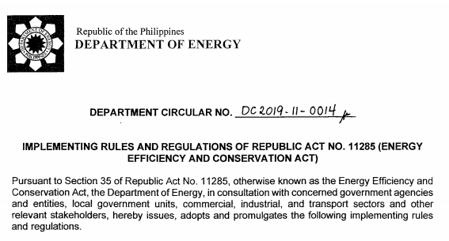
IMPLEMENTING RULES AND REGULATIONS OF REPUBLIC ACT NO. 11285 [2019] (ENERGY EFFICIENCY AND CONSERVATION ACT)
Currently, Philippine government’s attention is on the pandemic, Evaluation takes a back seat _what with the -4.2 GDP shrink at present [-9.1 in 2020], priority is obvious.
The Rep. Act s11285 shown here does not in anyway talk about M&E, only tidbits about assessment, audit , focusing on energy efficiency _corporate profit
But some development for M&E in the legislative front is being seen. Two [2] bills on RBME in the Senate filed, with one progressing toward legislation.

Slide 3
Since the 2nd APEA Conference in 2019, 2 Senate Bills -filed _establishment of a national evaluation policy in the Philippines.
1ST: Senate Bill No. 788: “An Act Establishing a National Evaluation Policy” (Senate of Philippines, 2019b).
Bill filed in JULY 2020 months after the APEA conference- Author: Senator Rissa Hontiveros, Member -minority bloc, the Upper House --- Keynote Speaker of the APEA event in the Senate.
2ND:MOST recent _Senate Bill No. 1885: “An Act Establishing A Result-Based National Evaluation Policy (RBNEP)” (Senate of Philippines, 2020b). Author: Senator Imee Marcos, Member-majority bloc in the Upper House.
First reading and approval of the Upper House in October 2020.
NOW _BILL referred to _Senate Committee Secretary: NEDA -for the refinement and further review. UNIQUE that the bills have bi-partisan support; no argument, debate in the PLENARY; APPROVED at once by Senate Committee; hoping that last legs will be the same.

Slide 4
STATE of Evaluation
Philippines | Developed -circulated the National Evaluation Policy in 2015. PDP 2017-2022 ensured integration of SDGs into national plan. 156 Indicators adopted. [103 –Global, 28- Supplementary, 25-Proxy] Current:
existing body of evidence of what works in Energy sector remains limited
majority of studies so far focused on rural electrification, improved cook stoves, and shift to LED lighting, while most investments are in power generation and transmission.
difficult to evaluate using randomized technique
- grid electricity infrastructure is networked & interdependent
Raitzer, Bondal & Sibal. 2019. Impact Evaluation of Energy Interventions, ADB

