Slide 1
Energy Evaluation in Indonesia
Rislima Sitompul
EEAP Ambassador/
Research Centre for Policy and Management of
Science, Technology and Innovation,
Indonesian Institute of Sciences (LIPI)
Jakarta, Indonesia
3rd Indonesia Energy Efficiency and Conservation Conference & Exhibition (IEECCE)
Jakarta 14-17 June 2021

Slide 2
Government's viewpoints on the role of energy in sustainable development and in meeting the climate change mitigation
Final energy use: target of achieving 23% renewable energy by 2025 and 31% by 2050, achieved only 11.2% in 2020
The total potential for renewable energy is around 400 GW, but of the total potential, only 2.5 percent or 10 gigawatts have been utilized
Electricity: Target of achieving 23% renewable energy power plant primary fuel-mix by 2025, only meet 13.7% in 2020
Jenis Pembangkit ET | Kapasitas Terpasang 2019 | Potensi | % Capaian
Air | 5.558,52 | 75.091 | 7,40%
Mini dan Mikro Hidro | 417,50 | 19.385 | 2,15%
Angin | 154,31 | 60.647 | 0,25%
Bioenergi | 1.889,81 | 32.654 | 5,79%
Panas Bumi | 2.130,70 | 29.544 | 7,21%
Surya | 149,39 | 207.898 | 0,07%
Laut | 0 | 17.989 | 0,00%
Energy Policy Targets of Indonesia
Committed to reduce its GHG emissions by 29% against the “business-as-usual” (BAU) scenario, and up to 41% with international support by 2030 as stated in Indonesia Nationally Determined Contribution (INDC).
need evaluation how far the achievement of the target is and how the action should be performed both in policy and implementation level to achieve the target
Indonesia (thorugh PLN) is currently developing a Long Term Strategy towards Carbon Neutrality and Net Zero emissions (NZE) in 2060 or earlier

Slide 3
What is being done BY The GOVERNMENT to promote and support ENERGY evaluation
MEMR (Ministry of Energy and Mineral Resources)
produce a number of rules and regulation related to energy, and conduct review and evaluation as necessary
conduct assessment (evaluation) for energy policy and programs both that are being and have been implemented
invite participation of third party (NGO or private sectors) to conduct evaluation/ assessment if necessary
fulfil assignment form the House of Representatives Commission VII, eg, request MEMR to review regulations that have received complaints or negative responses from public or investors.
Other Ministries, e.g: Coordinating Ministry for Economic Affairs, Ministry of Industry
Perform surveys, studies and assessment on energy regulation
conduct assessment (evaluation) for policies and programs
Ministry of Industry: issue regulation for the use of local component (TKDN), which is an indicator that represent the size of the domestic component of goods, services and the combination of goods and services in the energy sector, expressed as a percentage

Slide 4
2. The importance of properly and transparently evaluating the government energy policy and development programs for public accountability
Evaluation is an objective process of understanding on how a policy or program was planned and implemented, what effects it had, for whom and why, which leads to more effective policies and program (IEA, 2018).
The success of an intervention in development is not only measured by the scale of the investment but also by its continuing impact that can improve the quality of human life.
A large amount of funding has been invested in policies, programs and development projects with the aim of socio-economic improvement, including in the areas of renewable energy and energy efficiency. However, many of the results and products of development activities do not meet expectations.
Inputs, activities and outputs are elements of the intervention and not measures of success. The success of an intervention is measured by outcomes and impacts.
Good planning and design, effective implementation and post-activity completion affect the success of the intervention, for that it is necessary to study and identify which interventions are working well and which are not. Conducting an evaluation will ensure accountability for outcomes and lessons learned from the success and failure of the intervention (concept note EEI, 2021).
The absence of independent evaluation by third parties that work independently with proper methodology are needed as most of the evaluation are implemented not by separate institution and they are done on ad hoc bases.

Slide 5
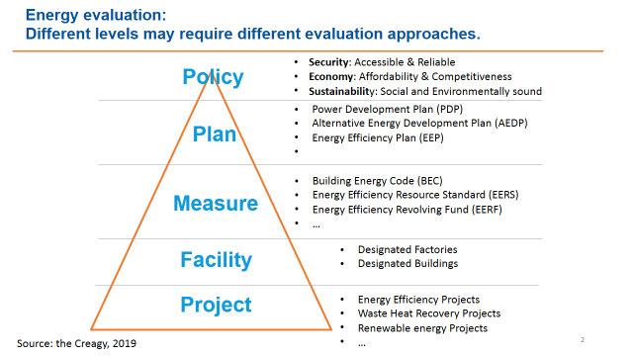
3. How the proper evaluation procedures are to be conducted by independent parties
Current Situation
The process and reasoning to perform evaluation are also not yet firmed, and mostly performed intuitively.
Non existence of specific methodology applied in evaluation both for energy policy and program in Indonesia.
The absence of evaluator professionals especially in energy related issues
What to propose
We need to have common methodologies that are valid and robust, and they should be done by independent parties to ensure the accountability and the compliance of the result.
We need appointed evaluator professionals
This also considers the fact that different levels of implementation may require different evaluation approaches.
Source: The Creagy, 2019

Slide 6
4. How the outcome of the evaluation is communicated to the stakeholders
Current Situation
Evaluation in Indonesia mostly conducted on ad-hoc bases, and the recommendation is delivered restricted to those who give assignment (project owner), both in government and private program. There are no disclosures on both the methodology and the results.
Non-existent of independent evaluation by third parties work independently with proper methodology and using valid data and information
To propose the Energy Evaluation Indonesia (EEI) that will be launched shortly aiming to promote the important role of Evaluation in Energy development, especially Renewable Energy and Energy Efficiency in Indonesia
What to propose
A proper and valid methodology and delivery mechanisms of the evaluation result are strongly needed to ensure the accountability of the evaluation as well as the compliance of the result.
Evaluator should be able to disclose their methodology use, and especially for the evaluation of the government policy and program, and the result should also be available at public domain. The result can be reported and disseminated through social media, workshop etc.

