Slide 1
Energy Efficiency for Developing Countries: Pivoting the Focus from Savings to Increased Outputs
Implications for Economic Evaluations
April 28, 2021
Philippe Benoit
Adjunct Senior Research Scholar
Columbia University, Center on Global Energy Policy
Managing Director –Global Infrastructure Advisory Services 2050
Joeri de Wit
Energy Economist
Energy Sector Management Assistance Program
World Bank

Slide 2
EE: generating savings and related benefits
Doing “more” with less
input (energy use)
Output
Energy savings
Time

Slide 3

More goods and services
input (energy use)
Output
Change focus from input savings to
more outputs from energy
Time

Slide 4
Projected change in energy demand in selected regions, 2014-2040
Mtoe
1 200
900
600
300
0
-300
European
Union
United
States
Japan
Latin
America
West
Asia
Southeast
Asia
Africa
China
India
Source: IEA - WEO 2014, 2015

Slide 5
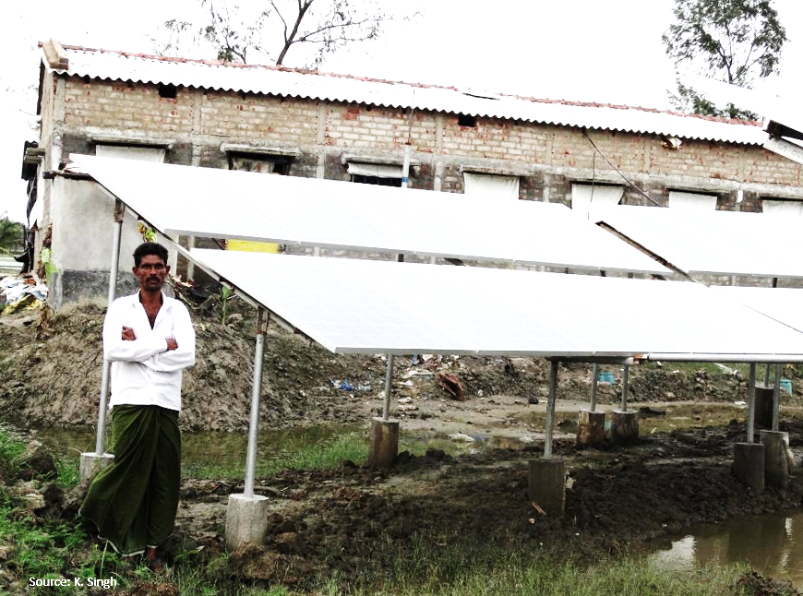
‘even more goods and services from more energy’
even more goods and services from more energy
Even more goods and services from more energy
More energy
input (energy use)
Output
Time

Slide 6
EE: A change in focus for deployment in developing countries
Doing “more” with less
… more goods and services
even more goods and services from more energy

Slide 7

Changing the EE Narrative to Include Outputs
Multiple constraints to the shift:
Dominance of OECD-oriented perspectives
Lack of energy evaluation methodologies for output-oriented EE projects
Incorporating non-economic benefits in energy project evaluations
Climate finance being driven by emissions reductions

Slide 8
Adapting the EE Project Typology to an Outputs Focus
Project category |  | Changes compared to status quo
 |  | (a) Level of goods or services provided (unit of output) | (b) Absolute final energy consumption (energy input) | (c) Specific energy consumption for goods or services provided (energy input/unit of output)
Demand side EE | 1) Brownfield EE project: Reduce energy consumption
 | 2) Brownfield EE project: Increase goods or services
 | 3) Greenfield EE project |  |  | Not defined
 | 4) Supply side EE project |  |  | Not defined
Rebound
w/Outputs

Slide 9
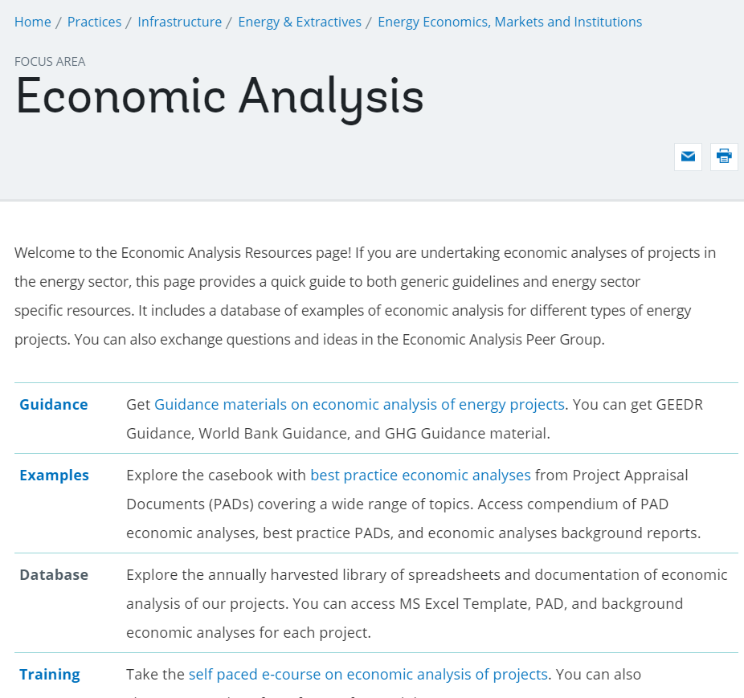
Guidance for economic analysis at the World Bank
General guidance
Projects evaluated based on (i) net present value, discounted at the social discount rate and (ii) economic internal rate of return
Energy sector guidance
2017, first comprehensive guidance for economic analysis of energy sector projects.
Energy efficiency guidance
Was focused on Category 1 (brownfield EE projects that reduce energy consumption) and 4 (T&D loss reduction) projects

Slide 10
Addendum to the existing guidance
  Broaden the framework of economic analysis of EE projects to include those that increase goods and services
  Dispels the idea that rebound always reduces benefits
  Provides guidance on the general steps to do the economic analysis
  Highlights the importance of the project counterfactual
  Alternative scenario: counterfactual yields same level of goods or services
  Status quo: counterfactual does not change level of goods or services

Slide 11
Increasing goods/services with an alternative project counterfactual
 | Category 2. Brownfield EE project: Increase goods or services | Category 3. Greenfield EE project
Project example | Buildings retrofit project that improves the EE and comfort levels (increase of indoor temperature to norm temperature, typically 20 to 22 celcius) of buildings. Measures could include upgrade of heating and ventilation systems, insulation, windows, etc. | Installation of efficient ACs in public buildings which have no cooling.
Establish a counterfactual that provides the same level of goods or services as the project | In the alternative scenario, the buildings are not retrofitted and the indoor temperature is increased to norm temperature without any retrofit | Consider a counterfactual scenario in which conventional ACs would be installed to provide the same level of cooling as the project.
Benefits from the reduction in energy consumption and associated GHG emissions of the project versus the alternative project scenario | The project investments deliver the norm temperature levels with less heating fuel than the counterfactual, resulting in energy savings and GHG emission reductions. | The project investments deliver the desired cooling levels more efficiently than the counterfactual, resulting in energy savings and GHG emission reductions
Notes:
Many of our EE projects are already following this sequence of steps but this was not formulated in current guidance.
Note however that typical framing of such projects is with outcome indicators that include energy saved and GHG emissions avoided. However, actual energy consumed and GHGs emissions produced increase to provide more goods and services.

Slide 12
Increasing goods/services with a status quo counterfactual
 | Category 2. Brownfield EE project: Increase goods or services | Category 3. Greenfield EE project
Project example | Water supply project that improves service levels (e.g., increase the number of water supply service connections, increase hours of supply, improve water quality). Measures could include upgrade or extension of transmission mains, treatment plants, etc. | New installation of efficient street lights in an unserved area.
Estimate the value of the incremental goods or services provided by the project | Avoided direct coping costs (e.g., construction of household water tanks, purchase of water from vendors), avoided indirect coping costs (e.g., reduced time and wage loss because households receive a private connection instead of relying on public taps), value of incremental water accessed due to increased hours of supply, etc. | Improved safety, reduced traffic accidents, benefits from stimulating local commerce, etc.
Estimate the value of the change in energy consumption and associated GHG emissions | The EE of water supply would be improved by, e.g., greater efficiency in pumping and a reduction of water losses, leading to a lower specific energy consumption (units of energy consumed per unit of water supplied). However, the improvement of service levels could require more energy. The net effect could be a reduction or an increase in absolute energy consumption. The change in GHG emissions would follow directly from the change in absolute energy consumption. | Increased energy consumption and associated GHG emissions from new street lighting installations.
Notes:
These two examples are real work bank projects. For the World Bank, what we highlighted internally, is that starting to really look at Energy projects that increases goods and services will requires cross-sector expertise to value these because that is where the real challenge often lies.

Slide 13
Addressing the rebound effect
A rebound may be reflective of greater consumption of goods and services
  An LED that is left on longer after replacing an incandescent bulb could provide additional lighting benefits
If the economic model is quantifying the value of project goods and services, it is able to quantify the rebound
Following the steps for category 2 and 3 type projects
If not, one can make assumptions about the minimum value associated with the direct rebound effect.
  The price of energy paid to produce a good or service may provide a minimum threshold for WTP of that good or service
Notes:
Rebound
Direct/substitution effect: An increase in the consumption of a good or service because its cost has gone down (due to a reduction in energy inputs)
Indirect/income effect: the lower cost of consumption of that good or service enables greater consumption of other goods or services

Slide 14

Case study: Efficient ACs for public buildings in Ghana
Purpose: Illustrate concepts – increased goods and services, greenfield, rebound
Case selection: Based on a draft investment proposal for Public Buildings EE in Ghana
Context
In an audit of ministerial buildings, ACs accounted for 70% of energy consumed with a typical Coefficient of Performance (CoP) of 2.5
Current energy performance standards require imported ACs have CoP no less than 2.8
Consider two investment alternatives
Brownfield (retrofit), replacing inefficient ACs (CoP 2.5) with efficient ones (CoP 3.8) rather than BAU (CoP 2.8)
Greenfield, directly installing efficient ACs (CoP 3.8) in a space that would otherwise remain un-airconditioned
Notes:
The COP is the ratio between amount of thermal energy that the AC transfers (ie the amount of cooling it provides relative to the amount of electricity it consumes.
If the greenfield analysis had considered as counterfactual the installation of BAU AC in the cooling space, the situation would be the same as retrofit, where there is no incremental benefit from cooling from energy savings, while counterfactual costs go up. How would this change the investment decision?
On the one hand, the greenfield would still be preferable since there the counterfactual requires capital expenditures to be made at the same time as in the project. In the Brownfield older ACs may not be near the end of their lifespan and the avoided capital expenditures may still exceed the value of any savings that can be achieved (discount rate matters !)
On the other hand, the WTP for cooling may be lower in the greenfield space. For example if we assume that ACs are installed first where they provide the greatest benefits per unit of cooling, and that the marginal utility for cooling declines as more an more buildings become cooled, then the greenfield may be a case where there is less demand for cooling and therefore less savings to be attained to opting for an efficient AC versus an inefficient one.

Slide 15
Case study key assumptions for economic analysis
Context
  Buildings identical, cooling output requirement of 245 kWh/m2/year →
  AC COP - 2.5 (Existing), 2.8 (BAU) and 3.8 (New)
  AC Lifespan - existing AC are due to be replaced, new and BAU ACs have a lifespan of 15 years
Costs and benefits
Capital costs - BAU and new ACs at 27 and 37 US$/m2 respectively
Fuel costs - marginal generation costs 5.5 USc/kWh for gas
Cooling benefits - measured in US$/kWh of cooling output
GHG emissions - valued at Social Cost of Carbon (SCC) starting at 40/80 US$/ton in 2020 in L/H scenarios at an annual rate of 2.2%
An AC with a CoP of 2.5, would require 245/2.5
= 97 kWh/m2/year

Slide 16
Summary of economic analysis
Summary of economic analysis | Units
 | Units | Brownfield | Greenfield
Social discount rate | [ ] | 6% | 6%
Project lifetime | [ ] | 15 | 15
Economic rate of return
EIRR excl. cost of carbon | [ ] | 26% | 13%
EIRR incl. low cost of carbon | [ ] | 37% | 1%
NPV for 1 m2
Costs
Incremental CAPEX new AC | [US$] | 34.8 | 34.8
Incremental fuel costs | [US$] | - | 61.5
Incremental GHG costs | [US$] | - | 19.7
Benefits
Avoided CAPEX of BAU AC | [US$] | 25.7 | -
Avoided fuel costs | [US$] | 22.0 | -
Incremental cooling benefits | [US$] | - | 109.1
Avoided GHG costs | [US$] | 7.1 | -
Net economic flows
NPV excl. cost of carbon | [US$] | 12.8 | 12.8
NPV incl. low cost of carbon | [US$] | 19.8 | (7.0)
Lifetime GHG emissions | [Tons CO2] | (0.2) | 0.6

Slide 17
Summary of economic analysis
Summary of economic analysis | Units
 | Units | Brownfield | Greenfield
Social discount rate | [ ] | 6% | 6%
Project lifetime | [ ] | 15 | 15
Economic rate of return
EIRR excl. cost of carbon | [ ] | 26% | 13%
EIRR incl. low cost of carbon | [ ] | 37% | 1%
NPV for 1 m2
Costs
Incremental CAPEX new AC | [US$] | 34.8 | 34.8
Incremental fuel costs | [US$] | - | 61.5
Incremental GHG costs | [US$] | - | 19.7
Benefits
Avoided CAPEX of BAU AC | [US$] | 25.7 | -
Avoided fuel costs | [US$] | 22.0 | -
Incremental cooling benefits | [US$] | - | 109.1
Avoided GHG costs | [US$] | 7.1 | -
Net economic flows
NPV excl. cost of carbon | [US$] | 12.8 | 12.8
NPV incl. low cost of carbon | [US$] | 19.8 | (7.0)
Lifetime GHG emissions | [Tons CO2] | (0.2) | 0.6

Slide 18
Summary of economic analysis
Summary of economic analysis | Units
 | Units | Brownfield | Greenfield
Social discount rate | [ ] | 6% | 6%
Project lifetime | [ ] | 15 | 15
Economic rate of return
EIRR excl. cost of carbon | [ ] | 26% | ?
EIRR incl. low cost of carbon | [ ] | 37% | ?
NPV for 1 m2
Costs
Incremental CAPEX new AC | [US$] | 34.8 | 34.8
Incremental fuel costs | [US$] | - | 61.5
Incremental GHG costs | [US$] | - | 19.7
Benefits
Avoided CAPEX of BAU AC | [US$] | 25.7 | -
Avoided fuel costs | [US$] | 22.0 | -
Incremental cooling benefits | [US$] | - | ?
Avoided GHG costs | [US$] | 7.1 | -
Net economic flows
NPV excl. cost of carbon | [US$] | 12.8 | 12.8
NPV incl. low cost of carbon | [US$] | 19.8 | ?
Lifetime GHG emissions | [Tons CO2] | (0.2) | 0.6
Which investment alternative is preferred when the WTP for cooling is unknown?
Switching value analysis can provide valuable information
Suppose the objective is to maximize NPV excluding GHG
What value of WTP for cooling output would equalize NPV between these options
?

Slide 19
Summary of economic analysis
Summary of economic analysis | Units
 | Units | Brownfield | Greenfield
Social discount rate | [ ] | 6% | 6%
Project lifetime | [ ] | 15 | 15
Economic rate of return
EIRR excl. cost of carbon | [ ] | 26% | 13%
EIRR incl. low cost of carbon | [ ] | 37% | 1%
NPV for 1 m2
Costs
Incremental CAPEX new AC | [US$] | 34.8 | 34.8
Incremental fuel costs | [US$] | - | 61.5
Incremental GHG costs | [US$] | - | 19.7
Benefits
Avoided CAPEX of BAU AC | [US$] | 25.7 | -
Avoided fuel costs | [US$] | 22.0 | -
Incremental cooling benefits | [US$] | - | 109.1
Avoided GHG costs | [US$] | 7.1 | -
Net economic flows
NPV excl. cost of carbon | [US$] | 12.8 | 12.8
NPV incl. low cost of carbon | [US$] | 19.8 | (7.0)
Lifetime GHG emissions | [Tons CO2] | (0.2) | 0.6
Which investment alternative is preferred when the WTP for cooling is unknown?
Switching value analysis can provide valuable information
Suppose the objective is to maximize NPV excluding GHG
What value of WTP for cooling output would equalize NPV between these options:
4.6 USc/kWh

Slide 20
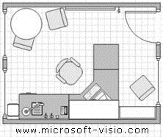

What does a WTP of 4.6 USc/kWh cooling output mean?
COOLING STANDARD
BENEFIT
COST
Office area
20m²
Cooling requirement
245 kWh/m²/year
Cooling output
4,908 kWh/year
Economic benefit
US$228/year
Based on WTP of 4.6 USc/kWh
Electricity generation
1291 kWh/year for
Fuel cost
~US$104/year
Capital investment
US$740
$

Slide 21
WTP for cooling based on observed consumption
In existing public buildings, a tariff of 22 USc/kWh and a AC CoP of 2.5 implies a WTP for cooling output of 8.8 USc/kWh
Note if a rebound were to be observed in the retrofit case it could reflect a WTP for cooling of at least 5.8 USc/kWH (22/3.8) that could also be valued
Need to consider how these values would change for specific circumstances under consideration, e.g.
The BAU AC in one building may be different than that in another building
WTP for cooling in some public buildings (e.g. hospital) may be higher than in others

Slide 22
Sensitivity analysis for critical parameters of uncertain value
Brownfield EIRR vs efficiency of BAU AC
Greenfield EIRR vs WTP for cooling
Alternative investment switching value
WTP = 4.6 USc/kWh
Implied WTP of keeping old AC running
WTP = 8.8 USc/kWh
Notes:
As always, where there exists uncertainty about key parameters that determine the net benefits of investment decisions, one does sensitivity analysis.
Including the costs of GHG, the switching value of WTP for cooling increases to 5.8 USc/kWh. However, both switching values are lower than the WTP that follows from the running of existing ACs at the going electric tariff of 22 USc/kWh. Namely, with a COP of 2.5, running the existing AC in the brownfield office building implies a WTP for cooling output of 8.8 USc/kWh. If this is interpreted as the minimum WTP for cooling, then the greenfield investment yields greater net economic benefits with or without GHG accounting
Even if the true value of these benefits are uncertain, efforts to calculate switching values could provide useful information, and if done consistently over time may allow for a better ranking of investment alternatives

Slide 23
Comparing investment decisions
WTP for cooling output, USc/kWh
Efficiency of BAU air conditioner, CoP
Notes:
Combining these parameters, this chart shows the NPV maximizing investment through the various colors. Within each color, a darker share represent higher NPV.
In spite of uncertainty about parameters, efforts to bring to light the sensitivity of the EIRR to these parameters and determine switching values to prefer one investment over another could provide useful information and if done consistently over time may allow for a better ranking of investment alternatives

Slide 24
Timing of investment decision
Brownfield EIRR vs lifespan existing AC
For a retrofit, a longer remaining lifespan of existing equipment lowers the project EIRR because it delays the capital investments in the counterfactual
With high discount rates in developing countries, the impact on the economic analysis is significant
In Ghana, the EIRR for the brownfield investment drops by more than half should existing ACs be able to keep running for two more years
Notes:
Have been assuming that existing AC were exactly at the end of their technical lifespan.
Slide
This is only to show that in developing economies where growth rates are high, there is also a penalty, if you will, against retrofits when existing infrastructure can continue to provide needed goods and services albeit less efficiently.

Slide 25
Conclusions
Guidance documents on the economic analysis of EE projects at MDBs and other international organizations focus almost exclusively on energy savings.
This is in part because (i) it is often difficult to quantify the value of goods/services and (ii) the EIRR based on energy savings are high enough anyway.
Where EE investments yield additional goods/services, benefits can often be estimated based on energy savings provided a realistic counterfactual that yields the same goods/services less efficiently.
However where project isn’t designed to provide the same level of goods/services, the additional value of these would need to be estimated with cross-sector expertise.
Identification and analysis of EE opportunities based on energy savings and GHG emissions alone can eliminate viable investment opportunities that efficiently produce more goods/services from consideration, especially in developing countries.
This work aimed to shift this narrative, by recognizing EE as means to increase production of goods/services, broadening guidance on the economic analysis of EE projects and reframing the discussion on the rebound effect.
Notes:
The simple average EIRR of the projects reviewed was 18%.
The case study illustrates that (i) a focus on EE savings and avoided GHG emissions could eliminate viable investment alternatives with non-quantified benefits from consideration; (ii) even if the true value of these benefits are uncertain, efforts to calculate switching values could provide useful information, and if done consistently over time may allow for a better ranking of investment alternatives; and (iii) assumptions about the counterfactual to an EE investment are very critical and need to be clearly established prior to the economic analysis.

